Slide 1

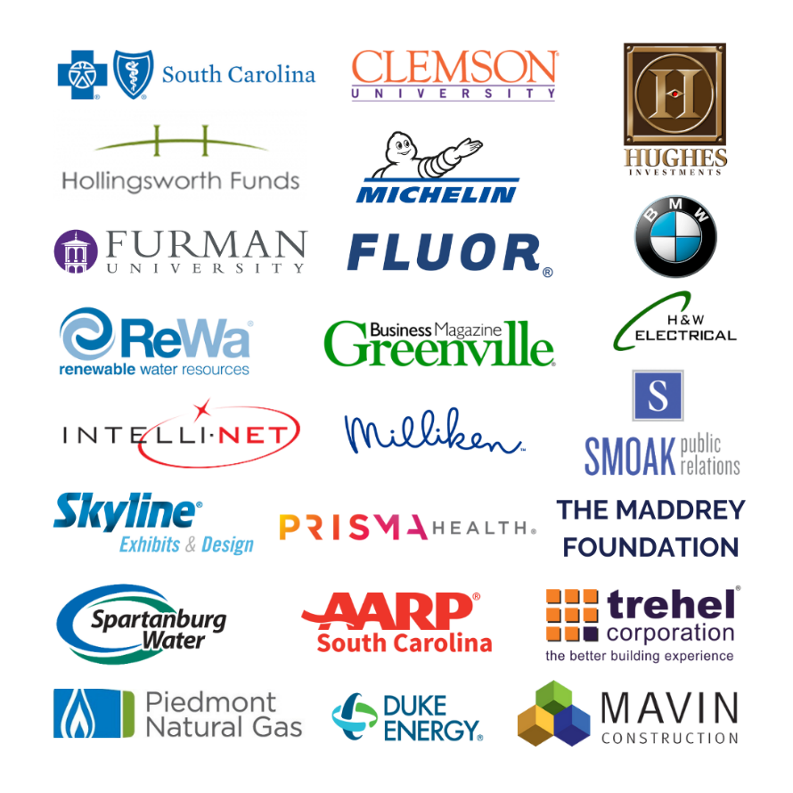
TATT CHAT – OCTOBER 7, 2021
Welcome
  Terence Roberts, TATT Chairman
DHEC Upstate Health Update
  Dr. Kandi Fredere,
  Upstate Public Health Director, SC DHEC
  Dr. Lisa Carlson,
  Upstate Medical Director, SC DHEC
TATT Initiative Update
  Dean Hybl,
  Executive Director, Ten at the Top
Resource Update
Megan Rogers,
Carolina Center for Behavioral Health
Carson Lecroy,
Hamilton Career and Technology Center
Adjourn
  Terence Roberts
LEADERSHIP LEVEL PARTNERS
NEXT TATT CHAT – OCTOBER 21, 2021

Slide 2
COVID-19 Response
10/8/2021
Lisa Carlson, MD, MPH
Kandi Fredere MHA,PhD,MCHES
Notes:
Intro - kandi

Slide 3
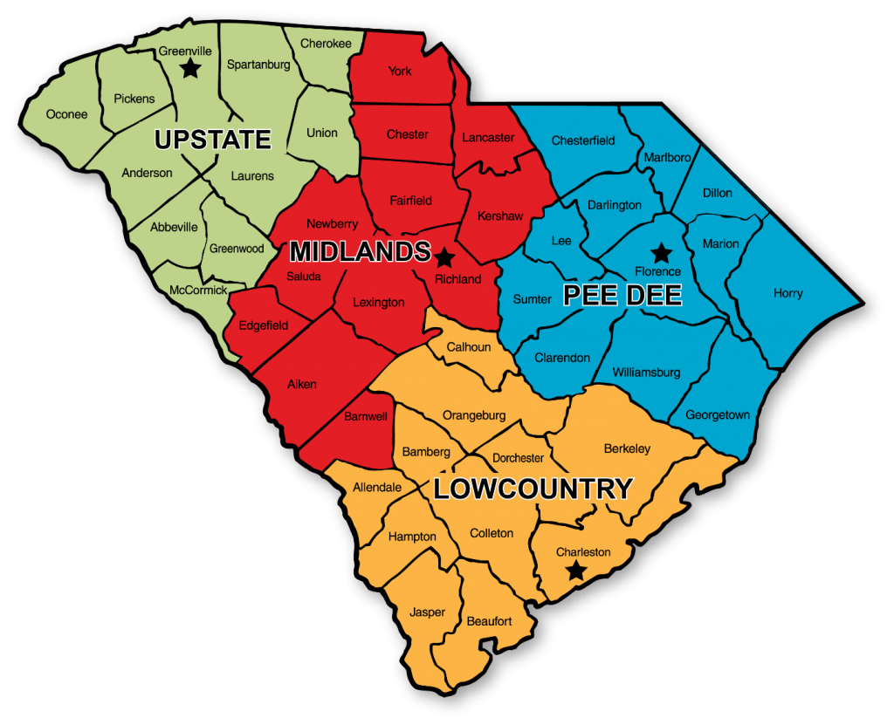
DHEC Regions
Notes:
Region overview - kandi

Slide 4
DHEC’s Role in the Response
Case Investigations
Contact Tracing
Supporting Testing Clinics
Supporting Vaccine Clinics
Community Education
Partnership and Systems Collaborations
Providing general guidance and support
Notes:
kandi

Slide 5
Impact of the Disease

Slide 6
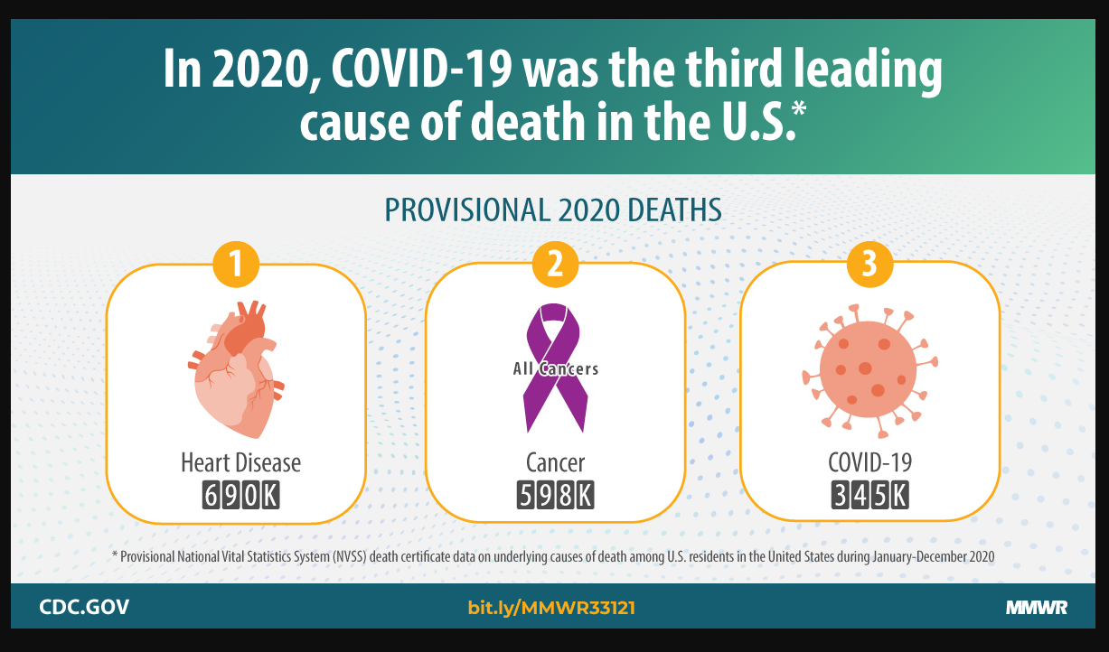

Slide 7
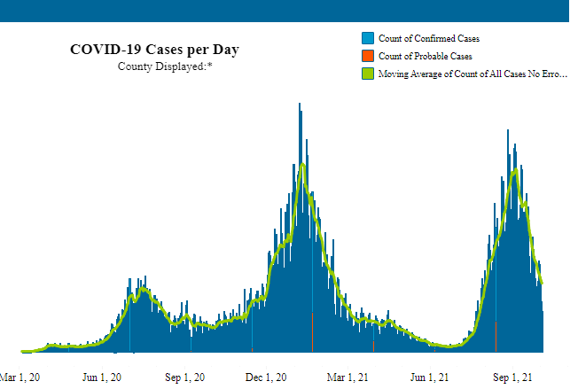
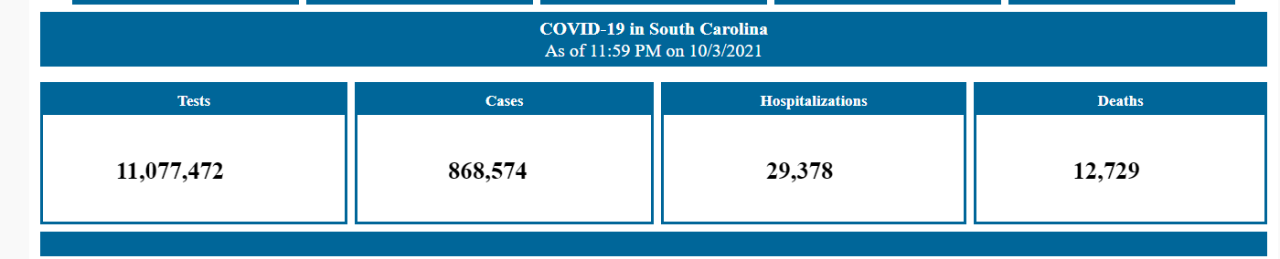

Slide 8
South Carolina 10/3/2021
867,326
  confirmed & probable cases
29,363 hospitalizations
  3.39% of known cases
12,729 deaths
  1.47% of known cases

Slide 9
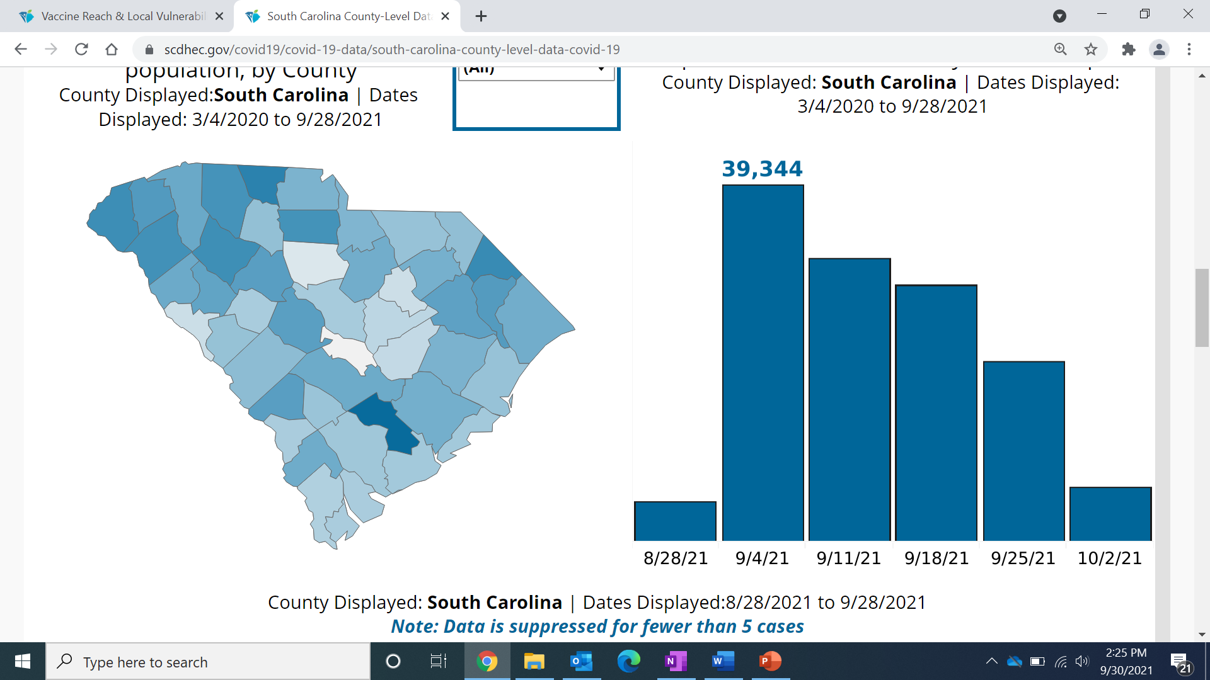
Rate of COVID-19 Cases per 10,000 population
8/28/21-9/28/21
Source: SCDHEC.gov
Notes:
Dr. c
Goals of Case-Contact Investigations
Reduce the burden of disease for the individual and the community
Improve understanding of the overall situation of the current burden of disease in the community
Improve understanding of the modes of transmission and effectiveness of control measures as we use the data to review what has happened
Serve as a source of information for the community
Assess risk factors for disease burden among vulnerable populations
Empower communities to plan better in the future

Slide 10
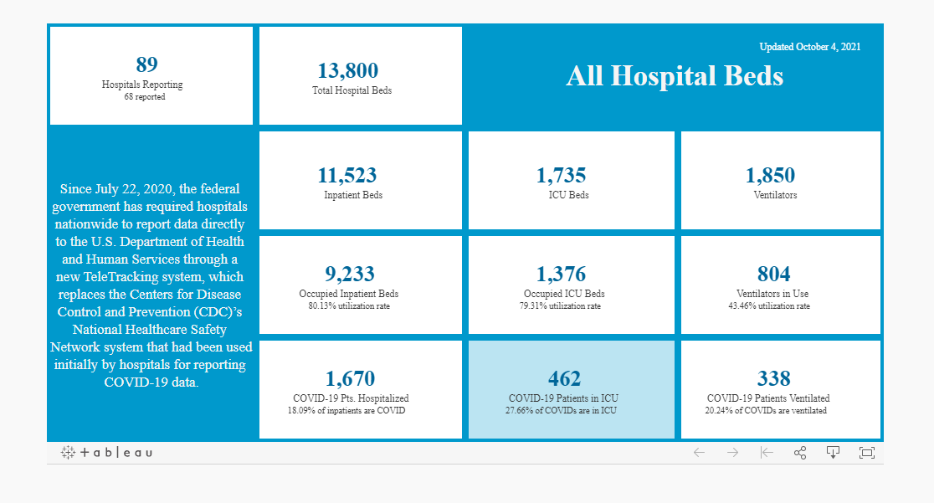

Nearly 1 in 5 patients is hospitalized for COVID and 33.5% of ICU patients are there related to their COVID-19 illness.
Notes:
These #s are down but still

Slide 11
% COVID-19 Cases ever Hospitalized 3/4/2020-9/28/2021
Source: SCDHEC.gov
Notes:
Dr. c

Slide 12
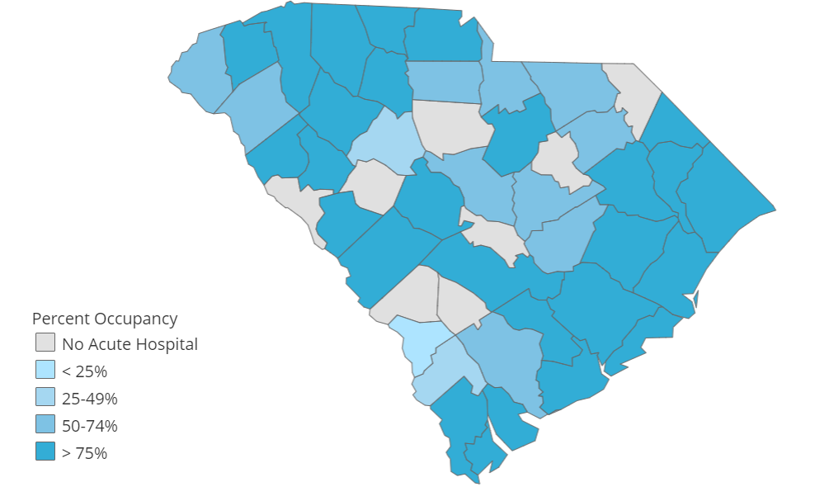
Acute Hospital Bed Occupancy 9/29/21
Source: SCDHEC.gov
Notes:
Dr. c

Slide 13
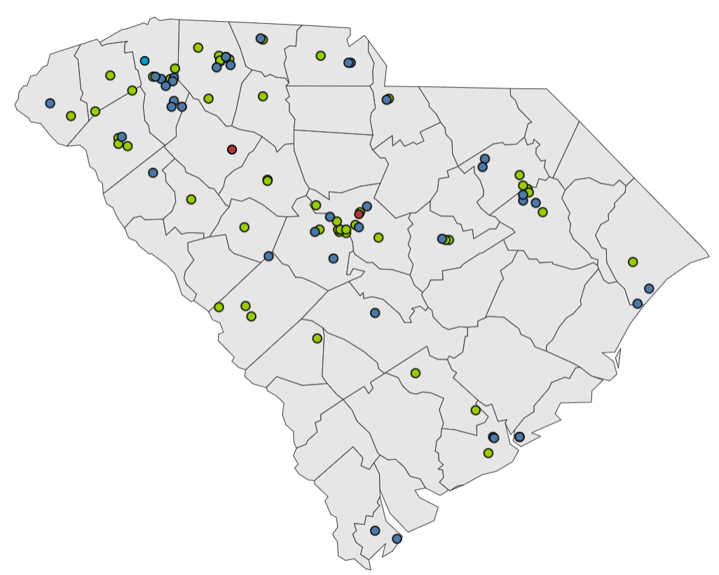
Long Term Care Facilities with at least one case of COVID-19 in the last 2 weeks as of 9/28/21
Source: SCDHEC.gov
Notes:
Dr. c

Slide 14
12,729 Lives Lost to COVID-19
Lives Lost | Ages
6 | <= 10
15 | 11-20
75 | 21-30
217 | 31-40
576 | 41-50
1319 | 51-60
2645 | 61-70
3650 | 71-80
4048 | 81+

Slide 15
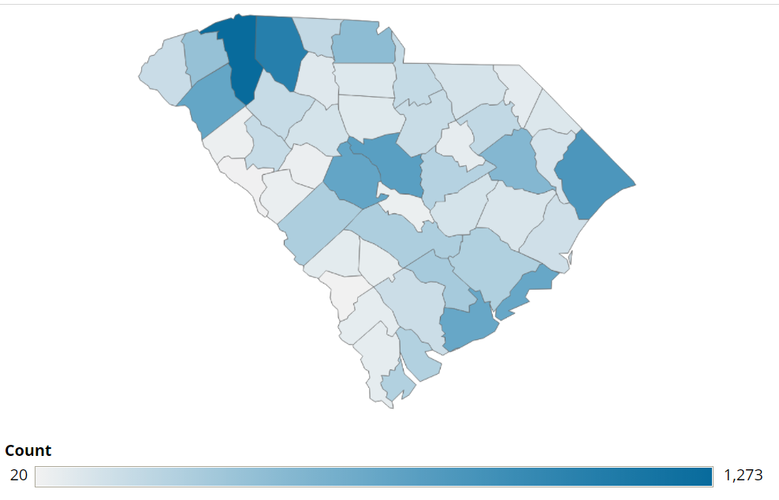
Reported Deaths due to COVID-19, total
12,472 deaths in SC as of 9/28/21
Source: SCDHEC.gov
Notes:
Dr c

Slide 16
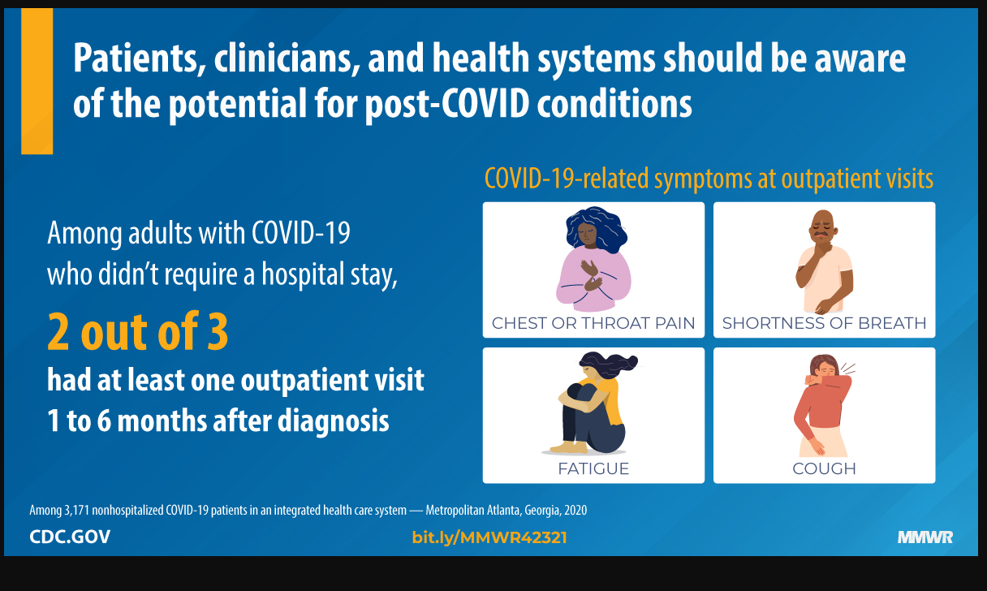

Slide 17
Prevention

Slide 18

Best Prevention Measures
Social Distancing
Masking
Vaccinating
Notes:
kandi

Slide 19
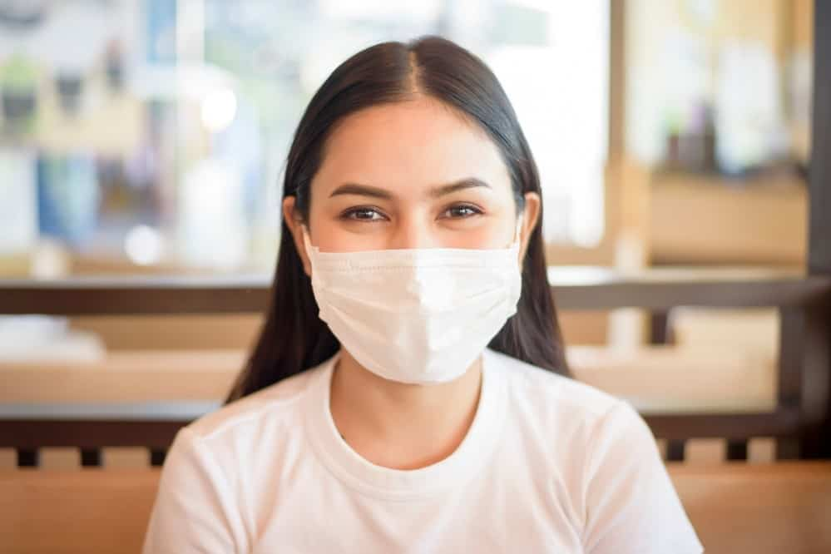
Do masks really work?
Notes:
kandi

Slide 20
Masks do work
Saint Louis University study:
  If one or both unmasked, 4.9x higher chance of infection
  Any additional exposures were associated with a 40.0% increase in odds of a positive test result
  http://dx.doi.org/10.15585/mmwr.mm7036a3external icon
Notes:
kandi

Slide 21
Masks do work
Notes:
Arizona School study
Schools without mask requirements were 3.5 times more likely to have a COVID-19 outbreak than those who started the year with a mask requirement
Jehn M, McCullough JM, Dale AP, et al. Association Between K–12 School Mask Policies and School-Associated COVID-19 Outbreaks — Maricopa and Pima Counties, Arizona, July–August 2021. MMWR Morb Mortal Wkly Rep 2021;70:1372–1373. DOI: http://dx.doi.org/10.15585/mmwr.mm7039e1

Slide 22
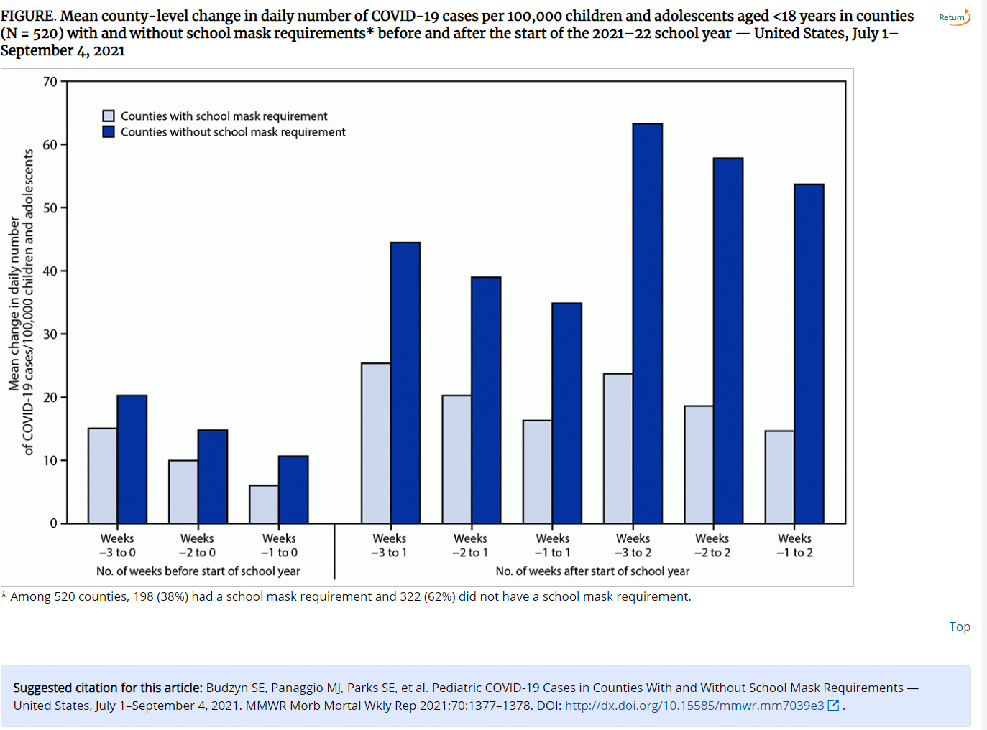

Slide 23
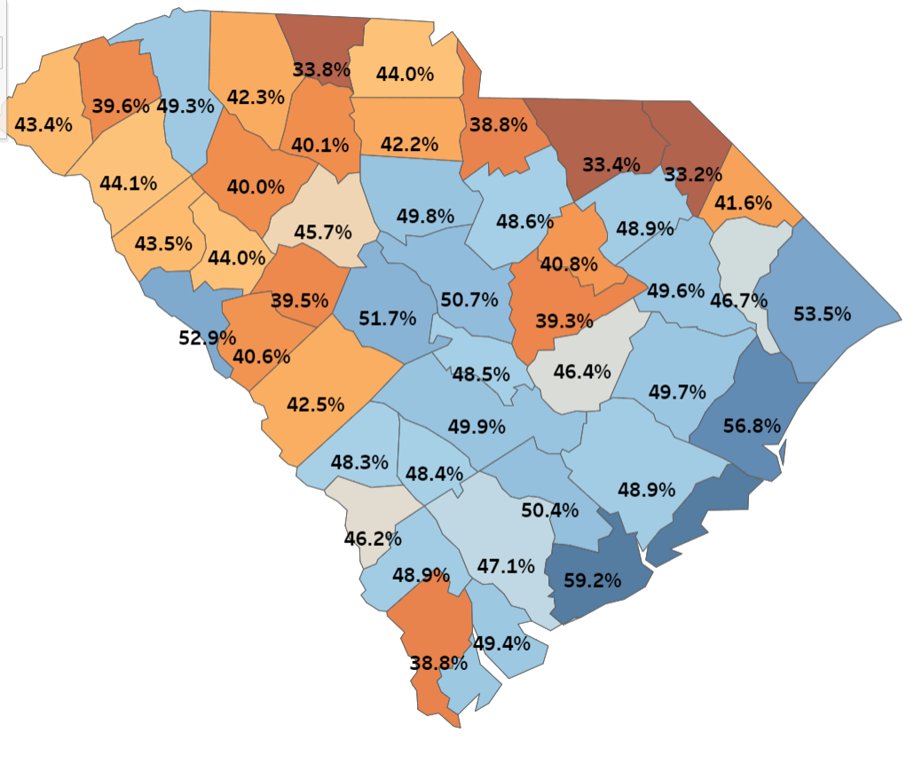
% Population aged 12+ fully vaccinated as of 9/26/21
Notes:
kandi

Slide 24
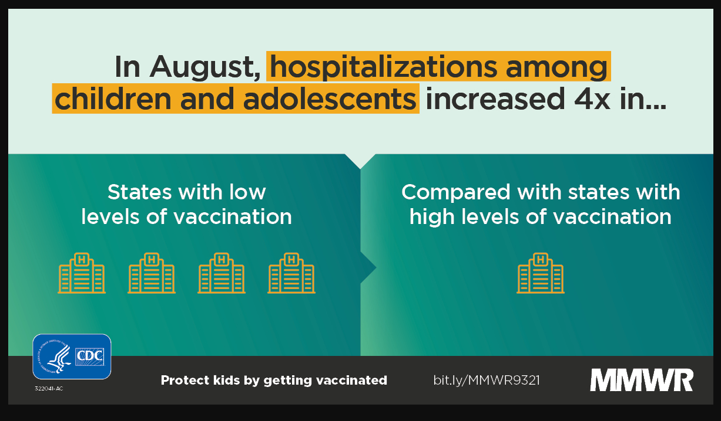

Slide 25
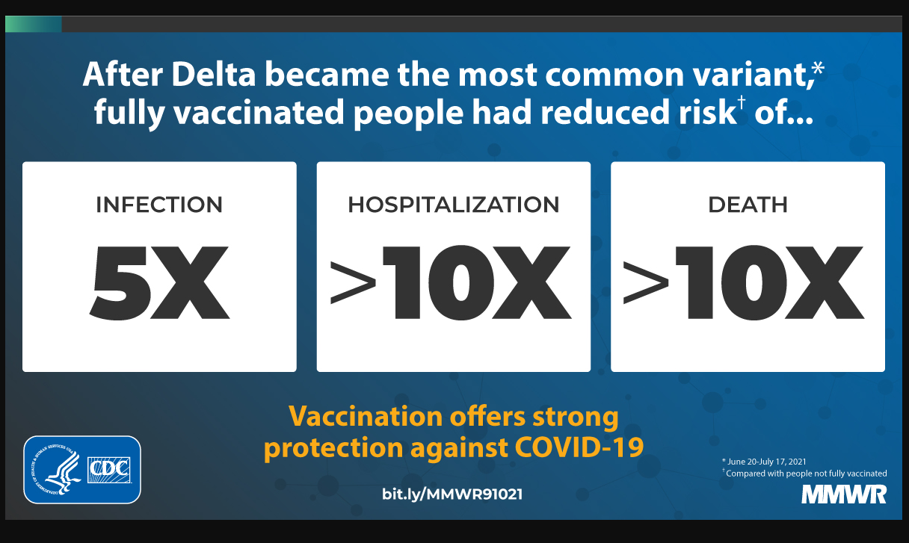

Slide 26
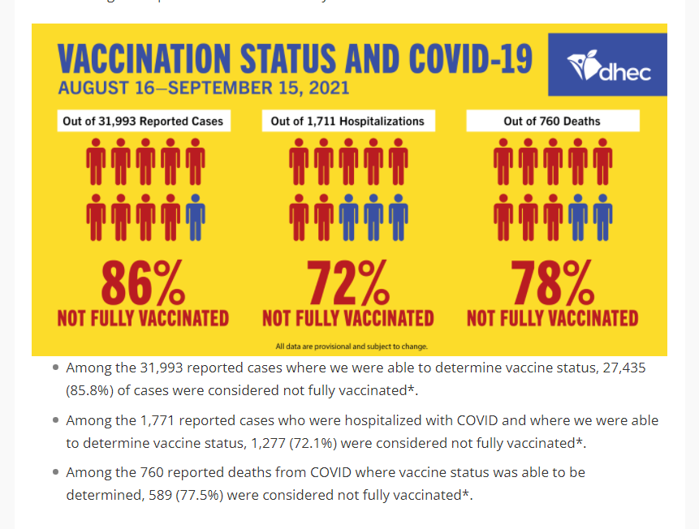
Notes:
Additional DHEC data points from this analysis shows how many breakthrough cases are among with those with preexisting/comorbid conditions:
Among the 411 reported cases who were hospitalized with COVID and fully vaccinated (that we were able to determine the vaccination and comorbid status):
388 (94.4%) has preexisting/ comorbid conditions.
Among the 143 reported deaths from COVID who were fully vaccinated (where we were able to determine the vaccination and comorbid status):
138 (96.5%) had preexisting/ comorbid conditions.

Slide 27
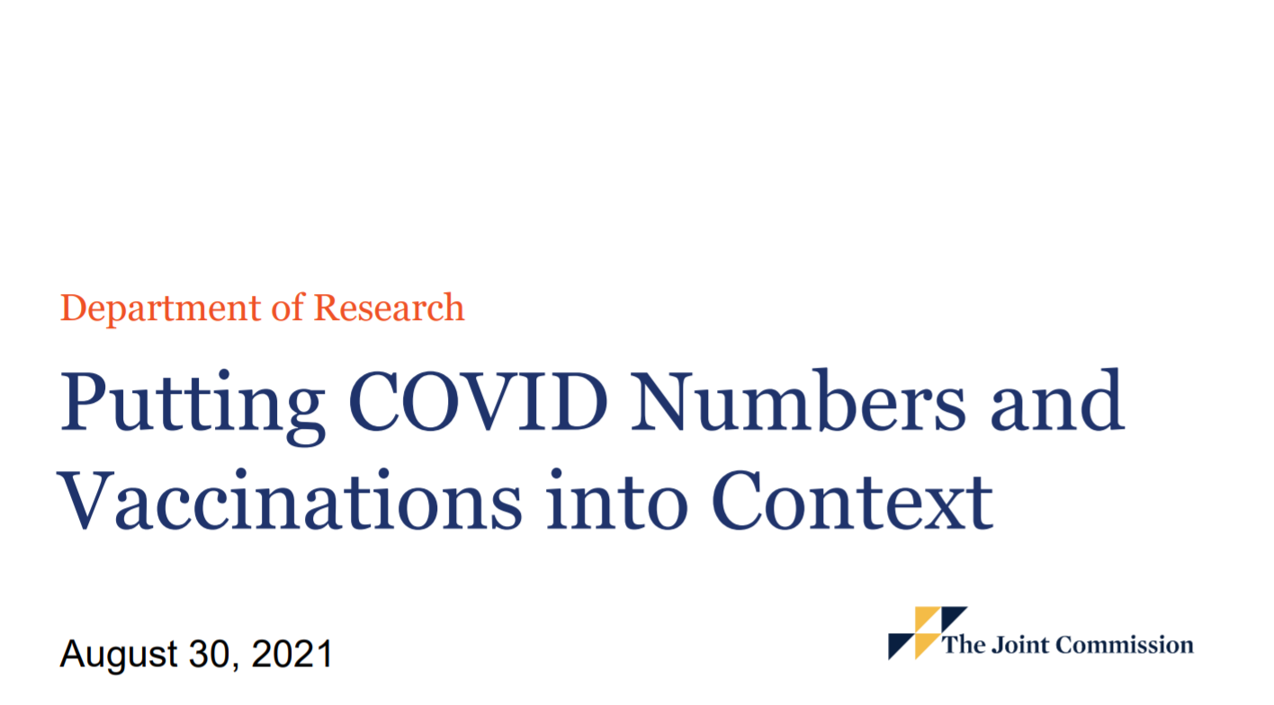
Source: https://www.jointcommission.org/-/media/tjc/documents/covid19/covid-numbers-perspective-8-30-21.pdf
Notes:
Dr c

Slide 28
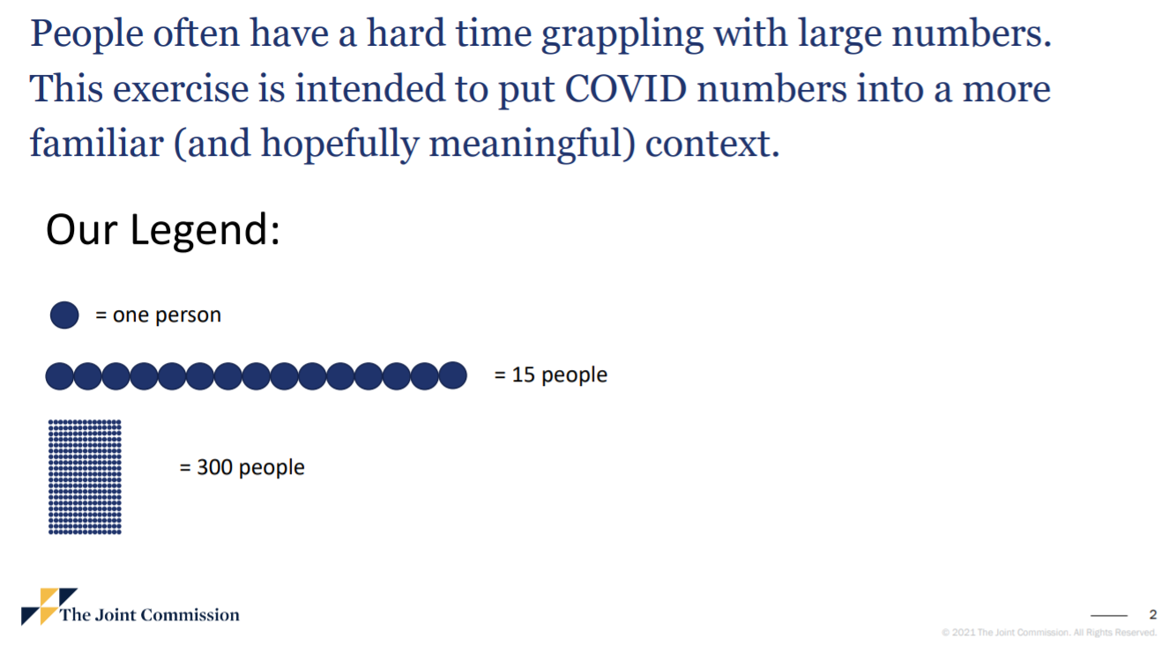
Source: https://www.jointcommission.org/-/media/tjc/documents/covid19/covid-numbers-perspective-8-30-21.pdf
Notes:
Dr c

Slide 29
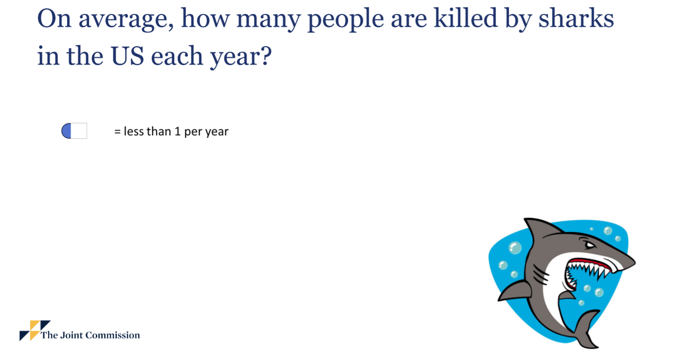
Source: https://www.jointcommission.org/-/media/tjc/documents/covid19/covid-numbers-perspective-8-30-21.pdf
Notes:
Dr c

Slide 30
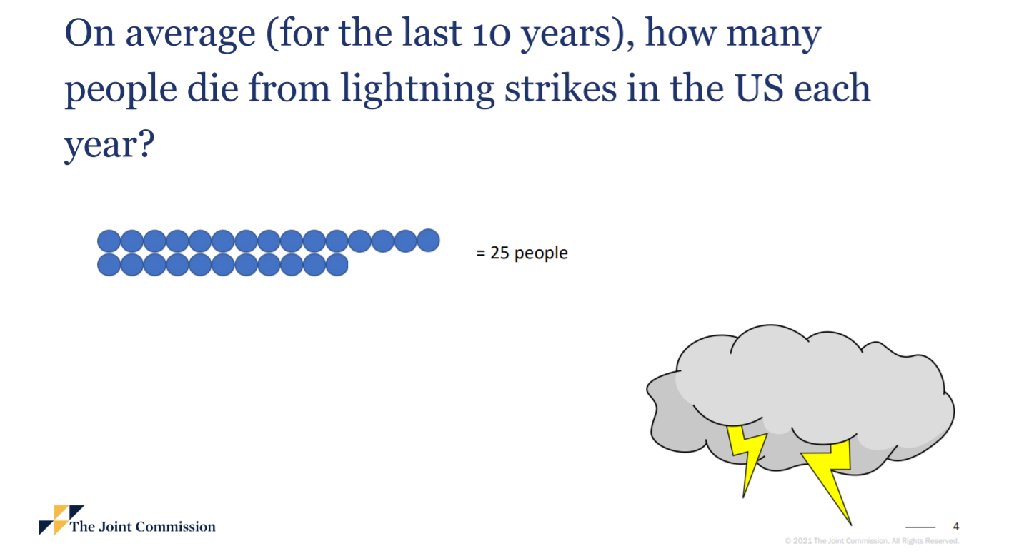
Source: https://www.jointcommission.org/-/media/tjc/documents/covid19/covid-numbers-perspective-8-30-21.pdf
Notes:
Dr c

Slide 31
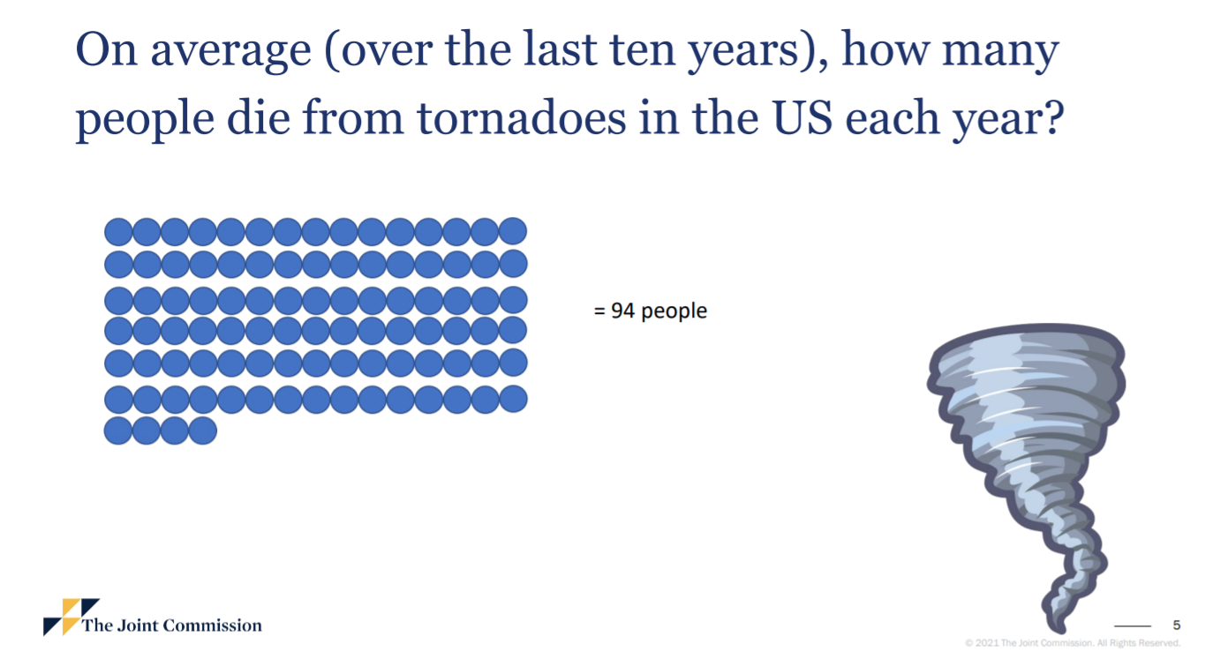
Source: https://www.jointcommission.org/-/media/tjc/documents/covid19/covid-numbers-perspective-8-30-21.pdf
Notes:
Dr c

Slide 32
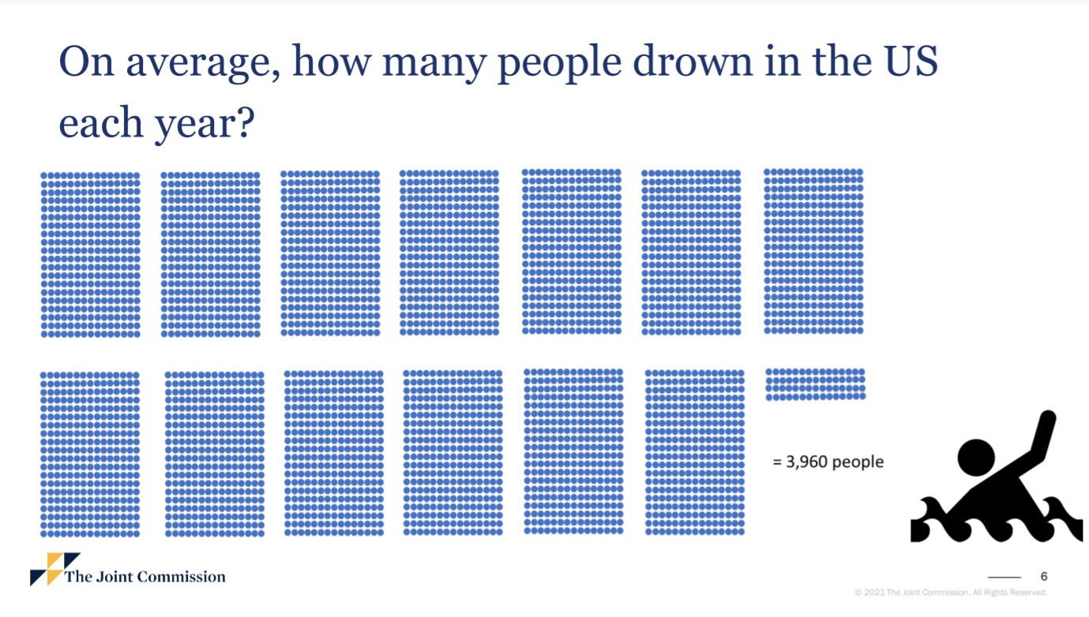
Source: https://www.jointcommission.org/-/media/tjc/documents/covid19/covid-numbers-perspective-8-30-21.pdf
Notes:
drc

Slide 33
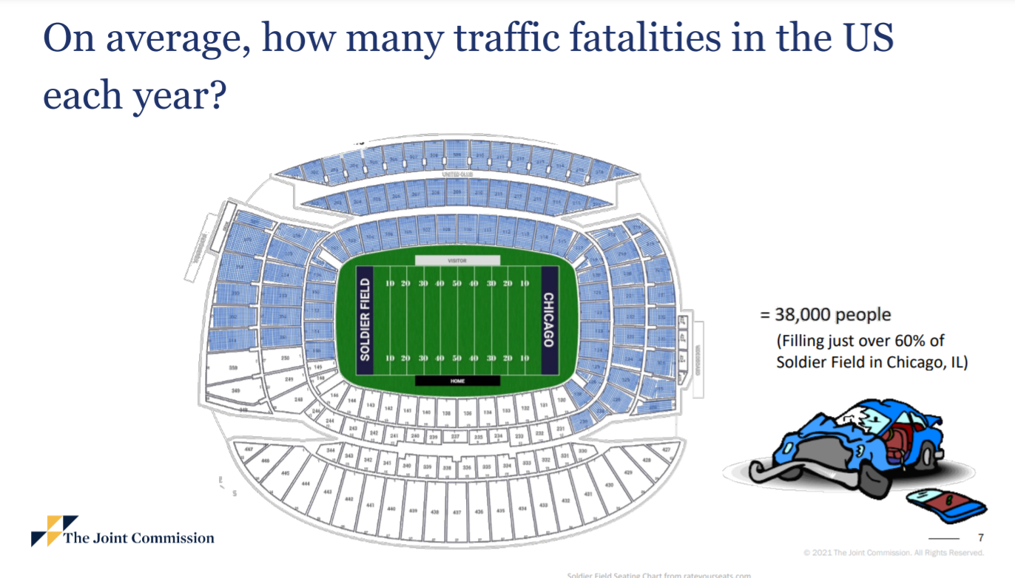
Source: https://www.jointcommission.org/-/media/tjc/documents/covid19/covid-numbers-perspective-8-30-21.pdf
Notes:
Dr c

Slide 34
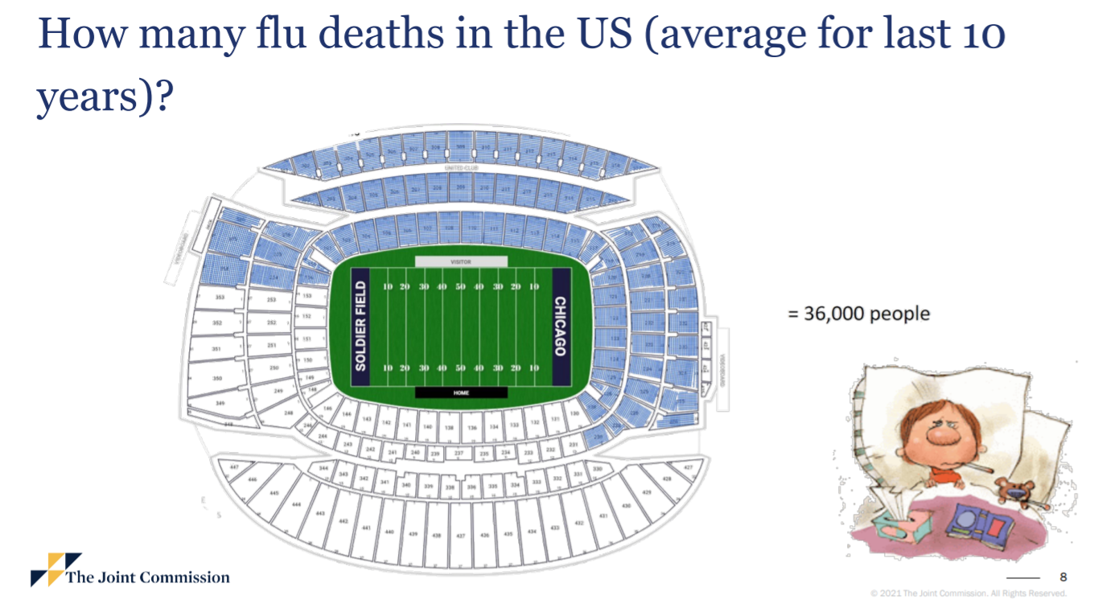
Source: https://www.jointcommission.org/-/media/tjc/documents/covid19/covid-numbers-perspective-8-30-21.pdf
Notes:
Dr c

Slide 35
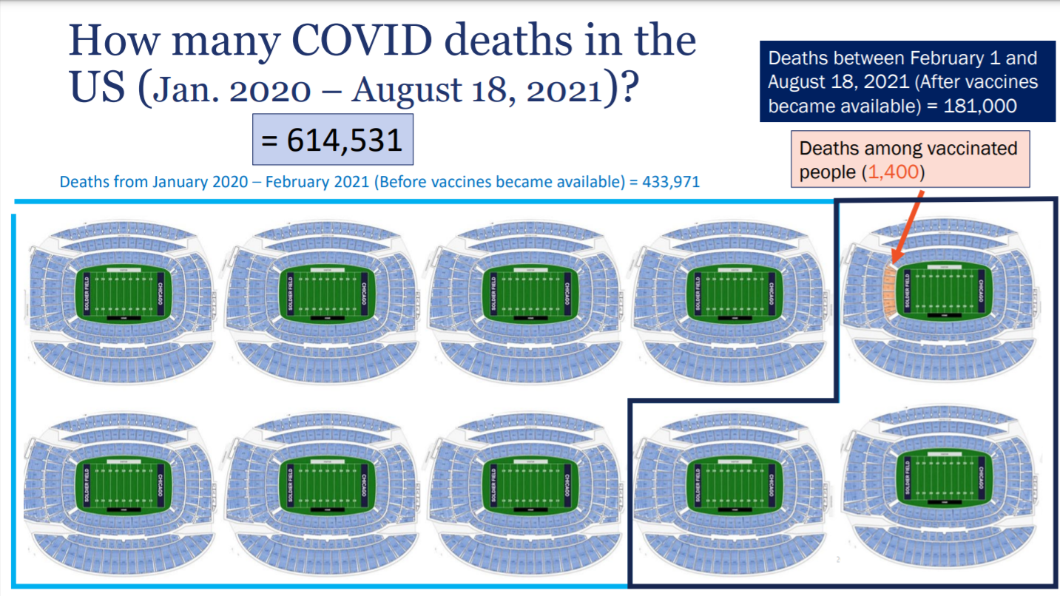
Source: https://www.jointcommission.org/-/media/tjc/documents/covid19/covid-numbers-perspective-8-30-21.pdf
Notes:
Dr c

Slide 36
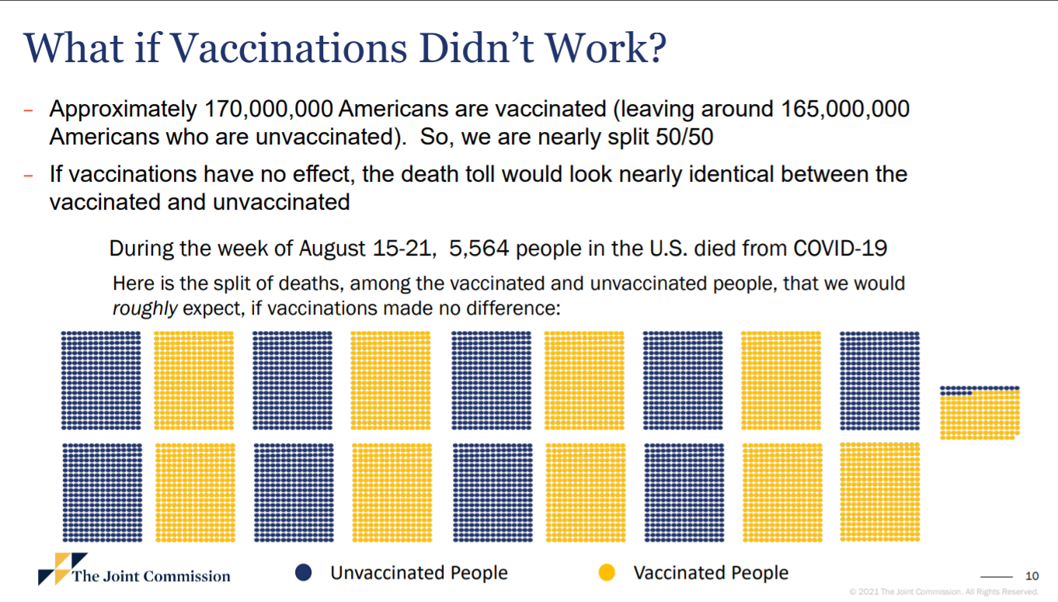
Source: https://www.jointcommission.org/-/media/tjc/documents/covid19/covid-numbers-perspective-8-30-21.pdf
Notes:
Dr c

Slide 37
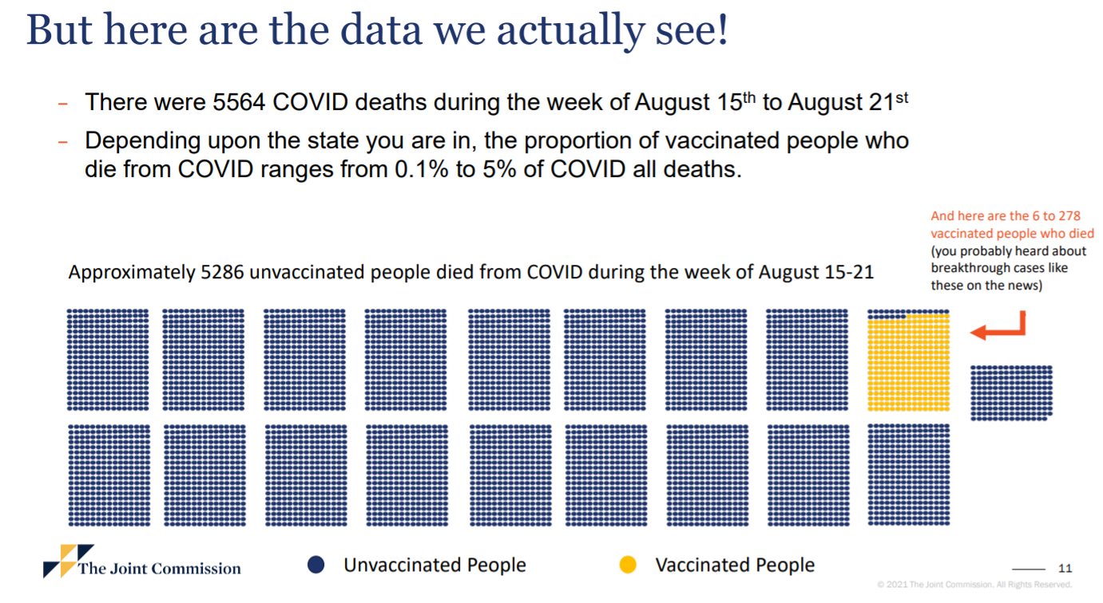
Source: https://www.jointcommission.org/-/media/tjc/documents/covid19/covid-numbers-perspective-8-30-21.pdf
Notes:
Dr c

Slide 38
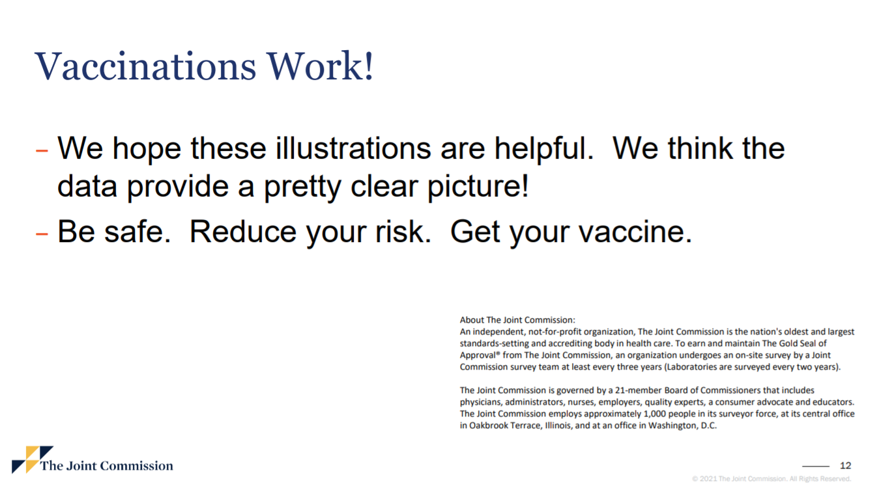
Source: https://www.jointcommission.org/-/media/tjc/documents/covid19/covid-numbers-perspective-8-30-21.pdf
Notes:
Dr c

Slide 39
Boosters vs. 3rd doses
“Booster doses” are for individuals who likely had a good immune response to the initial vaccine but now those immune responses are waning
“3rd doses” are for when the first 2 mRNA doses are not likely to be adequate
Notes:
Dr c

Slide 40
3rd doses
Given after Pfizer or Moderna vaccine series
For ages 12+ who are moderate to severely immunocompromised
  Organ transplant recipients, advanced HIV, immunosuppressing medications for autoimmune disease or cancers
28 days or more after the primary series
Notes:
Dr c

Slide 41
Boosters
Pfizer vaccine
6 or more months after receipt of first 2 doses
Categories of individuals for boosters
  Age 65 +
  High risk of severe disease ages 18 to 64 yrs.
  High risk of catching or transmitting COVID-19
Notes:
Dr C.
“Should” receive booster if at least 6 months after Pfizer series and 65+ or people aged 50 to 64 y/o with certain medical conditions that put them at increased risk of severe disease
“May” receive booster if 18 to 49 y/o and at high risk for severe COVID-19
“May” receive booster if 18 to 49 y/o and at increased risk for exposure or transmission

Slide 42
Boosters
65+
18+ years with medical conditions that predispose them to severe disease
  Immune suppression, cancer, diabetes, Down syndrome, high blood pressure, history of heart attacks, HIV, liver disease, overweight/obesity, pregnancy, sickle cell disease, smoker, stroke, dementia, and substance use disorders
18+ years and at high risk of catching COVID-19 or transmitting it to others at risk
  healthcare workers, teachers, residents of nursing homes, and incarcerated
Notes:
Dr c

Slide 43
What about natural immunity?
Risk of Re-infection 78.8% from first to second waves in 2020 and may be up to 47% in older persons per study from Denmark
From Lancet April 9, 2021 Re-infection risk in Denmark
Hansen, et al. The Lancet. 397: pages 1204-1212.

Slide 44
Flu
Don’t forget about your annual Flu shot!!!
Notes:
Guidance for Use in Specific Populations and Situations
Populations at Higher Risk for Medical Complications Attributable to Severe Influenza
All persons aged ≥6 months who do not have contraindications should be vaccinated annually. However, vaccination to prevent influenza is particularly important for persons who are at increased risk for severe illness and complications from influenza and for influenza-related outpatient, emergency department, or hospital visits. When vaccine supply is limited, vaccination efforts should focus on administering vaccination to persons at higher risk for medical complications attributable to severe influenza who do not have contraindications. These persons include the following (no hierarchy is implied by order of listing):
All children aged 6 through 59 months;
All persons aged ≥50 years;
Adults and children who have chronic pulmonary (including asthma), cardiovascular (excluding isolated hypertension), renal, hepatic, neurologic, hematologic, or metabolic disorders (including diabetes mellitus);
Persons who are immunocompromised due to any cause (including but not limited to immunosuppression caused by medications or HIV infection);
Women who are or will be pregnant during the influenza season;
Children and adolescents (aged 6 months through 18 years) who are receiving aspirin- or salicylate-containing medications and who might be at risk for experiencing Reye syndrome after influenza virus infection;
Residents of nursing homes and other long-term care facilities;
American Indians/Alaska Natives; and
Persons who are extremely obese (body mass index ≥40 for adults).
An IIV4 or RIV4 (as appropriate for the recipient’s age) is suitable for persons in all risk groups. LAIV4 is not recommended for some populations, including some of these listed groups. Contraindications and precautions to the use of LAIV4 are noted (Table 2).
Persons Who Live with or Care for Persons at Higher Risk for Influenza-Related Complications
All persons aged ≥6 months without contraindications should be vaccinated annually; however, in addition to persons at higher risk for medical complications attributable to severe influenza, emphasis also should be placed on vaccination of persons who live with or care for those who are at increased risk. When vaccine supply is limited, vaccination efforts should focus on administering vaccination to persons at higher risk for influenza-related complications, as well as persons who live with or care for such persons, including the following:
Health care personnel, including all paid and unpaid persons working in health care settings who have the potential for exposure to patients or to infectious materials. These personnel might include (but are not limited to) physicians, nurses, nursing assistants, nurse practitioners, physician assistants, therapists, technicians, emergency medical service personnel, dental personnel, pharmacists, laboratory personnel, autopsy personnel, students and trainees, contractual staff, and other persons not directly involved in patient care but who might be exposed to infectious agents (e.g., clerical, dietary, housekeeping, laundry, security, maintenance, administrative, and billing staff and volunteers). ACIP guidance for vaccination of health care personnel has been published previously (44);
Household contacts (including children aged ≥6 months) and caregivers of children aged ≤59 months (i.e., aged <5 years) and adults aged ≥50 years, particularly contacts of children aged <6 months; and
Household contacts (including children aged ≥6 months) and caregivers of persons with medical conditions that put them at higher risk for severe complications from influenza.
Health care personnel and persons who are contacts of persons in these groups (with the exception of contacts of severely immunocompromised persons who require a protected environment) may receive any influenza vaccine that is otherwise indicated. Persons who care for severely immunocompromised persons requiring a protected environment should receive either IIV4 or RIV4. ACIP and the Healthcare Infection Control Practices Advisory Committee (HICPAC) have previously recommended that health care personnel who receive LAIV should avoid providing care for severely immunosuppressed patients requiring a protected environment for 7 days after vaccination and that hospital visitors who have received LAIV should avoid contact with such persons for 7 days after vaccination (45). However, such persons need not be restricted from caring for or visiting less severely immunosuppressed patients.

