Slide 1

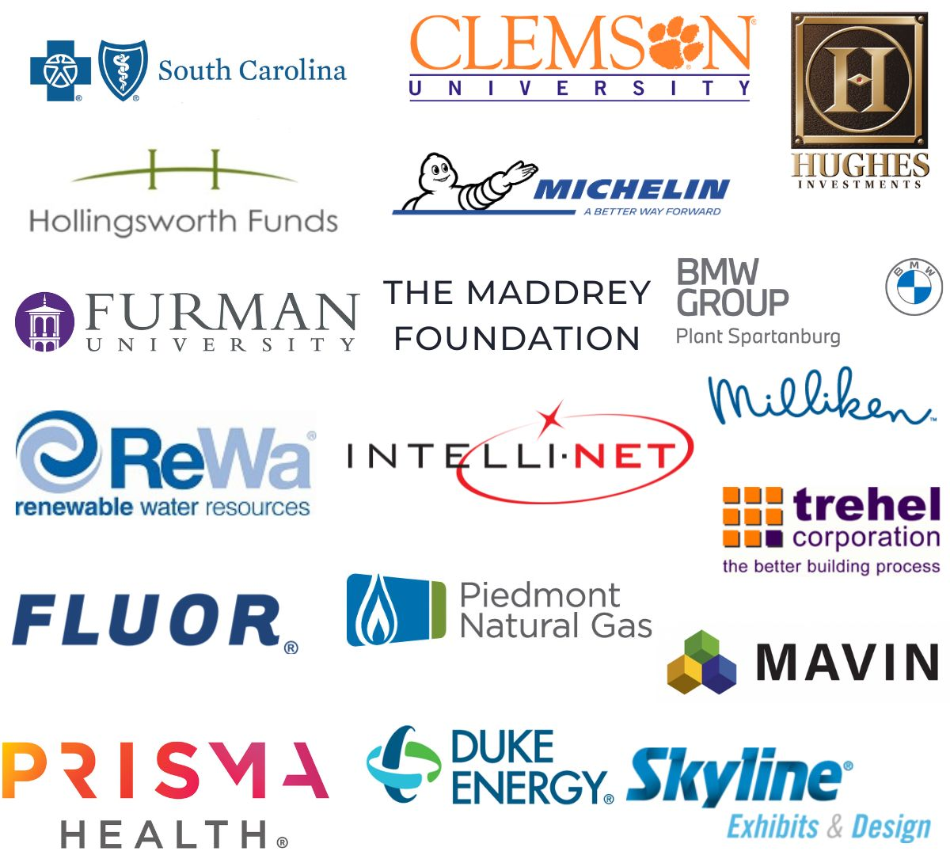
TATT CHAT – JULY 13, 2023
Welcome
David Feild, TATT Board of Directors Chair
Guest Speaker
Jenny Boulware, Main Street South Carolina
Resource Updates
Regan Freeman, ECHO Project
Karen Dudley-Culbreath, Period Project
Adjourn
David Feild, TATT Board of Directors Chair
NEXT TATT CHAT – AUGUST 10, 2023
LEADERSHIP LEVEL PARTNERS

Slide 2


2023 Elevate Upstate Grants

Slide 3
Overview
Important Dates
August 2nd
EU Grant Workshop
The grant exists to identify and provide initial funding support for community-based programs.
The initiative will award three grants of up to $5,000 each (total of $15,000).
Two of the grants will be awarded using the same format and criteria as in past years. The third grant will be awarded for a project implemented at the new Bridgeway Station development in Mauldin, SC.
Applicants must be located in and do their work within one of the ten Upstate counties: Abbeville, Anderson, Cherokee, Greenville, Greenwood, Laurens, Oconee, Pickens, Spartanburg, or Union.
Finalists will be announced in October and will be asked to give a brief summary of their project before the recipients are announced at the Ten at the Top Celebrating Successes Event of 2023.
August 7th
Interest Form Due
September 22nd
Application Due
November 15th
Celebrating Successes

Slide 4
Find more information about the Elevate Upstate Grants here:
https://tenatthetop.org/hughes-investments-elevate-upstate-grants-initiative/

