Slide 1
State of the Economy 2024 Soft Landing, Sustained Growth, or Recession
Scott Baier
Clemson University
1/11/2024

Slide 2
Summary
In the December meeting, the Federal Reserve decided to hold their targeted interest rate steady the Federal Funds Rate, to 5.25% – 5.50%
2023:Q3 GDP growth came in at 4.9%
It was higher than most expected (3.4 %), and the Atlanta Fed GDPNow forecast was 5.4%
Inflation continues to trend down.
Labor market continues to add jobs, but the last couple of job reports indicate that the labor market is cooling.

Slide 3
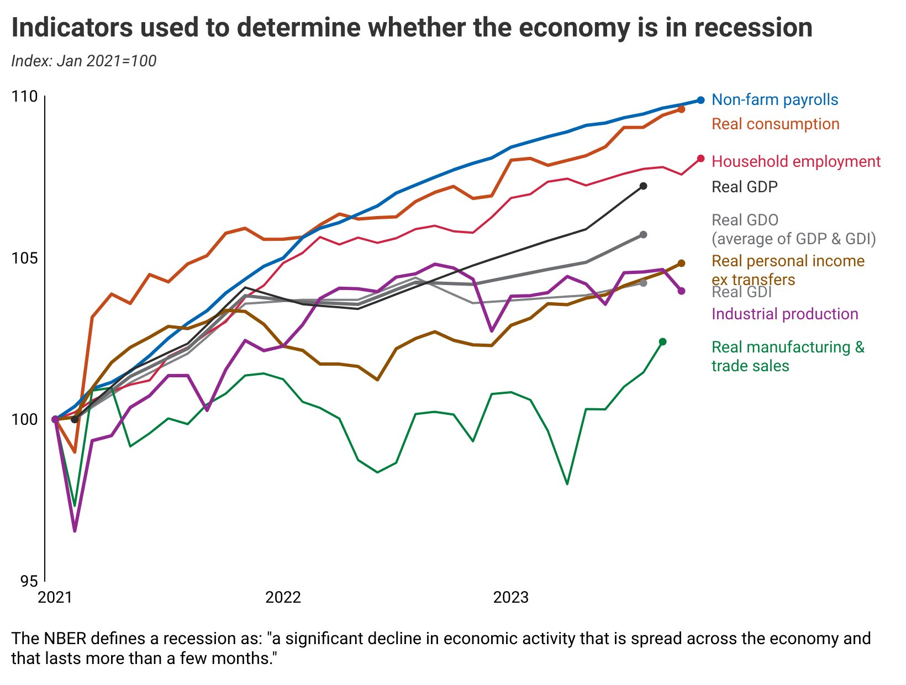
The News Does Not Align with the Data

Slide 4
The News Does Not Align with the Data

Slide 5
GDP Growth: 1947 - 2023
GDP Growth is the norm:
Over time, income grows because
Population growth
More educated population
Accumulation of physical capital,
New Technologies

Slide 6
GDP Growth: 1947 - 2023
Prior to 2000, real GDP growth averaged about 3 percent a year

Slide 7
Real Gross Domestic Product Growth Rates

Slide 8
Real Gross Domestic Product Growth Rates
Since the end of the pandemic, GDP growth has averaged about 3.14%
Why the underperformance?
Slower population growth and demographic,
Slower growth in educational attainment,
Lower productivity growth.
Inequality
Taxes and Regulation
Only 36% of the time GDP growth has been
above 3%

Slide 9
GDP Long Run Growth vs Recessions
When we think of GDP growth in the economy, it is important to remember that economic growth is the norm.
Typically, recessions are result of imbalances in the economy that
Result in periods of slack in output ,
These imbalances an be caused by shifts in demand that are large and sustained,
Structure of supply is not able to adjust rapidly enough to reallocate resources across sectors,
Length of the cycle depends on the permanence of the demand shock and the appropriateness of the policy response.
Sometimes these imbalances are easy to identify – often times not.
Imbalances may also result in inflation:
The inflation may be the result of increases in demand or decreases in supply.
Typically, recessions are se.

Slide 10
Real Gross Domestic Product
V-Shaped Recovery
L-Shaped Recovery
Source: Bureau of Economic Analysis

Slide 11
GDP Growth and the Economy
For the rest of the talk, we will focus on the demand side because
This is where the imbalances come from,
It is easier to identify (historically) the nature of the imbalances,
It is easier to describe how components of demand also respond to economic shocks.

Slide 12
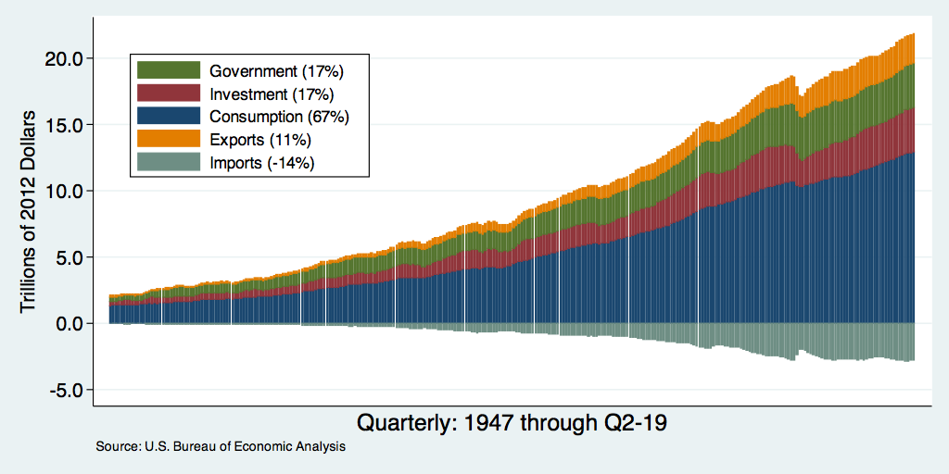
Composition and Contribution of Real GDP
Notes:
Components sum to GDP
Average % of GDP for each component from 1960-Present: C = 64%, I=15%, G=24%, NX = 2% (X = 7%, M=9%)
Net Exports as a % of GDP has increased over the sample period, but it’s contribution to GDP is relatively small

Slide 13
Understanding Contributions to GDP Growth
GDP Growth is a combination of the growth in its components:
Consumption, Investment, Government, and Net Exports
It’s a weighted average of these components
For example: Consumption
If consumption accounts for 2/3 of the economy,
If consumption grew by 3%,
It implies that consumption growth accounts for 2 percentage points of GDP growth; that is, $2\%=\left(\frac{2}{3}\right)∗3\%$.

Slide 14
Contributions to 2023:Q3 GDP Growth

Slide 15
2023:Q2
2023:Q1
2022:Q4
2022:Q3
2022:Q2
2022:Q1

Slide 16
Consumption’s Contribution to GDP Growth
From 2000 through 2019, consumption growth contributed about 1.56 percentage points to GDP growth (about 70 %)
Since the end of the pandemic, consumption growth accounts for 2.58 ppt (about 82.5%)
Source: Bureau of Economic Analysis

Slide 17
Real Disposable Income
Stimulus
Source: Bureau of Economic Analysis

Slide 18
Real Disposable Income and Consumption
Source: Bureau of Economic Analysis

Slide 19
Rebalancing is Taking Some Time
Durable Goods
Nondurable Goods
Services
Source: Bureau of Economic Analysis

Slide 20
Excess Saving
Source: Wells Fargo: Special Commentary Oct 5

Slide 21
Consumer Borrowing
Student loans
Autos
Credit Card
Mortgage debt

Slide 22
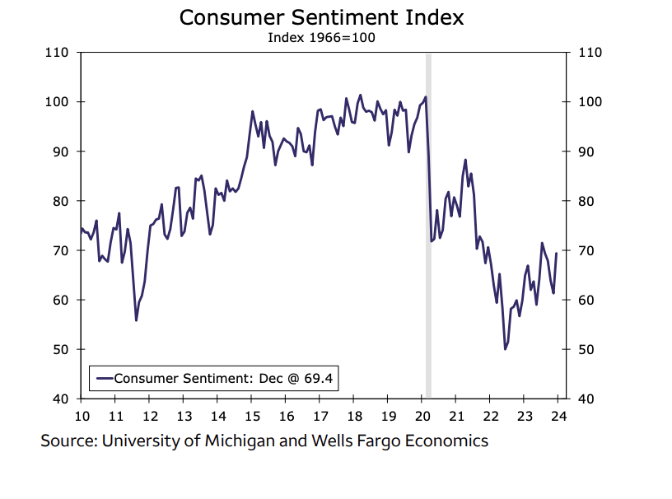
Consumer Sentiment

Slide 23
Investment Spending’s Contribution
Source: Bureau of Economic Analysis

Slide 24
Investment Spending:
Investment includes the:
purchase of plants machines and equipment,
changes in business Inventories,
and residential investment
The drivers of each of these components are different.

Slide 25
Investment’s Contribution to GDP Growth
4.63
2.71
0.62
1.74
1.16
0.89
-0.84
-1.45
-1.68
-2.10
Source: Bureau of Economic Analysis

Slide 26
Fixed Investment
Source: Bureau of Economic Analysis

Slide 27
Business Sales and Employment Forecast
4.5%
1.6%
Data: Federal Reserve Bank of Atlanta

Slide 28
Business Uncertainty: Sales and Employment
Take Away: Employment Growth Uncertainty has returned to pre-pandemic levels,
whereas sales uncertainty remains elevated

Slide 29
Inventory’s Contribution to GDP Growth
Inventory Investment is the most volatile component.
Inventories of intermediate inputs and finished products move quickly
JIT and JIC
Source: Bureau of Economic Analysis

Slide 30
Residential Investment’s Contribution to GDP Growths
Source: Bureau of Economic Analysis

Slide 31
Mortgage Rates and Housing Starts
Source: Bureau of Economic Analysis

Slide 32
Net Exports and GDP Growth
Source: Bureau of Economic Analysis

Slide 33
Government Spending

Slide 34
Government Spending

Slide 35
State and Local Gov’t Employment

Slide 36
Interest Rate on 10-year US Security
What was driving the higher rates?
Belief that Fed will keep rates higher.
Concern over the path of the US Debt
Fitch downgrading of US Securities

Slide 37
Unemployment: US and SC

Slide 38
Gains in Non-Farm Payrolls
There have been almost 27 million jobs added
In 2021, the average monthly gain was 605k
In 2022, the average monthly gain was 399k
In 2023, the average monthly gain was 232k

Slide 39
Employment Gains By Industry

Slide 40
Employment Gains and Losses
Source: BLS

Slide 41
Wage Gains by Industry
BLS Change in Weekly Earnings

Slide 42
Wage Gains by Industry
BLS Change in Weekly Earnings

Slide 43
Job Separations

Slide 44
Quits and Layoffs

Slide 45
Vacancies Per Unemployed Worker
Tighter Labor Market
Slack in the Labor Market
When vacancies per worker go up, more firms are competing for each worker.
This can induce pressure on wage.

Slide 46
Employment Cost Index
Annual
Quarterly

Slide 47
Inflation
Inflation less
food and energy
Inflation CPI

Slide 48
Consumer Inflation Expectation

Slide 49
Global Supply (and Demand) Chains
Source: New York Federal Reserve

Slide 50
Goods and Service Consumption

Slide 51
Goods and Service Inflation

Slide 52
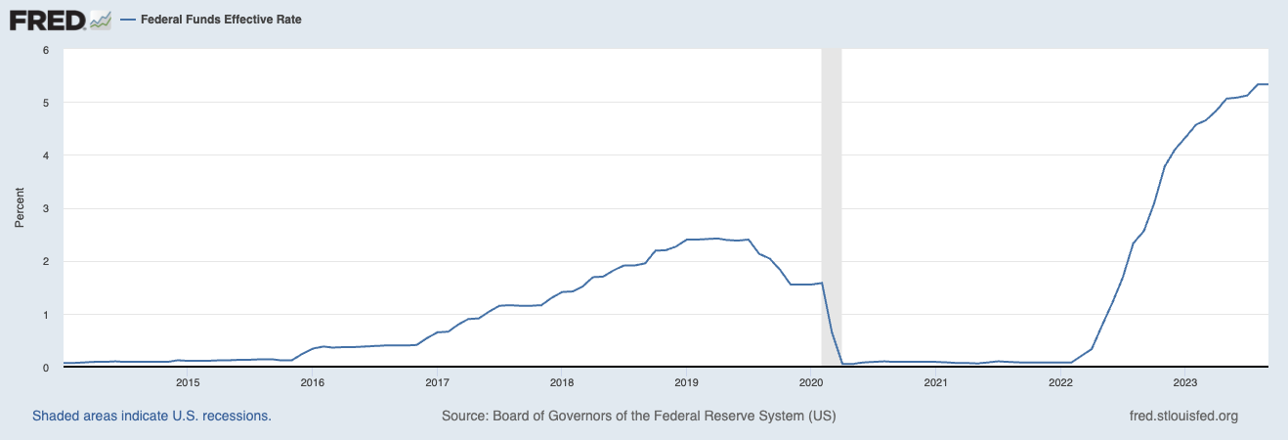
Federal Funds Rate
Tomorrow, the Federal Reserve will likely
hold the Federal Funds target Rate at its current level.
In July, the Federal Reserve decided
to raise interest rates 25 basis points
at 5.0 to 5.25. percent.
In September, it held the target rate
constant.
In November, it again held the target rate constant

Slide 53
Money Growth: M2 (Transactions Money)
6 percent

Slide 54
Inflation Outlook
The inflation outlook is improved:
Falling commodity prices,
Supply chain improvements,
Higher interest rates cooling demand,
Reduction of the money supply.
Still issues – core inflation is above the target rate of 2 percent.
Main question: How much lower will inflation have to go before the Fed takes off the breaks?

Slide 55
Inflation: Comparison
Inflation 1967-1977 (RHS)
Current Inflation

Slide 56
Inflation: Comparison
Inflation 1967-1983 (RHS)
Current Inflation

Slide 57
Inflation and Federal Funds Rate: 1967-1976
Inflation
Federal Funds Rate

Slide 58
Summary
In the September meeting, the Federal Reserve decided to hold their targeted interest rate steady the Federal Funds Rate, to 5.25% – 5.50%
The Federal Reserve is expected to hold interest rate at this level when they meet next week from Oct 31 to November 3
2023:Q2 GDP growth was a revised down to 2.1% following a 2.2% increase in the first quarter.
2023:Q3 Comes out tomorrow – expected to be 3.4 % and Atlanta Fed GDPNow comes in at 5.4%
Inflation continues to trend down.
Labor market continues to add jobs, but the last couple of job reports indicate that the labor is not quite as overheated as it was earlier in the year.

Slide 59
Not all Supply Disruptions

Slide 61
ISM Manufacturing Index
Recession

Slide 62
ISM Manufacturing Index and Real GDP
Real GDP Growth

Slide 63
Excess Saving
Source: Wells Fargo: Special Commentary Oct 5

Slide 64
Consumption of Real Goods and Services
Service spending is up back to trend
About 5% higher than start of pandamic
Goods consumption is up 18%
compared to pre-pandemic

Slide 65
Recession in the Future?

