Slide 1


TATT CHAT – April 11, 2024
Welcome
        James Bennett, TATT Board of Directors Member
Guest Speaker
Brandon Constantino, Beep, Inc.
Resource Update
John Groce and Brian Vickers, Mary Sunshine House
Adjourn
        James Bennett, TATT Board of Directors Member
NEXT TATT CHAT – May 9, 2024
LEADERSHIP LEVEL PARTNERS

Slide 2
TATT Chat

Slide 3
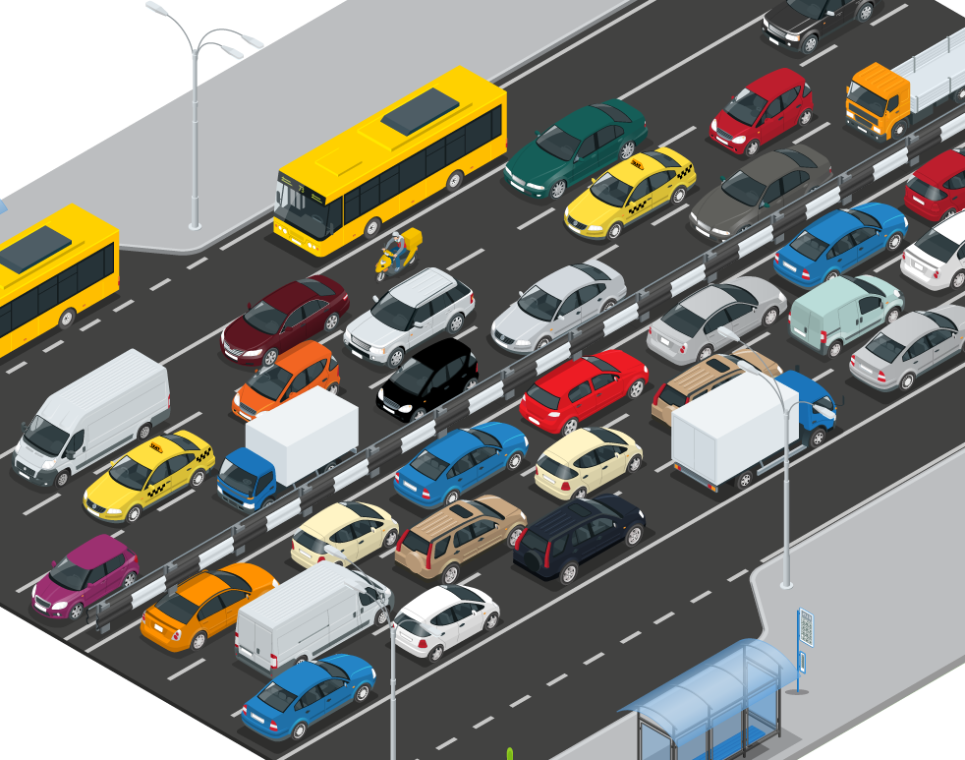
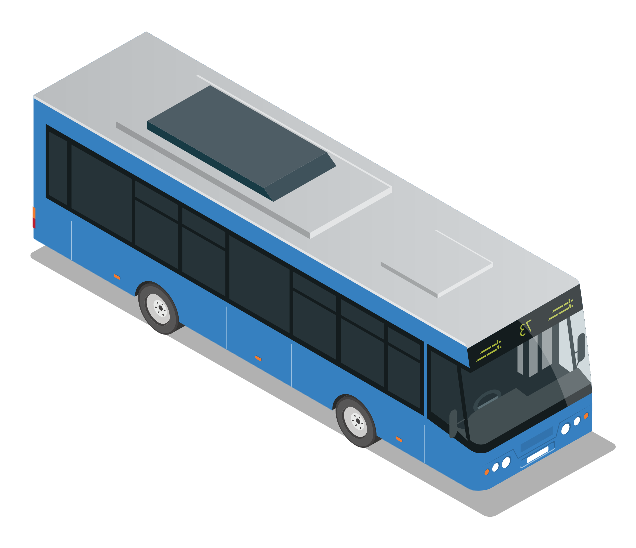
Strategic Focus
10% of US households
do not have personal transportation
45% of US households
do not have access to
public transportation
>25 million
disabled people in the US have difficulty traveling outside of home
Solve for Congestion
Enable Mobility
Transform Public Transit
Pursue the root cause and force multiplier of major transportation issues – carbon emissions, noise pollution, road safety
Enables urban transformation: pedestrianization, green space, etc.
Reduce infrastructure needs and costs
Connect underserved communities
Deliver first and last-mile services to connect people, goods and services
Provide safe and accessible solutions designed around the passenger experience
Leverage autonomous vehicle and smart city tech for improved service efficiency
Increase ridership by improving passenger experience and extending reach
Supplement and extend existing modes with dynamic, data-driven services

Slide 4



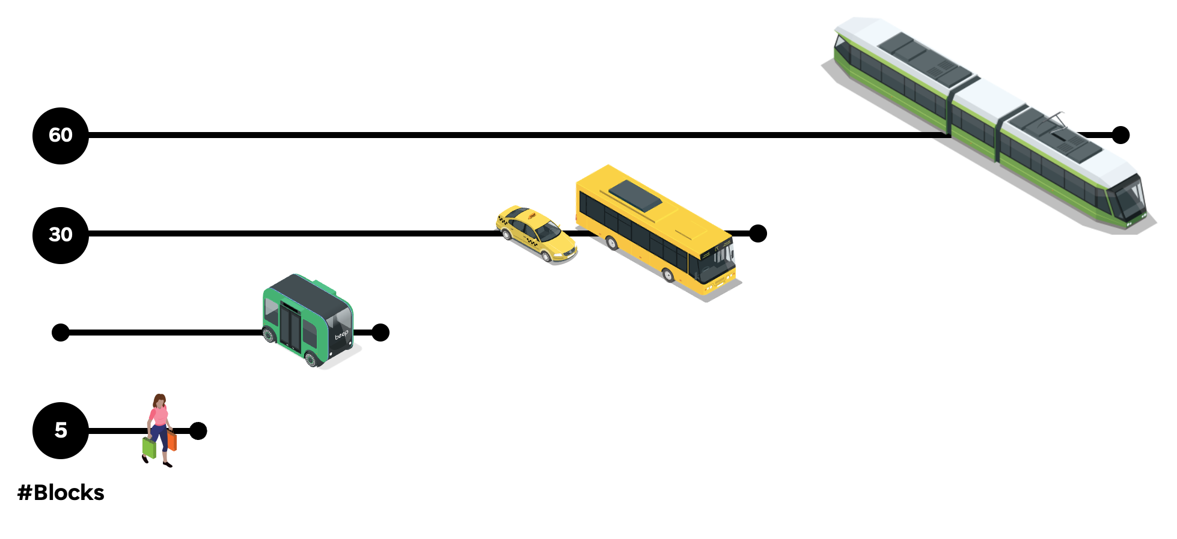
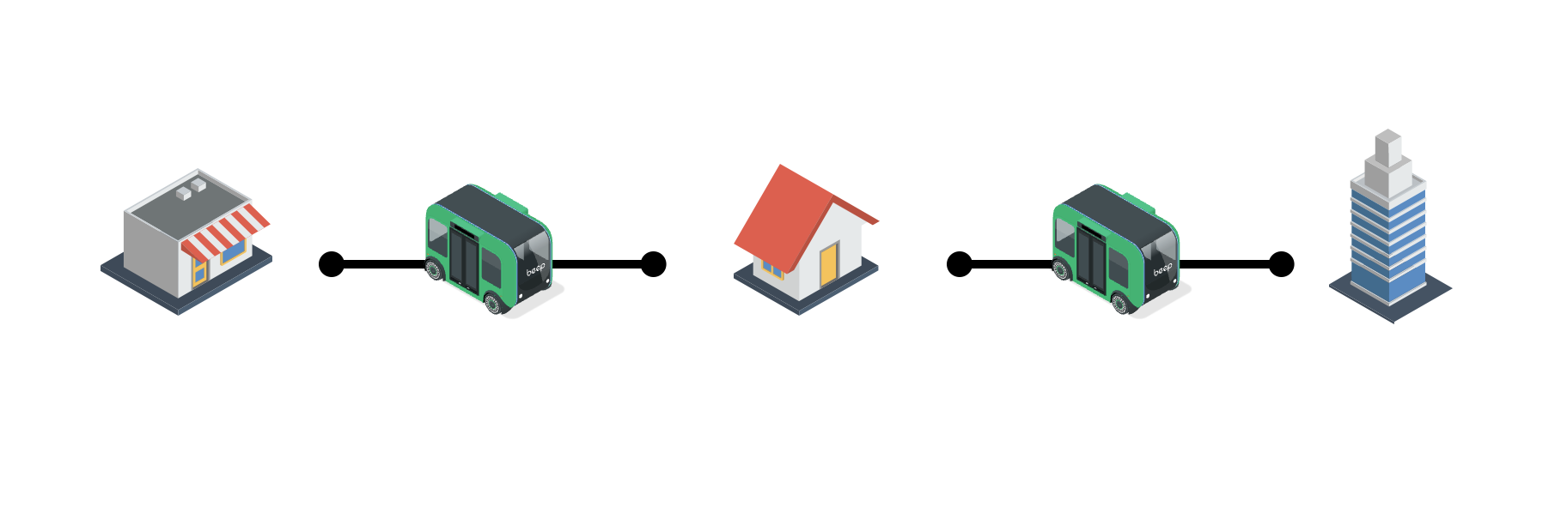

Enabled by Autonomy: The Multi-Passenger Form Factor
Micromobility represents most underserved segment for U.S. transportation access
Multi-passenger form factor provides unique advantages for enabling mobility, reducing traffic, extending public transit access
Autonomous vehicle platforms will first be adopted in more controlled ODDs
Next-generation platforms will transform mobility
Frequency
Connect communities
Provide onramp to public transit
Fill the short-haul urban gap
Frequency
Capacity
Capacity

Slide 5




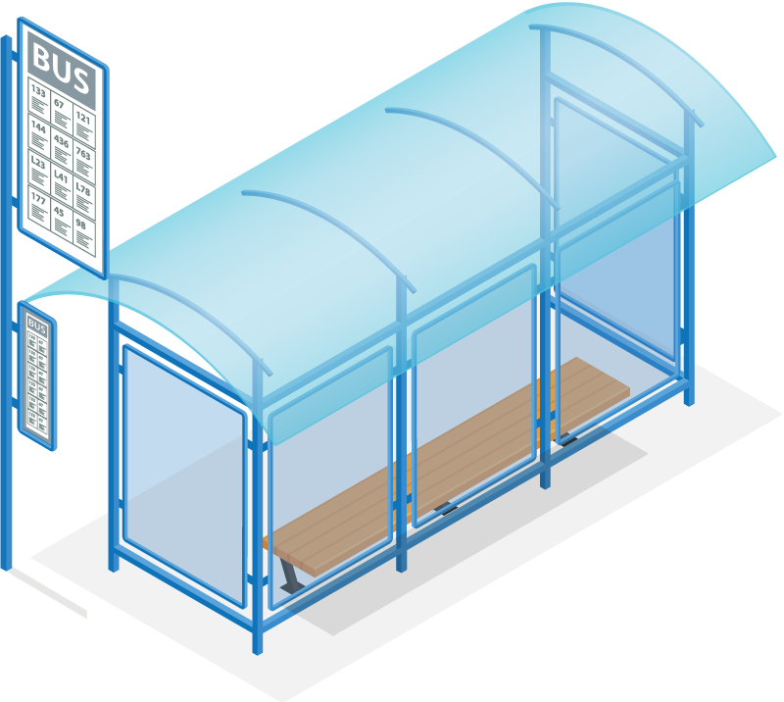



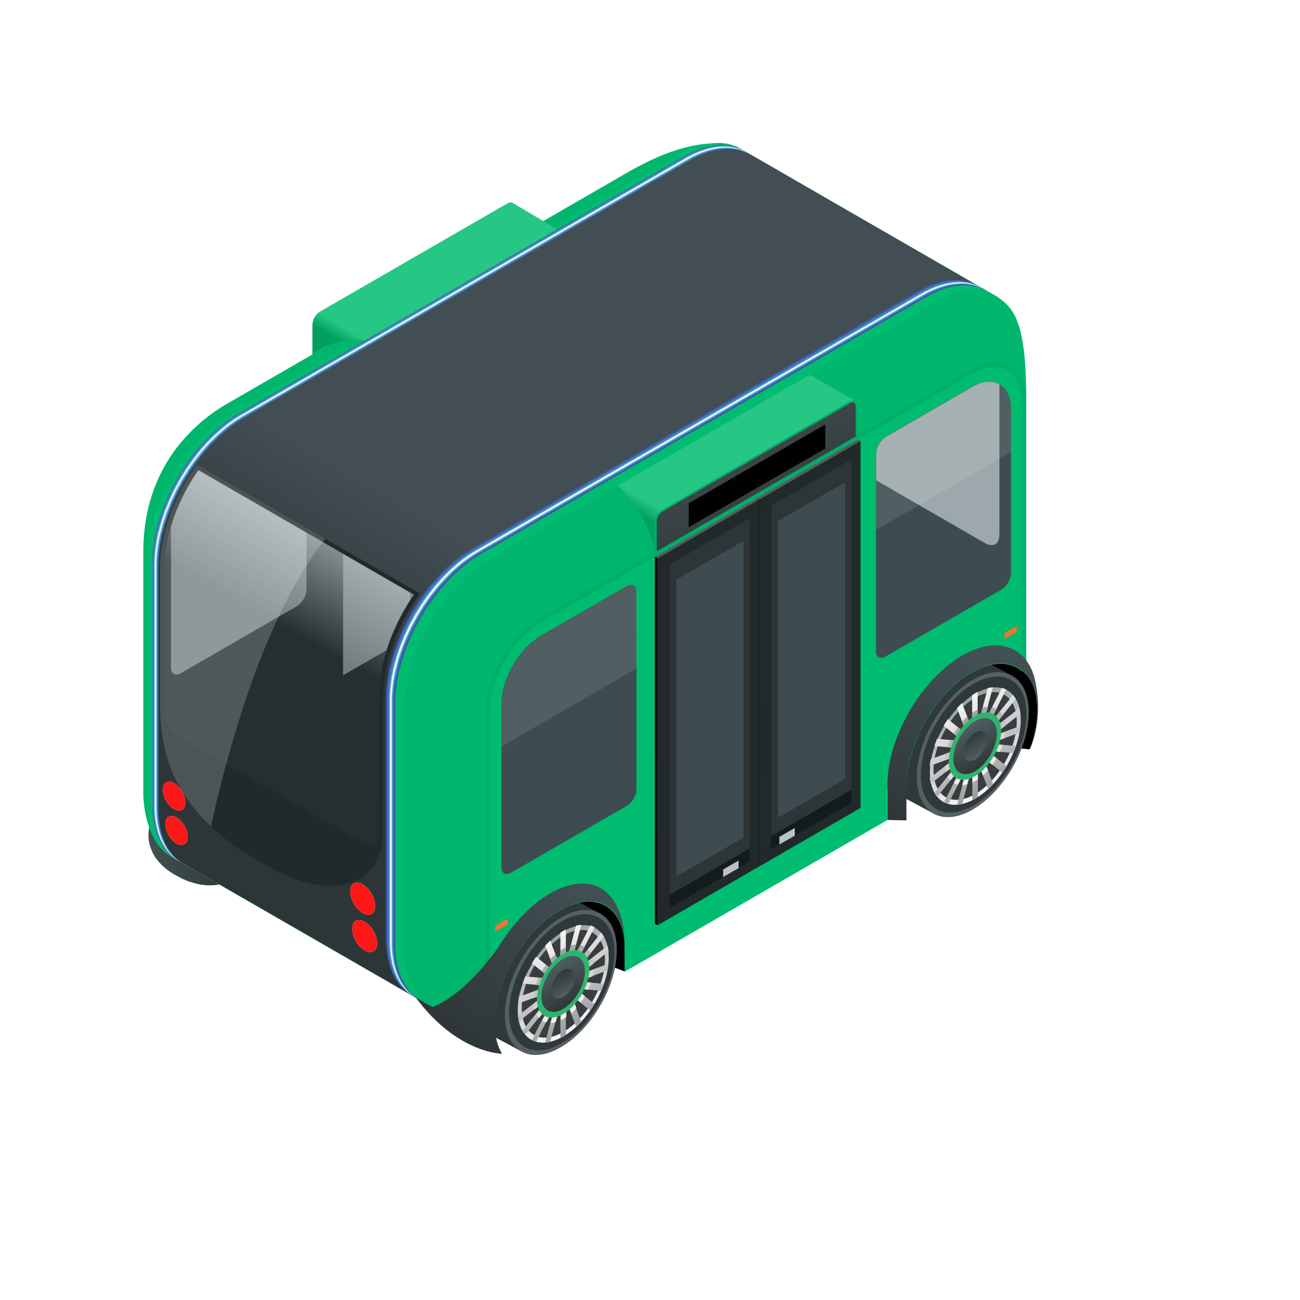
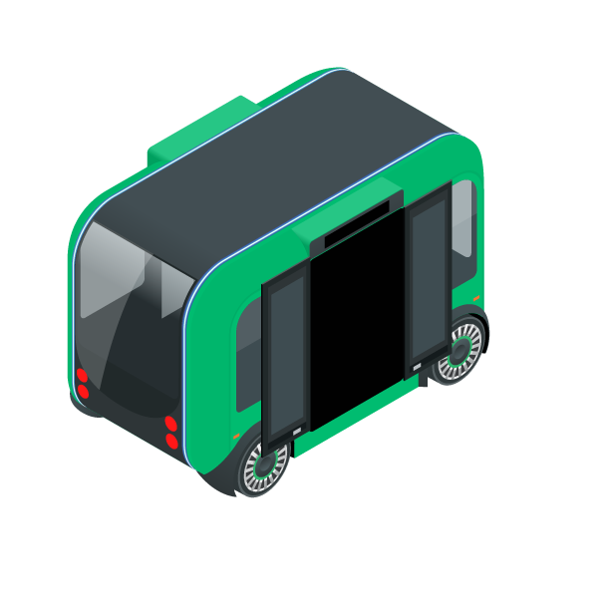

Beyond Physics
Edit waypoint, bypass obstacle
Pass via oncoming lane when safe to do so
Wait until obstacle is cleared
Play an announcement, open doors
Is anyone waiting at or for the next stop?
Is the shuttle on time and at target headway?
How’s the weather?
What’s the truck driver doing?

Slide 6

















Industry Leadership
179,300
154,000
600
Live Road Hours
Passengers Carried
First Responders Trained

Slide 7
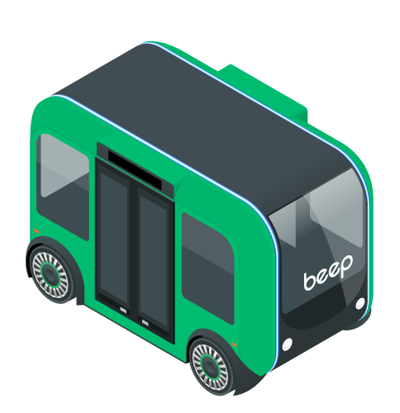







Broad Range Of Use Cases
public sector
private sector
Community Redevelopment
Transform mobility accessibility
and activate communities
Planned Communities
Connect residential, retail and business
Transit Extensions
Extend first and last mile mobility routes to existing networks
Colleges & Universities
Provide student, visitor and employee transportation
City Centers
Reduce traffic congestion, resolve parking constraints
Healthcare & Business
Service campus buildings and remote parking areas
Airports and Event Centers
Upgrade to eco-friendly platforms and enhance connectivity
Senior Living
Address on and off property needs of residents

Slide 8
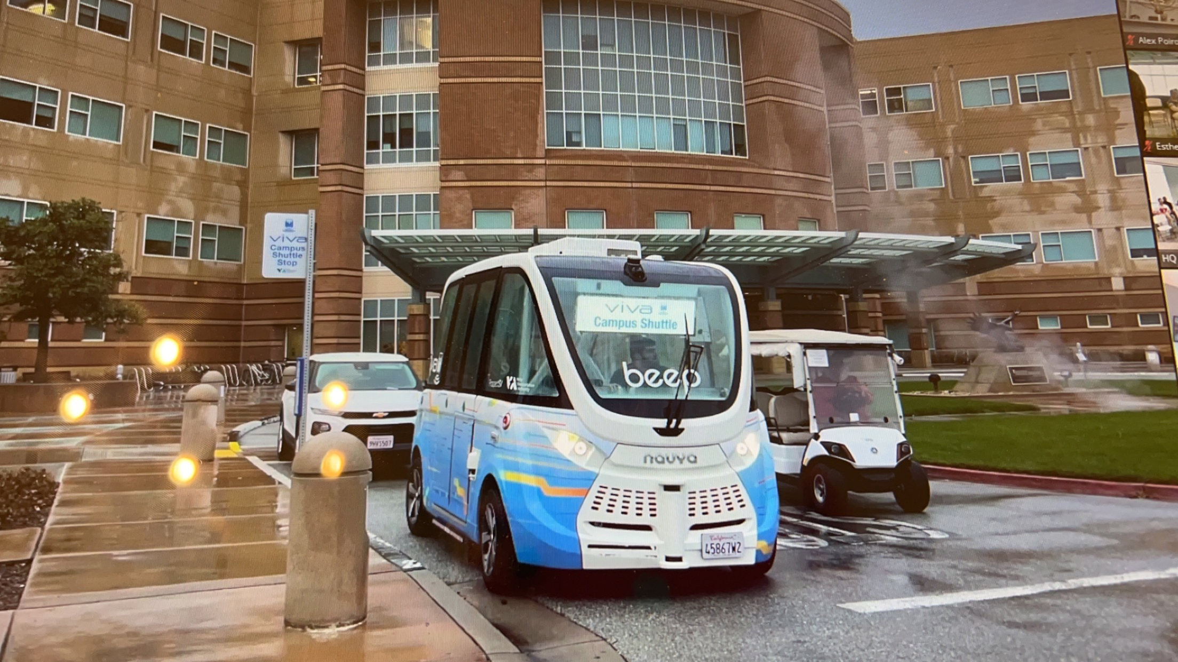
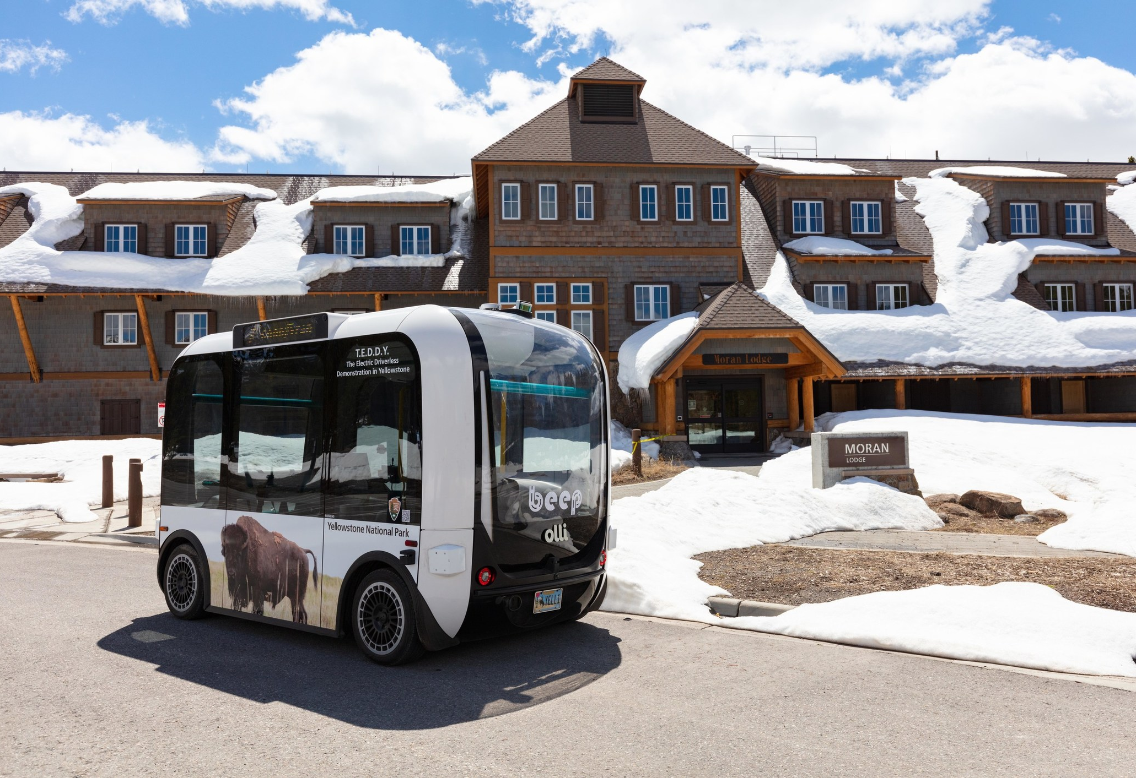


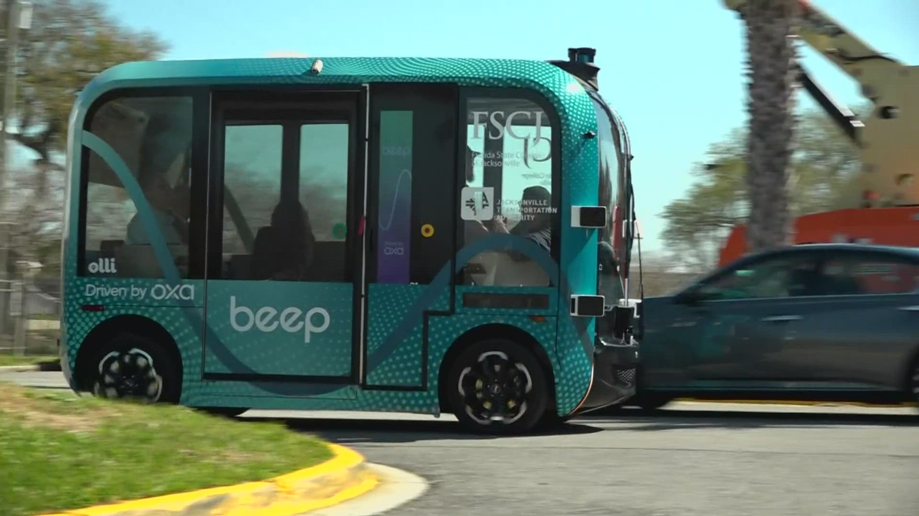
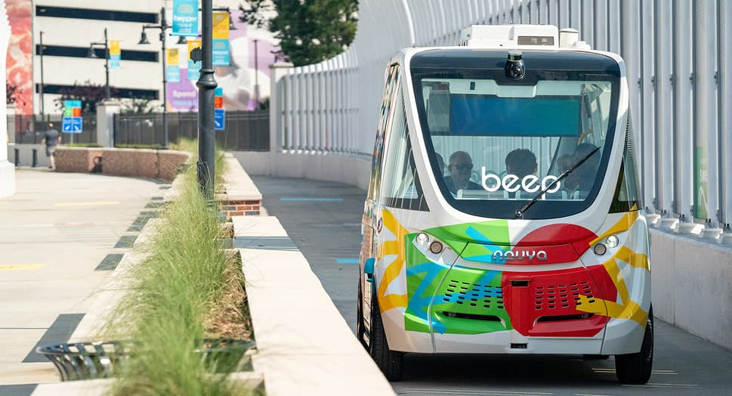
U.S. Pilot Programs | Active and Previous
Active (or upcoming)
Previous
FTA funding

Slide 9
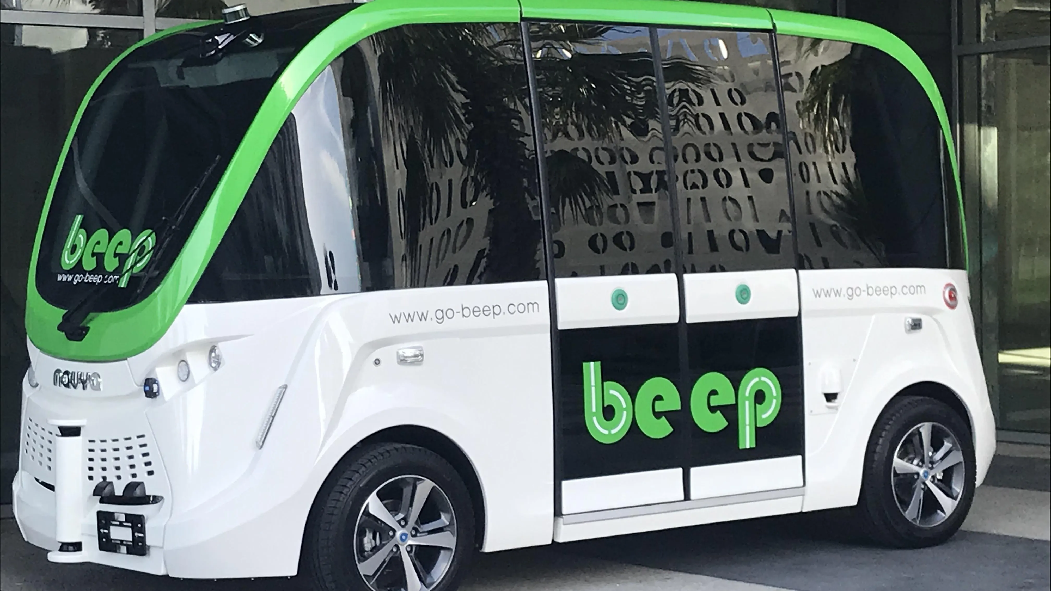
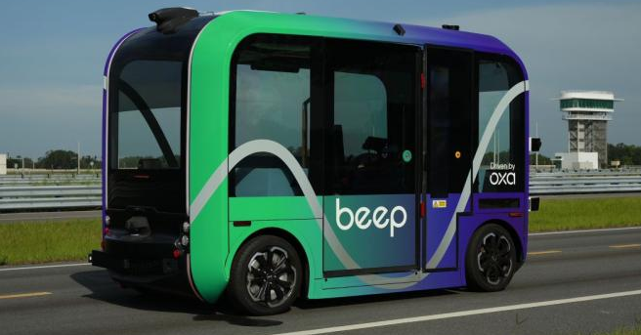
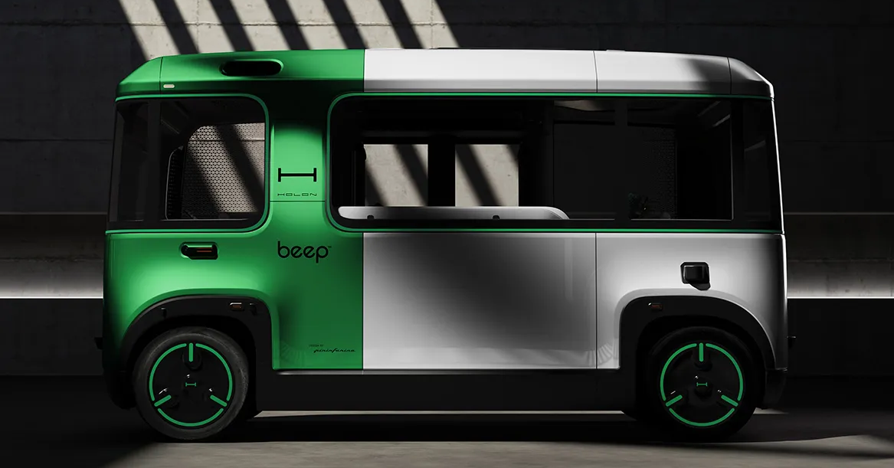
Review & Outlook
Early Research & Demonstration
(2018-2023)
Developing a nascent technology
Demonstrating viability
Preparing for Scale
(2024-2026)
Applying operational lessons
Piloting next-generation capabilities
Industrialization
(2026-)
Serial production
Multimodal integration
Workforce transitions
Post | Feed | LinkedIn

Slide 10




Beep Next-Generation Shuttle Requirements
Automotive-grade platform
Industrialized manufacturing
Mass production pricing
Key component redundancy
Safety, quality and reliability
Meets U.S. compliance requirements
FMVSS (applicable)
Buy America
ADA
Altoona
Enhanced autonomous technology
Fused sensor/camera platforms
Full V2X integration
SAE Level 4 Autonomy
Onboard audit governance
Expanded service capabilities
Longer routes
More complex deployments
Enhanced user experience
Road user communication

Slide 11



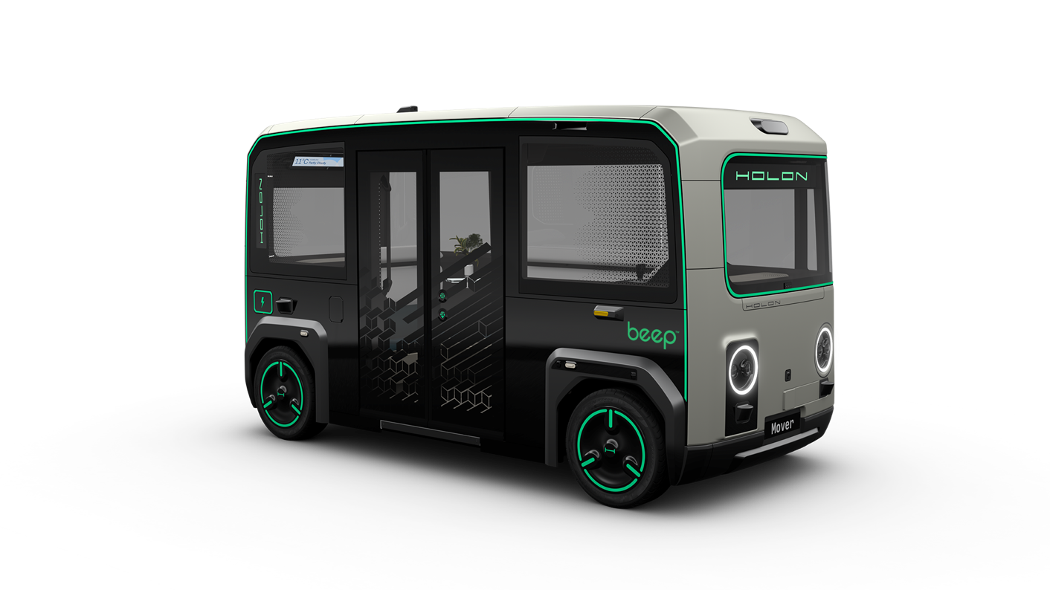
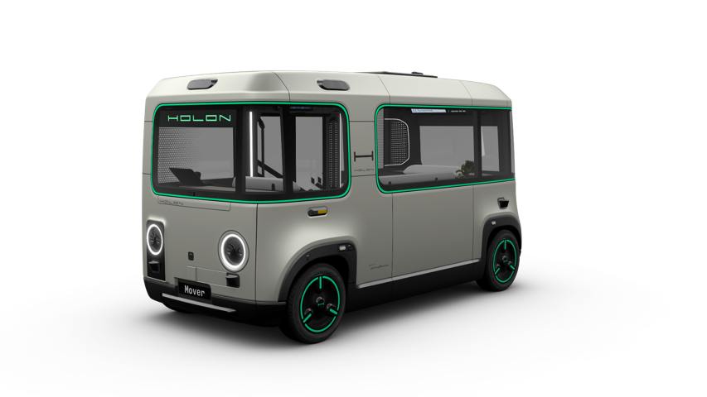

A World-Class Next-Generation Platform
Beep has partnered with HOLON, a division of Tier 1 automotive supplier Benteler A.G., and self-driving leader Mobileye to develop and deliver a new generation of
purpose-built, autonomous, electric shuttles.
Designed by Pininfarina, these vehicles will deliver automotive-grade build and ride quality, extended operations through high-capacity battery and power systems, and significantly enhanced automated driving systems.
Beep’s AutonomOS™ Service Experience platform will be integrated into each vehicle, providing in-cabin monitoring, service governance and mission compliance, and virtual steward technology to ensure a safe and enjoyable ride.
Battery Electric Vehicle
SAE Level 4
Autonomous Drive System
Upgradable
Over-the-Air Updates
Supervised
15 passenger cabin
Made in USA
Transit Class
Gross Weight 10,582 lbs
Curb Weight 7,055 lbs
Appealing
Large, Airy, Modern Interior
Approachable
Asymmetric Design
Safe
37mph Top Speed
Redundant Lidar, Radar
and Camera Sensors
Long Range
180 Miles 90 kWh
7 hr Operating Time
9 ft 1 in
Accessible
10.6” Step-In Height
Automatic ADA-compliant Wheelchair Ramp & Restraints
8 ft 2 in
16 ft 3 in
Confidential and Proprietary – NDA only

Slide 12
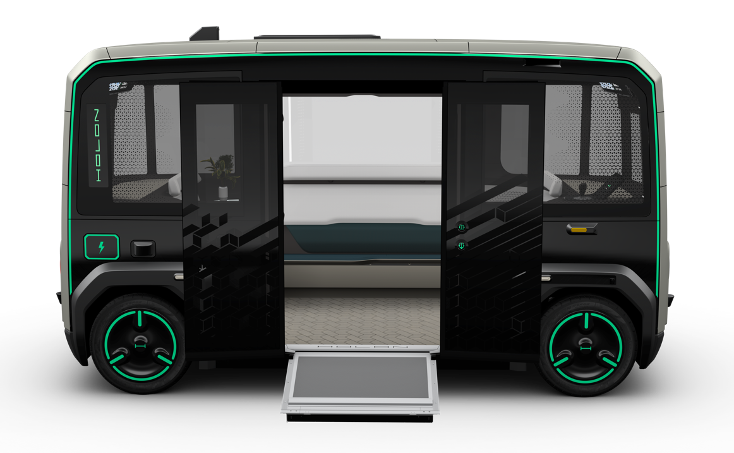
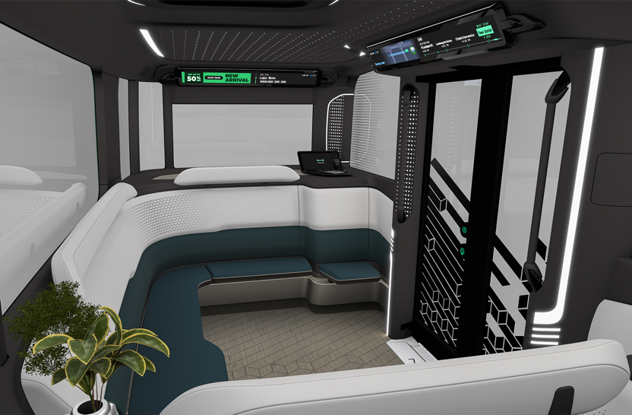
Integrated Beep AutonomOS™ Service Governance & Passenger Experience
Revenue Generating
Targeted advertising platform commands premium CPM rates
Virtual Steward
Passenger-friendly AI persona and UI provides service information
Supervised
AI-enabled in-cabin monitoring for passenger safety, medical emergencies and uncivil behavior
Service Governance
AutonomOS On Board module
provides mission monitoring and data collection for deep learning and service optimization
Notes:
revenue-generating screens
AI/computer vision passenger experience
Beep Box

Slide 13
Supervised
AI-enhanced in-cabin monitoring
Top Speed | 37 mph
Range | 180 miles
Power | 150 kW
Capacity | 11 seated + 4 standing
GVWR | >10,000 lb
Dimensions | 16.3’ L x 8.2’ W x 9.2’ H
Step-In Height | 10.6”
ADS | Mobileye Drive
Service Governance | Beep AutonomOS
Accessible
10.6” Step-In Height
Automatic ADA-compliant Wheelchair Ramp & Restraints
Notes:
revenue-generating screens
AI/computer vision passenger experience
Beep Box

Slide 14
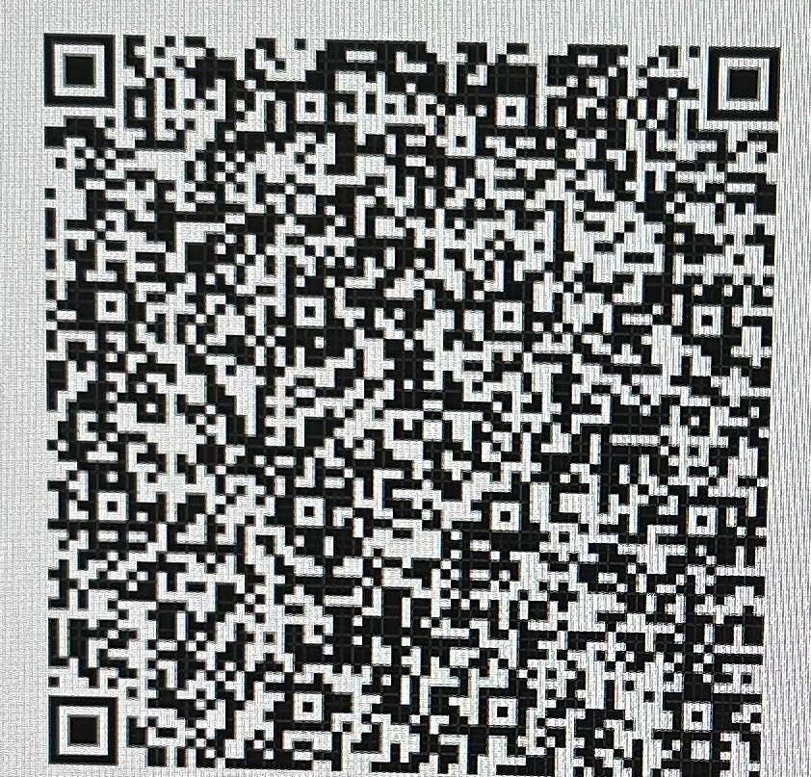
Brandon Corsentino
Director, US East
Brandon.Corsentino@ridebeep.com
631-645-3850
See you May 16th!

Slide 15


Mary Sunshine House
Comprehensive independent living community for adults with neurodevelopmental/autism spectrum disorders
Website: www.Marysunshinehouse.org
Email: info@marysunshinehouse.org
Notes:
John

Slide 16
Why the need for Mary Sunshine House?
National Challenge-
Limited choices for families
Limited access with a growing need
Inadequate housing options
Cost prohibitive
Low availability and increasing wait lists
MSH Response-
In the Southeast, few options exist for semi-independent living that offer full wraparound programs like MSH.
MSH is meeting a growing need as more autistic youth enter adulthood.
MSH provides a cost effective and proven strategy to encourage healthy, safe living for adults with autism.
Housing is a powerful social determinant of health; lack of housing for people with ASD has an even greater impact as it leads to displacement from one’s community of support.
Notes:
John

Slide 17
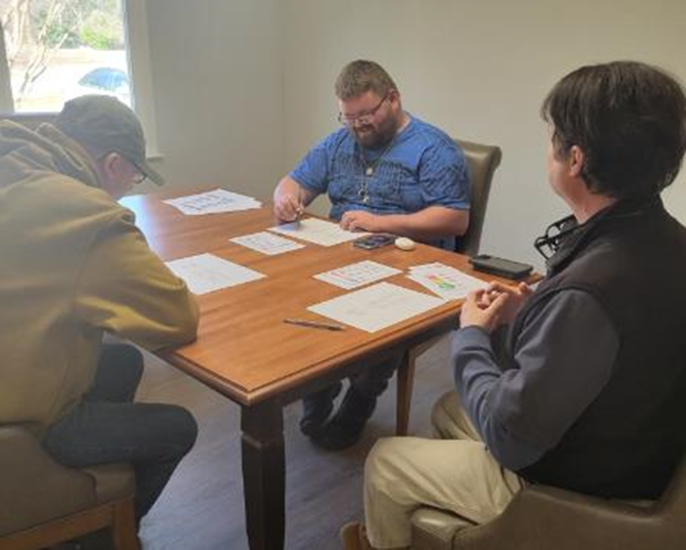
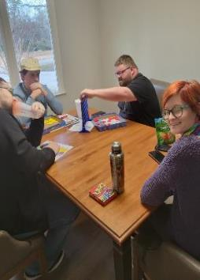
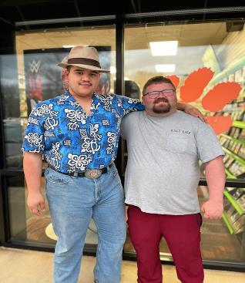

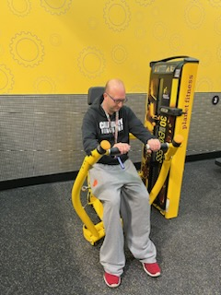
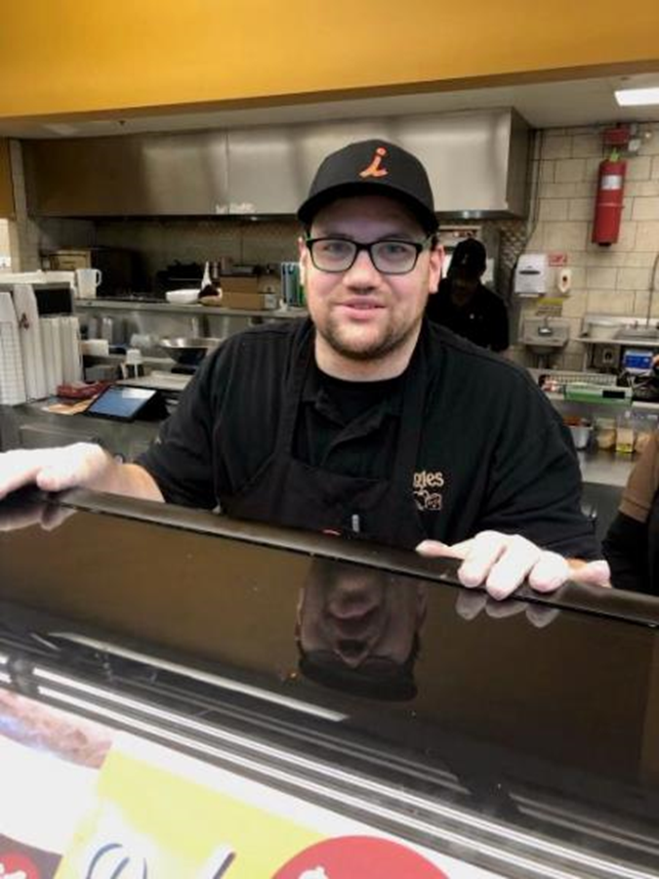
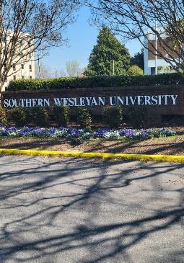
Mary Sunshine House Programs
Apartment Living
Socialization
Education
Employment Development
Community Integration
Notes:
Brian

Slide 18
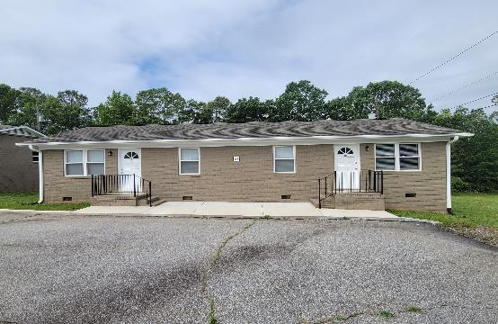
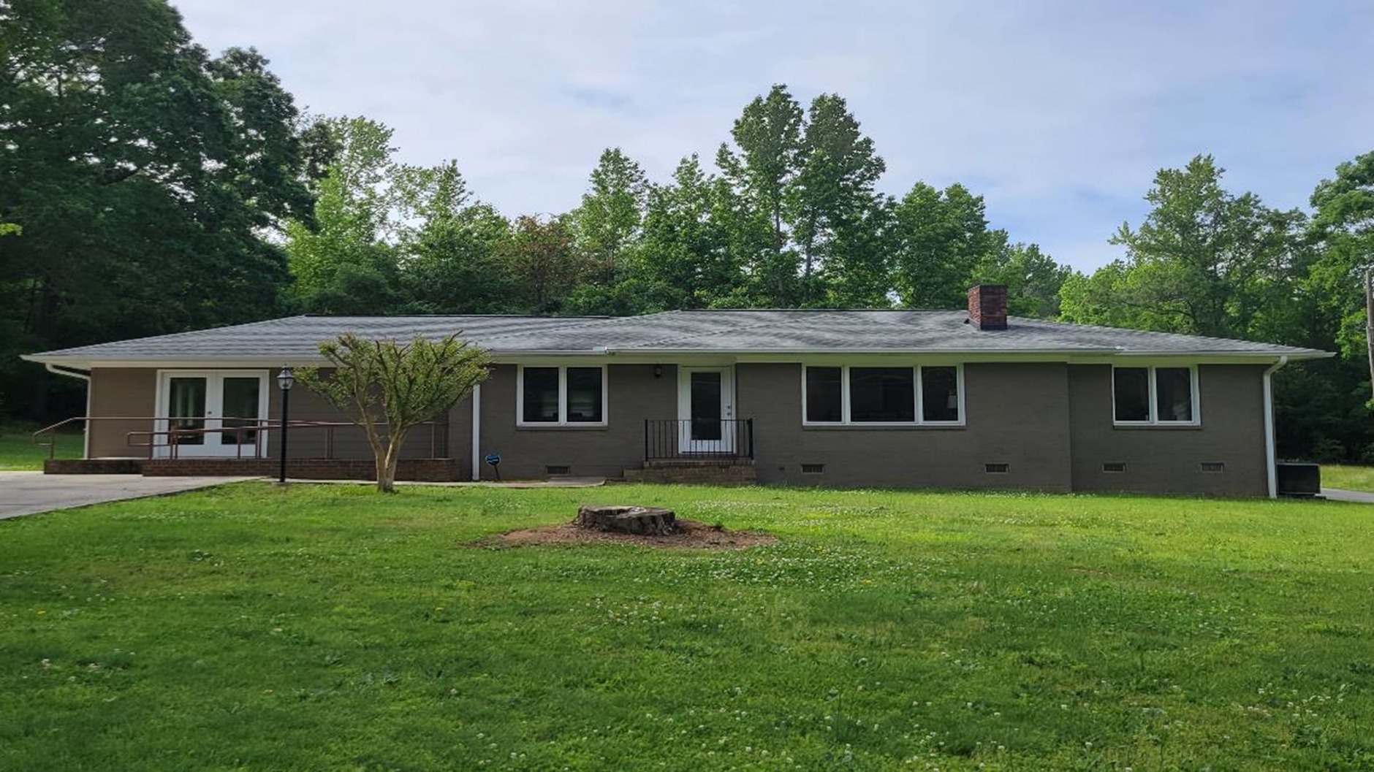
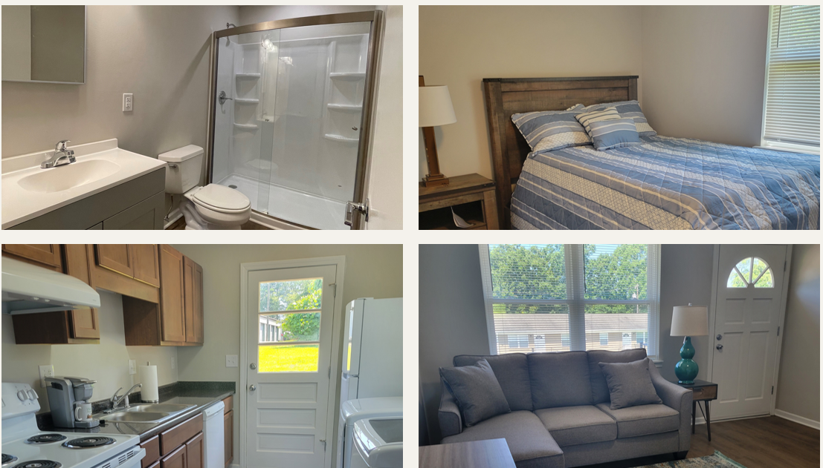
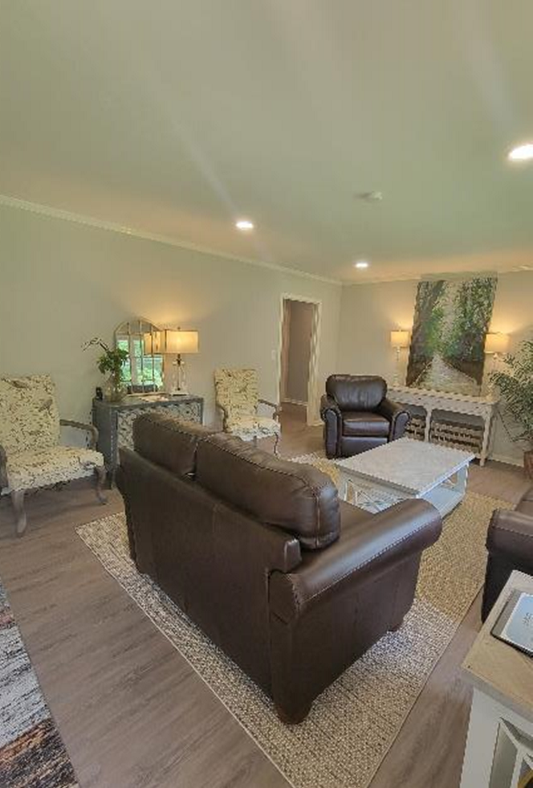
Notes:
Brian

Slide 19

Key Contributors/Investors Update
Sunshine Lady Foundation
Southern Wesleyan University
South Carolina Physicians Care Charity
Abney Foundation
Barbara Stone Foundation
Fellowship Greenville
All In (Dabo’s) Foundation
TD Bank
Katherine Smith Family Foundation
Board of Directors - MSH
George Shinn
https://www.gaaclassiccars.com/vehicles/39724/2012-ford-mustang
Notes:
John starts Brian Ends

