Slide 1
TATT
A BIG
-
chat
June 13th, 2024
thanks to…
Welcome
Todd Horne, TATT Board Chair
Guest Speaker
Bob Quinn, SCRA
Resource Update
Craig Scharton, TATT/UEE Upstate Downtown Academy
Adjourn
Todd Horne, TATT Board Chair
Our
Partners
Leadership-Level
Next TATT Chat - July 11, 2024

Slide 2
July 10, 2024
Clemson, SC
You’re invited to join TATT and the Upstate Mobility Alliance at the SC Rural Transit Day in Clemson, SC on July 10, 2024.
SC Rural Transit Day serves as a pivotal platform dedicated to championing the interests of South Carolina’s rural communities, aiming to address the distinctive transportation challenges they face while fostering connections to alleviate existing disparities and inequities. The event serves as a nexus for advocacy, bringing together elected representatives, various organizations, stakeholders, and transit experts to delve into the intricacies of rural transportation.

Slide 3
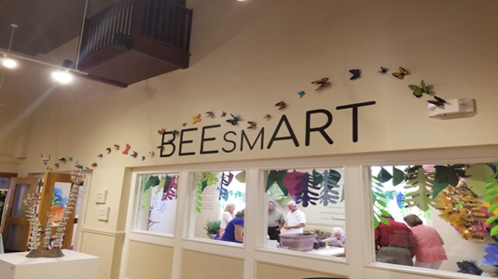
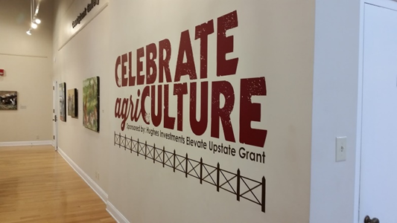
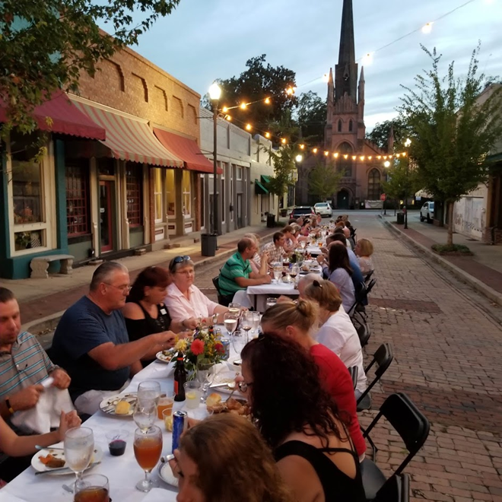
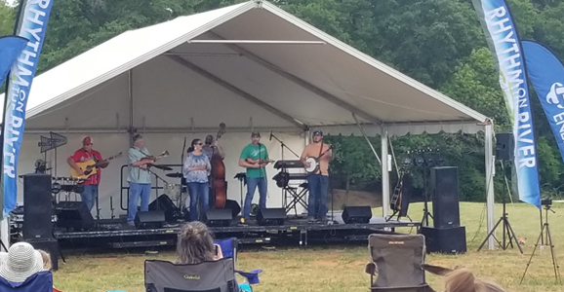
Hughes Investments Elevate Upstate Community Vibrancy Grants
Who Qualifies:
Neighborhood associations
Civic & community organizations
Nonprofit organizations
Local governments
Where should the applicants be located?
Each should be located and work within the 10 Upstate counties:
Abbeville, Anderson, Cherokee, Greenville, Greenwood, Laurens, Oconee, Pickens, Spartanburg, & Union Counties
Timeline:
Interest forms are due August 9, 2024
Final grant application due September 20, 2024
Finalist Presentations November 19, 2024 at TATT’s Celebrating Successes Event at the Greenville Convention Center

Slide 4
SCRA: Past, Present, and Future
Bob Quinn
June 13, 2024

Slide 5
ABOUT US Our History & Mission

Slide 6
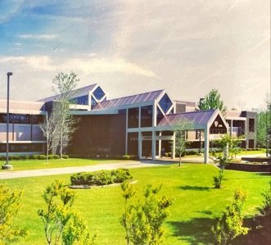
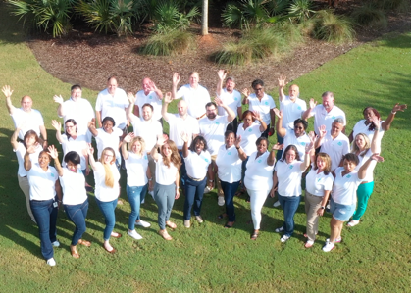
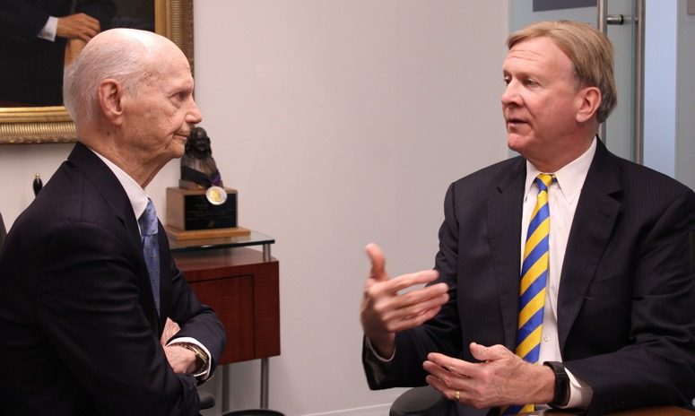
Our History
1983
SCRA established by SC General Assembly as a public, non-profit organization
1998
Henderson Building
Staff celebrating 40 years
Advanced Technology International (ATI) established
2006
SC Launch and Innovation Centers established
2017
ATI sold
2023
Secretary Richard Riley and Bob Quinn
SCRA celebrates 40 years

Slide 7
Our Mission
SCRA fuels South Carolina’s innovation economy
…by accelerating
technology-enabled growth of academia, entrepreneurship, and industry.

Slide 8
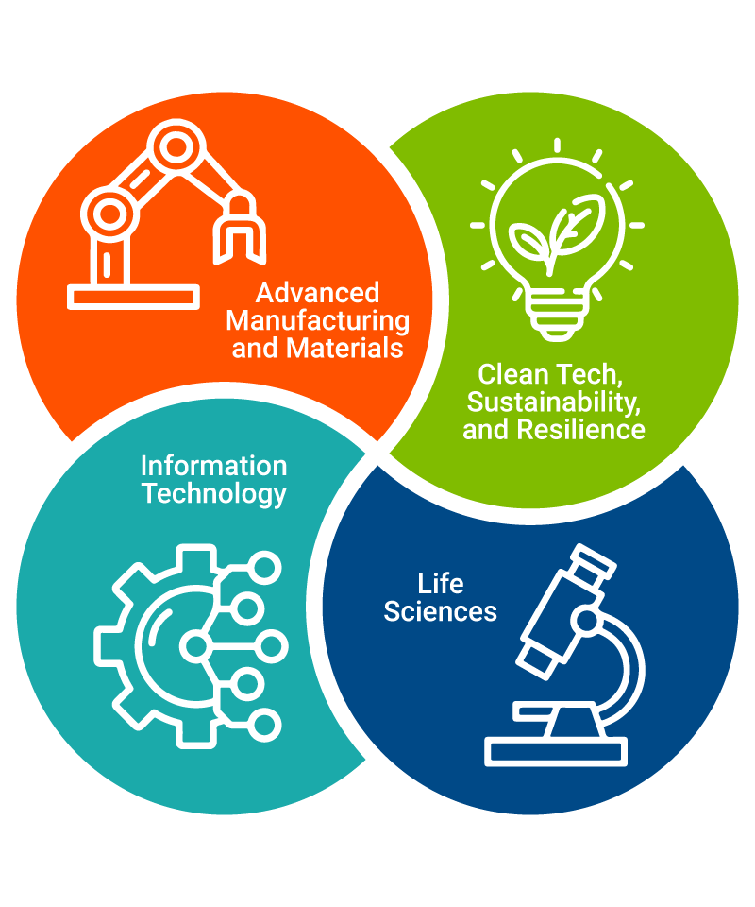
Sectors of Focus
SCRA brings together the key players in innovation. By working in close alignment with academic institutions, entrepreneurs, and industry, four key areas of focus have been defined as being the drivers of South Carolina’s innovation economy:
Advanced Manufacturing and Materials
Information Technology
Life Sciences
Clean Tech, Sustainability, and Resilience
Notes:
These key sectors align with South Carolina’s workforce strengths, institutional research, and existing companies. The intersection of multiple sectors yields the most significant potential for innovation and economic growth.

Slide 9
Our Economic Impact (FY23)
ANNUAL ECONOMIC
IMPACT ON SC
$1.19
BILLION
$91.2K
5.8K
SC JOBS
AVERAGE SALARY
$680M
SCRA operations and programs supported 5,825 SC-based
jobs in FY23.
The $91,209 average salary of SCRA Member Companies is
70% higher than the average state salary of $53,618.
Through follow-on funding to member and portfolio companies, up to an additional $680 million was contributed to the state's economy.

Slide 10
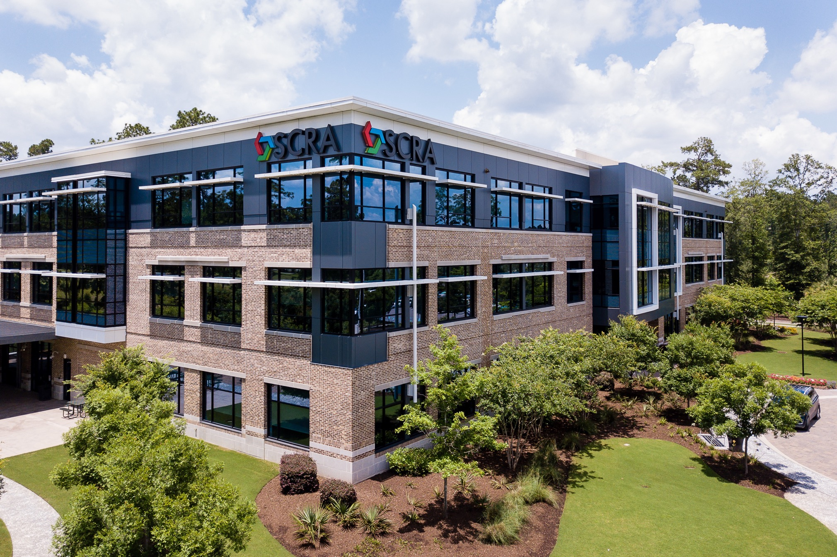
FACILITIES

Slide 11
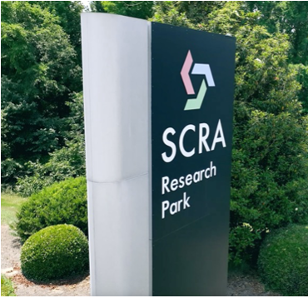
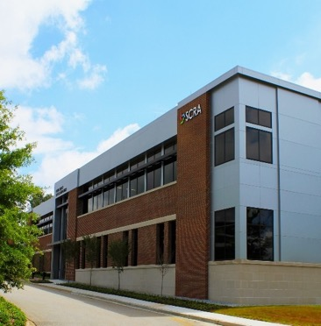
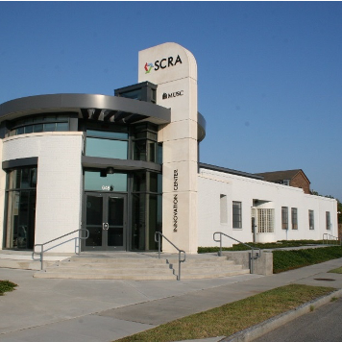
SCRA Innovation Centers & Facilities
22
WESTEDGE
Charleston, SC
APPLIED TECHNOLOGIES CENTER
Summerville, SC
CAROLINA RESEARCH PARK
Columbia, SC
DUKE ENERGY INNOVATION CENTER
Anderson, SC
MUSC INNOVATION
CENTER
Charleston, SC
USC INNOVATION
CENTER
Columbia, SC

Slide 12
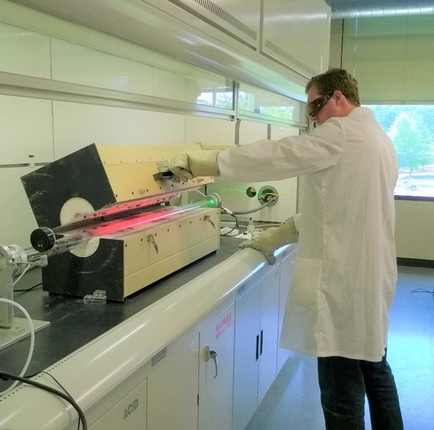
Success Story: Partnerships Driving Innovation
SCRA Facilities team collaborates with the state’s three research universities, Clemson University, the Medical University of South Carolina, and the University of South Carolina. SCRA’s Duke Energy Innovation Center is near Clemson, the USC Innovation Center and the Carolina Research Park are near USC, and the MUSC Innovation Center and 22 WestEdge are near MUSC.
The Clemson Nanomaterials Institute, a Duke Energy Innovation Center tenant, researches various nanomaterials' fundamental properties and applications.
SC Launch Inc. Portfolio Company Precision Genetics, a tenant of the MUSC Innovation Center, is delivering one example of life-saving innovation.
The facilities team continues to work with the McNair Aerospace Center, a tenant of the USC Innovation Center. They have fostered the Center from its origins to be a state-of-the-art facility that now accommodates various types of innovation under one roof that meets the state’s research and development needs.
Notes:
The Clemson Nanomaterials Institute, an Anderson Innovation Center tenant, researches the fundamental properties and applications of various nanomaterials (particles that are smaller than a strand of hair). Its cutting-edge multidisciplinary research aims to push the frontiers of nanoscience forward and significantly impact industry. The institute has approximately 6,000 square feet of research space that houses various synthesis and characterization equipment. It collaborates with seven industrial partners, and nearly 10 faculty members and 25 students and post-doctoral students work on multiple projects in the facility.
SC Launch Inc. Porfolio Company Precision Genetics, which is also a tenant of the MUSC Innovation Center, is delivering one example of life-saving innovation. They are modernizing the standard of care by enabling doctors and other providers to prescribe medications with more precision and safety. Their solutions help provide better patient outcomes designed to lower overall healthcare costs.
The facilities team also continues to work with the McNair Aerospace Center, a tenant of the USC Innovation Center. They have fostered the Center from its origins to being a state-of-the-art facility and programs that now accommodate various types of innovation under one roof and meets the state’s research and development needs. AI and digital twins technologies are just two innovations being utilized by the digital transformation lab and future factories laboratories.

Slide 13
SCRA MEMBER BENEFITS

Slide 14
Types of Support
COACHING AND SUPPORT FROM SCRA TEAM AND ALLIANCE PARTNERS.
COACHING
GRANT
FUNDING
VARIOUS TYPES OF GRANTS TO DE-RISK TECHNOLOGY AND BUSINESS.
NETWORKING & MARKETING SUPPORT
INVESTMENTS
ALLIANCE PARTNERS, NETWORKING EVENTS, AND MARKETING SUPPORT.
COMPANIES MAY BE ELIGIBLE FOR SC LAUNCH INC. INVESTMENTS.

Slide 16
ACADEMIC INNOVATIONS

Slide 17
Funding Opportunities
Early-stage Startups
Academic Research
Federal Matching Grant
Up to $50,000
Matching funds to accelerate Federal research dollars obtained by SC small businesses, in particular support for SBIR/STTR Phase 1 awardees to position them for Phase 2 funding.
Academic Matching Grant
Up to $15,000
Matching funds awarded to institutions of higher education to expand the impact of their funding for commercially relevant technology development.
Academic Startup Grant
Up to $25,000
Early-stage funding for startups that are advancing academic IP to support achieving critical milestones toward commercialization.
SACT Collaborative Research Grants
$6.7 million over three years
SCRA-Academia Collaboration Team (SACT) funding for multi-institutional research developing innovative approaches for SC industry.

Slide 18
Success Story: Providing Resources to Meet Research and Development Goals
The academic innovations team aligns resource offerings with technology transfer office stakeholders and researchers by providing mentoring, access to subject matter experts, and targeted grant funding to advance technology and startup development. While SCRA’s support varied in type, the common thread was providing the services each research university needed to meet its goals, which also fueled innovation for South Carolina.
Purchased educational programs, databases, and innovation toolkits that helped research faculty advance technology development and create a commercialization strategy.
Provided funding to help them reach their goals by expanding their Columbia-based Innovation Hub into the Upstate.
Funded and supported MUSC’s Zucker Institute for Innovation Commercialization to conduct market research and provided professional training and development to help researchers identify future customers, investors, and partners.
Notes:
Examples of support at Clemson University included funding for CURF (Clemson University Research Foundation) to purchase educational programs, databases, and innovation toolkits that helped research faculty advance technology development and create a commercialization strategy. “Our relationship has evolved to mutual investment in high commercial potential technologies through the technology maturation match program, resulting in numerous follow-on grant support, commercial licensing, and start-up formation,” said Clemson University Research Foundation Executive Director Chris Gesswein.
SCRA’s academic innovations team also provided funding for the University of South Carolina’s Office of Economic Engagement to reach its goals by expanding its current Columbia-based Innovation Hub into the Upstate. The new center is called the USC Upstate Innovation Experience Hub and provides advanced engineering solutions and industry-skilled graduates to support manufacturers in the Upstate. This is a win for the state as South Carolina has become a top destination for manufacturing companies. “At the USC Office of Economic Engagement, our work with SCRA academic innovations is a team effort. That means our USC and SCRA teams are engaging monthly to compare caseloads to ensure we do not miss anybody who needs our collective assistance,” said Deputy Director Chad Hardaway. “Working with Russell Cook and the team has been a pleasure, and we have done great work together taking care of our innovation community.”
The Medical University of South Carolina Zucker Institute for Innovation Commercialization also benefitted from the academic innovations team’s funding and support. This included funding for market research and professional training and development to help researchers identify future customers, investors, and partners.
These initiatives leverage the state’s strengths and resources to positively impact patient care and continue developing our life science workforce. “Our collaborative engagement exemplifies the power of aligning vision and resources to drive breakthrough innovations, ensuring that MUSC’s research and clinical work is translated into impactful commercial outcomes,” said Zucker Institute CEO Todd Headley. “This partnership strengthens our commitment to pioneering solutions and reinforces SCRA’s dedication to facilitating academic advancements in South Carolina.”

Slide 19
INDUSTRY SOLUTIONS

Slide 20
Addressing Industry Needs
INDUSTRY
NEEDS
Our team works with industry partners to understand their capabilities and needs.
FIND PARTNERS
Depending on the needs, SCRA works with academic researchers and/or entrepreneurial companies with tech-based solutions to address the needs.
STRATEGIC PARTNERSHIPS
R&D EFFORTS
HIGH-TECH SOLUTIONS

Slide 21
Funding Opportunities
Demonstration Grants
Amounts Vary
Benefits both an industrial partner and a smaller company and/or academic institution by lowering technical or business risk through technology demonstration.
Relocation Grants
Amounts Vary
Established, technology-based companies looking to move to
South Carolina can apply for the relocation grant.

Slide 22
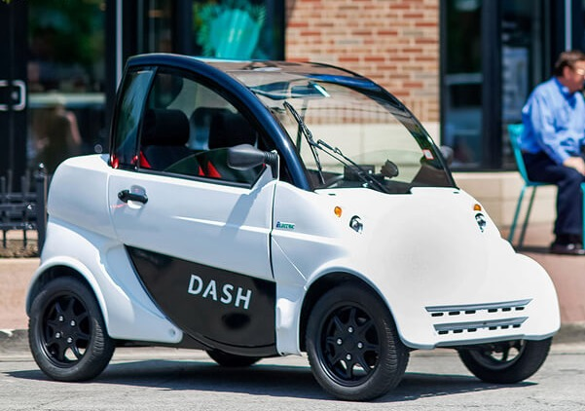
Success Story: Testing New Technologies
The SCRA Industry Solutions team partnered with Clemson University Watt Innovation Center to host a pilot kick-off event that showcased 24 DASH vehicles deployed around campus. The vehicles securely fed data about nearby pedestrians, location, speed, use patterns, and other critical information to a central control center. This demonstration project created a testbed for expanded operations anywhere.
Demonstration projects such as this one are critical for showing the impact of new technology in South Carolina.
Relocation and demonstration grants provide a complete solution for a startup to move to the state and begin showing the impact of their new technology.
[

Slide 23
SC LAUNCH & SC LAUNCH, INC.

Slide 24
Funding Opportunities
Project Development
Fund Grants
Up to $25,000
Early-stage development funding for companies not affiliated with an academic institution.
Acceleration
Grants
Up to $50,000
Later-stage development funding. Each company is eligible for one grant during
its lifetime.
SC Launch Inc.
Investments
Member Companies may receive investments from SC Launch Inc. upon approval by the SC Launch Inc. Board.

Slide 25
By the Numbers: SCL and SCL Inc.
$2.66B
$45.93M+
$17.06M
INVESTMENTS MADE
FOLLOW-ON FUNDING
GRANTS AWARDED
Total amount of SC Launch Inc.’s
investments made in
123 SC Launch Inc.
Portfolio Companies
since 2006.
Total amount of additional capital
raised by SCRA Members Companies and SC Launch Inc.
Portfolio Companies
since 2006.
Total amount of
entrepreneurship
program grants awarded
to 257 SCRA Member Companies since 2006.

Slide 26
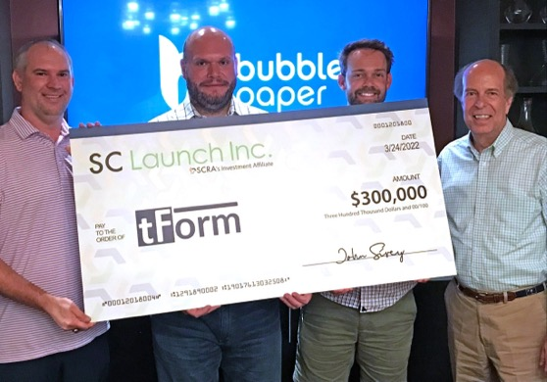
Success Story: Bubble Paper A Gamechanger in the Packaging Industry
Bubble Paper, an advanced manufacturer, has transformed the packaging industry by developing products that are better-performing and eco-friendly replacements for plastic and other non-sustainable shipping materials.
Current products include:
Bubble Paper Wrap™
Bubble Paper Mailers™
Bubble Paper Icebox™
Notes:
Bubble Paper closed out a seed round, raising the total amount of over $5,000,000. Bubble Paper became an SCRA Member Company in 2018 and received a $25,000 Project Development Fund Grant, followed by a $50,000 Acceleration Grant in 2019. Later that year, they received their first investment of $300,000, officially becoming SC Launch Inc. Portfolio Company. SC Launch Inc. invested another $300,000 in 2022 as a part of Bubble Paper’s seed round.
Their engineering and design team tailor-packaging solutions for any application with in-house tooling capabilities that utilize the latest machining and 3D printing processes. Design, tooling, and machine building under one roof speed development and lowers overall costs because of their streamlined process
Bubble Paper Wrap™ and Bubble Paper Mailers™ provide the same physical protection that current plastic alternatives have at a comparable cost. Founder and CEO Benjamin Moore said, “Bubble Paper Wrap is a void-fill solution fan folded and packed into a box, allowing us to ship about nine times more product than the alternative plastic wrap. This saves the customer on logistics costs and warehouse space. Customers can also recycle it versus the plastic alternative ending up in landfills.”
Bubble Paper’s most recent development is the Bubble Paper Icebox™. It is a paper-based replacement for Styrofoam coolers and has a two-part liner construction that ships flat and goes into a corrugated box for cold chain applications. This product provides up to 96 hours of protection for customers who need to ship items cold such as groceries, meal kits, medicines, and medical supplies.
Bubble Paper is now taking the manufacturing to the customer’s location with onsite manufacturing. Newly engineered machines with automation and internet connectivity allow Bubble Paper to remotely manage operations from their Upstate headquarters for satellite locations and onsite customer locations, reducing logistics costs by up to 90%.
Many areas of the country, including several counties in South Carolina, have already banned plastic foam insulation from keeping food cold and protecting products in shipping. This trend is expected to continue to accelerate, and Bubble Paper is uniquely positioned to leverage this movement.
Bubble Paper’s motto is “better packaging, better planet.” With Mother Nature in mind, this eco-friendly company is the answer to more versatile, safer, sustainable, and cost-effective packaging solutions.

Slide 27
STRATEGIC INITIATIVES

Slide 28
SC Nexus for Advanced Resilient Energy
Broad consortium of public and private entities operating across the state
Working to drive innovation in technologies that enable an end-to-end resilient, sustainable energy ecosystem
One of only 31 U.S. Department of Commerce’s Economic Development Administration’s (EDA) designated Regional Technology and Innovation Hubs (Tech Hubs) and one of only three in the Southeast

Slide 29
Projects Included in Phase 2 Application
Carolina Institute for Battery Innovation (CIBI) led by the University of SC
H2 Resilience Demonstrator and Testbed led by Rolls Royce
Economic Development through Grid Emulation (EDGE) led by Clemson University
Grid Enabled Cyber Operations Range (GECO) led by Savannah River National Lab
Education and Workforce Center led by SC Technical College System
Entrepreneurship and Innovation Exchange (eiX) led by SC Research Authority

Slide 30
Entrepreneurship and Innovation Exchange (eiX)
Component Programs:
Matchmaking
Online Platform connecting industry researchers, entrepreneurs, grants, capital
IP Clearinghouse (Portal) to accelerate technology transfer and commercialization
Entrepreneur Development
Entrepreneurship Academy to train research faculty, post docs, aspiring entrepreneurs
Grid Resilience Technology Accelerator for high-impact grid tech startups
Deployment of New Funding
SBIR/STTR Phase II Match for grid resilient startups
Technology Demonstration Matching Grants to provide industry and startups with access to the testbeds
[

Slide 31
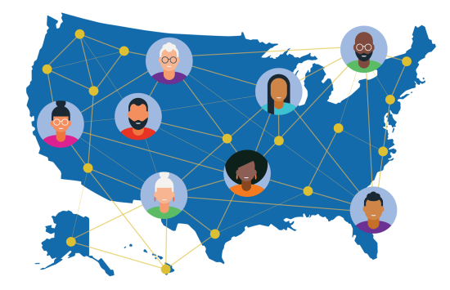
NSF Regional Innovation Engines
Focused on tech-based economic development
Type-1 Development Awards
$1M, two years
44 awarded from ~500 Concept Papers
SCRA is core member of two teams: CLEANcarolinas and Maritime Cybersecurity
Type-2 Awards
Up to $160M, ten years
Preliminary proposals due August 6

Slide 32
INDUSTRY PARTNERSHIP FUND

Slide 33
Industry Partnership Fund
Contributions to this Tax Credit Program are fueling South Carolina’s innovation economy
Your support to the IPF gives you the ability to decide how your state will be used
Contributions made by individuals and organizations provide a dollar-for-dollar tax credit on your state income tax returns
In addition, depending on your organization’s tax status, IPF contributions may be deductible as an ordinary business expense

Slide 34
Benefits Beyond the SC Tax Credit
Recognition on the SCRA website, annual report, and other venues as an innovation economy leader
Invitations to SCRA-hosted events throughout the year
Cash-flow savings
Numerous other benefits

Slide 35
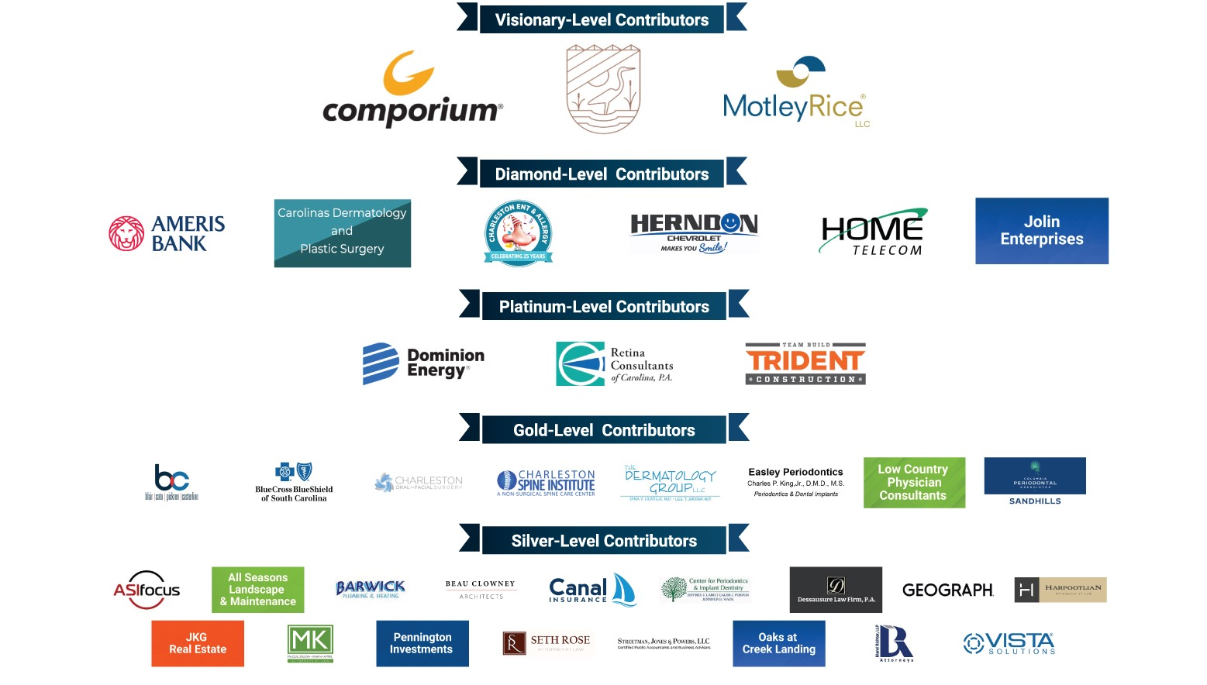
Major Contributors to the IPF

Slide 36
FOLLOW SCRA

Slide 38
What
Ten downtowns in ten cities, one from each of South Carolina’s ten Upstate counties, over ten months
Local resources and experts in each location
Each month’s tour has a revitalization theme/focus
25 people per tour
$20 per participant per tour (does not include transportation, parking, or food/drink)

Slide 39
Format – Third Thursday
Video/resources given to each participant in advance, on that month’s theme
5:00 p.m. - Talk to local experts
5:30 p.m. - Walk the downtown
7:00 p.m. - Eat at a local, downtown restaurant together

Slide 40
Local Experts (confirmed)
August
Greenville
Mayor White
September
Laurens
Mayor Senn County Council Chair Patterson
October
Anderson
Mayor Roberts
November
Liberty
County Council Vice Chair, Roy Costner
January
Spartanburg Deputy City Manager, Mitch Kennedy
February
Walhalla
Libby Imbody
March
Gaffney
April
Abbeville
May
Union
June
Greenwood
Main Street Manager, Gibson Hill
Lara Hudson

