Slide 1
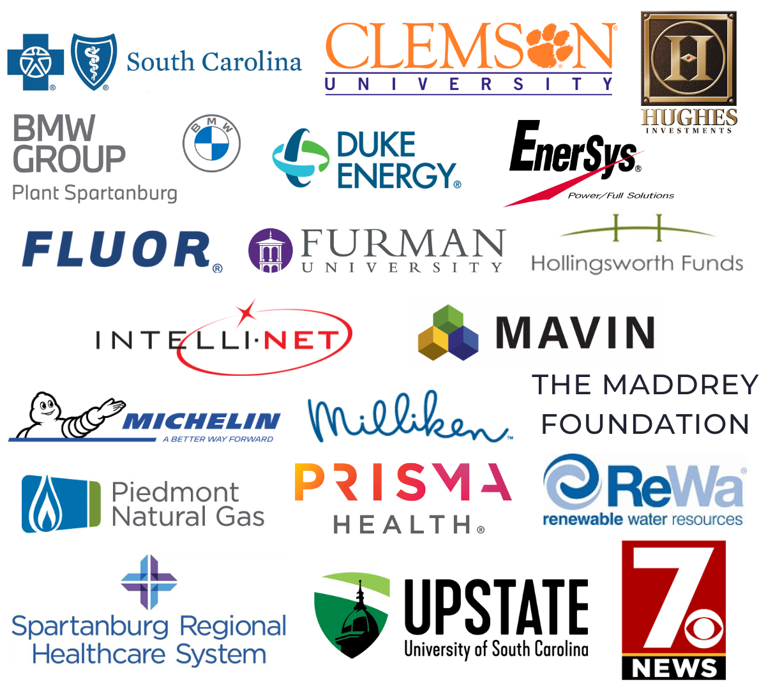
TATT Chat -
A BIG
July 11, 2024
thanks to…
Welcome
Dean Hybl, Executive Director
Guest Speaker
Douglass Lineberry, Offit Kurman
Resource Update
Monnie Whitson, Greenville Technical College Foundation
Adjourn
Dean Hybl, Executive Director
Our
Partners
Next TATT Chat - August 8, 2024
Leadership-Level

Slide 2
UNDERSTANDING INTELLECUTAL PROPERTY AND AVOIDING IP SCAMS
Presented by:
Douglas L. Lineberry
Principal
864.256.4875
Doug.Lineberry@offitkurman.com

Slide 3
What We’ll Learn Today
TYPES OF INTELLECTUAL PROPERTY
HOW TO PROTECT INTELLECTUAL PROPERTY
HOW TO AVOID SCAMS, charlatans, AND
SNAKE-OIL SALESMEN

Slide 4
Two Key Purposes of Intellectual Property
(1) Encourage creativity and/or investment for research and development by rewarding innovations; and
Patents – Utility and Design – how something works or is made/how it looks;
Trademarks – Words, Logos, Slogans, Sounds, Smells (Yep!);
Copyrights – “Original Works” such as software code, pictures, writings, music; and
Trade Secrets – marketing plans, pricing, sourcing costs, secret recipes.
(2) Protect inventors from improper competitive activities
Infringement
Counterfeiting/Passing Off

Slide 5
Two Types of Intellectual Property
“Public” intellectual property;
Seen by and/or explained to the public:
Patents
Trademarks
Copyrights
“Private” intellectual property;
Not seen or known by the public;
Trade Secrets

Slide 6
Forms of Intellectual Property
Utility Patent – protects how your invention works
Lasts 20 years from when you file it at the Patent Office
Design Patent – protects how your invention looks
Lasts 15 years from when it issues from the Patent Office
Trademark – protects brand names, slogans and logos used, or that you intend to use, in commerce
Lasts for as long as you use the mark and pay the Trademark Office
Copyright – protects your original works of authorship
Lasts for the author’s life PLUS another 70 years
Trade Secret – protects your ways of doing business that are not generally known, e.g., customer lists, business processes, price lists
Lasts for as long as you keep it a secret, e.g., Coca-Cola, KFC

Slide 7
The BEST WAY to think of IP Timing

Slide 8
“Squaring Away” Your IP
Patents
Have assignments in place when you file your applications, especially for employee or third contractor inventors
Have license/royalty agreements in writing, no hand-shakes
Trademarks
File for federal registration before use in commerce
Ensure you own your logos (both trademark and copyright ownership apply to a company’s logos)
A buyer wants your business’s “goodwill,” which includes your branding and marketing items such as trademarks and logos, ownership of these must be clear
Copyrights
Ensure you have assignments from artists, independent contractors, etc.
Federal registration allows for organizing, recording, and protecting the rights, as well as enforcing them against others

Slide 9
“Squaring Away” Your IP
Trade Secrets
Use nondisclosure agreements, even with prospective buyers, do not say/show anything without protecting yourself
Show a buyer how you protect Trade Secrets;
Physical Security
Passwords;
Locked Rooms;
Limited Access
Documentation
The files you retain showing you actually do preserve the documents used to protect your trade secrets
Signed handbooks, NDAs, non-compete agreements, licenses

Slide 10
What To Do With Intellectual Property?
Sell
Sell it;
License
License it:
Exclusive;
Non-exclusive;
Timing is your choice
Assign
Assign it:
To your business;
To a third company;

Slide 11
TAKE AWAY MENU
START IP PROTECTION EARLY
Review IP to know the types they have;
Protect IP file trademarks and patent applications, keep trade secrets a secret;
Pause to Consider BEFORE advertising or discussing new concepts;
Remember IP protection helps businesses now and later

Slide 12
IP SCAMS AND HOW TO AVOID THEM
“LOW COST” FEES FOR TRADEMARK SERVICES
Want your personal information – emails, phone numbers
CHECK ATTORNEY CREDENTIALS BEFORE YOU HIRE
Scummy attorneys? Who knew?!?!?!
If you’re being pressured, watch out!
If they don’t communicate, watch out!
If they hide their fees, watch out!

Slide 13
How Scammers Contact You
E-MAILS AND LETTERS, OH MY!
Letters claiming a third party will file for your mark
Letters claiming your mark will go abandoned showing fake documentation
Pretend to be the USPTO and give a short 24-72 hour turnaround to respond

Slide 14
Some “Legion of Doom” Members
BRAND REGISTRATION OFFICE
GLOTRADE
NATP REGISTER SERVICS
PATENT AND TRADEMARK BUREAU
PATENT & TRADEMARK OFFICE
TRADEMARK RENEWAL SERVICE
WTP TRADEMARK PUBLICATION
WTPR

Slide 15
RECOGNIZING COMMON IP SCAMS
SIGNS TO WATCH OUT FOR
USPTO personnel will never
ASK for personal information
ASK for payment information
Require payment via check or money order to third party addresses
COMMON SCAMS
Spoofing phone numbers
Imposter Emails
Fraudulent Communications
False change of email address

Slide 16
What do you do if you are scammed?
TAKE ACTION!
CALL YOUR REAL ATTORNEY!
Report to TMScams@uspto.gov
Contact your bank, dispute the charges
File a complaint with the FTC
File a complaint with the FCC
File a complaint with the BBB
File a report with the US Postal Inspection Service

Slide 17
Further ways to protect your trademarks
Check your name to see if it appears with marks you don’t know
Do not give personal information, SS#, payment information to anyone claiming to be from the USPTO
If you are concerned about your marks – CONSULT AN IP ATTORNEY
If your mark registered without your authorization, file a petition to cancel it.
Check with Customs and Border Protection to ensure no unauthorized registrations have registered

Slide 18
TATT Chat -
A BIG
July 11, 2024
thanks to…
Welcome
Dean Hybl, Executive Director
Guest Speaker
Douglass Lineberry, Offit Kurman
Resource Update
Monnie Whitson, Greenville Technical College Foundation
Adjourn
Dean Hybl, Executive Director
Our
Partners
Next TATT Chat - August 8, 2024
Leadership-Level

Slide 19
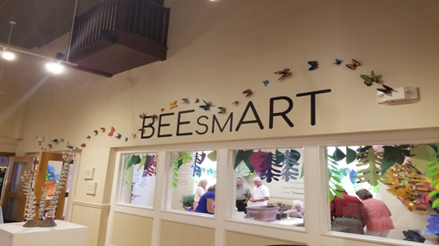
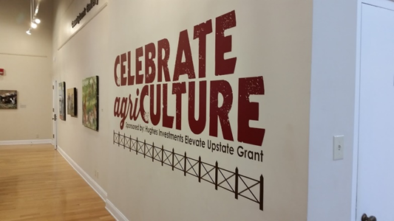
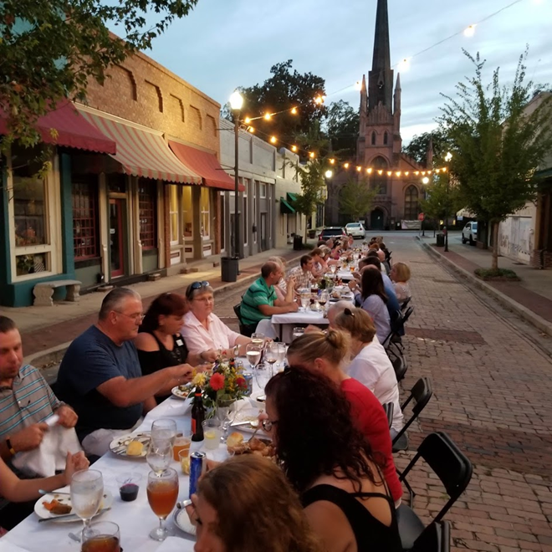
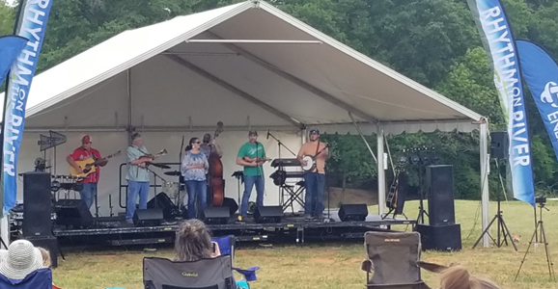
Hughes Investments Elevate Upstate Community Vibrancy Grants
Who Qualifies:
Neighborhood associations
Civic & community organizations
Nonprofit organizations
Local governments
Where should the applicants be located?
Each should be located and work within the 10 Upstate counties:
Abbeville, Anderson, Cherokee, Greenville, Greenwood, Laurens, Oconee, Pickens, Spartanburg, & Union Counties
Timeline:
Interest forms are due August 9, 2024
Final grant application due September 20, 2024
Finalist Presentations November 19, 2024 at TATT’s Celebrating Successes Event at the Greenville Convention Center

Slide 20
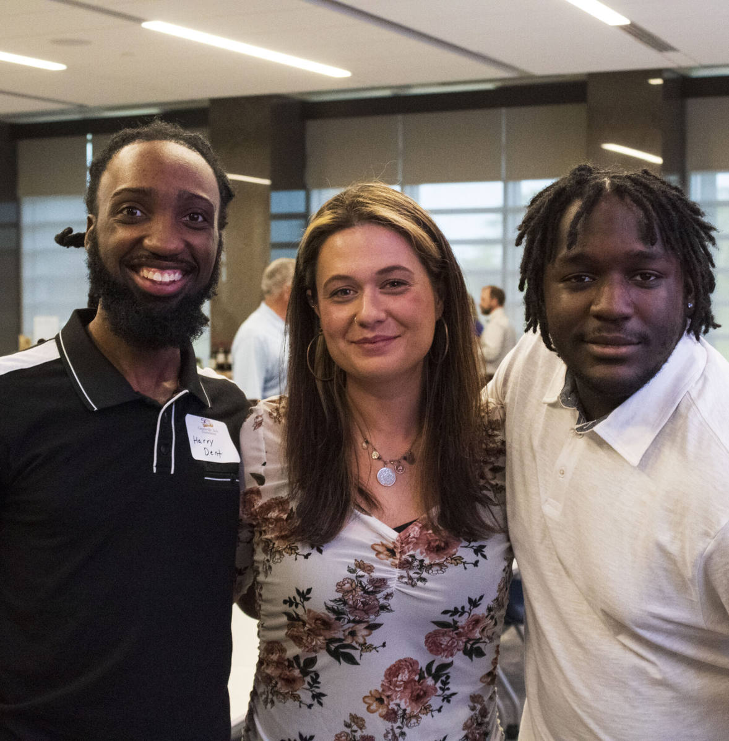
ABOUT US
Our Mission
The Greenville Tech Foundation provides resources to Greenville Technical College and its students through fundraising, collaborative partnerships, and innovative programs. By expanding access to education, we ignite personal transformation and contribute to the economic vitality of our region.
Notes:
We were established in 1973 to provide financial support in pursuit of the college’s mission – to transform the lives of students through education.
The Foundation’s role continues to grow more urgent as State assistance for Greenville Tech’s operating budget has fallen from about 62% when the College opened in 1962 to just about 16% of the budget today.
As you may know, the College strives to keep higher education affordable, so the foundation helps to fill in those gaps for students.

Slide 21
Why the Foundation?
Diverse Student Body
with Differing Needs
Provide Financial Support
• 23% First-generation college students
• 57% experienced basic needs insecurity
• 55% Pell grant eligible
• Single parents
• Adult career changers
• Work while attending
• Scholarships and affordability remain critical factors in the decision to attend GTC
• 68% receive financial aid
• Support beyond
federal, state,
and local aid
Notes:
So why is there a Greenville Tech Foundation?
Whether you’ve been here for just a few days or much longer, you’ve probably noticed that we have a diverse student body with differing needs:
About a quarter of our students are first generation college students
A recent survey found that 57% experienced a form of basic needs insecurity (in the areas of food or housing insecurity) in the past year
About half of our students are Pell grant eligible, meaning they come from low-to-moderate income households.
And many are Single parents or Adult career changers
Many work either part or full-time while attending school
We know that scholarships and affordability remain critical factors in a student’s decision to attend Greenville Tech. So with these varying needs, the Foundation provides financial support beyond that which can be obtained from federal, state, and local sources

Slide 22
2023 Revenue
by Sources
12%
22%
Gifts-In-Kind $393,208.87
TOTAL
REVENUE
$3,271,676.08
Individuals $763,736.31
23%
Corporations & Corporate Foundations $763,736.31
19%
Professional, Civic, Governmental, Nonprofit, Organizations $623,384.99
24%
Foundations $715,500.00
Notes:
For the 2023 calendar– the Foundation raised over $3.2, this shows a break down of the sources of our funding.
As you can see nearly 24% of our donations came from Corporations and their Foundations. If you think about a lot of the programs the college offers, the business community hires our graduates as well as provides financial support for the college and our students.
Then just over $763K came from individual donors.
12% were gifts in kind donations of equipment, goods, and services.

Slide 23
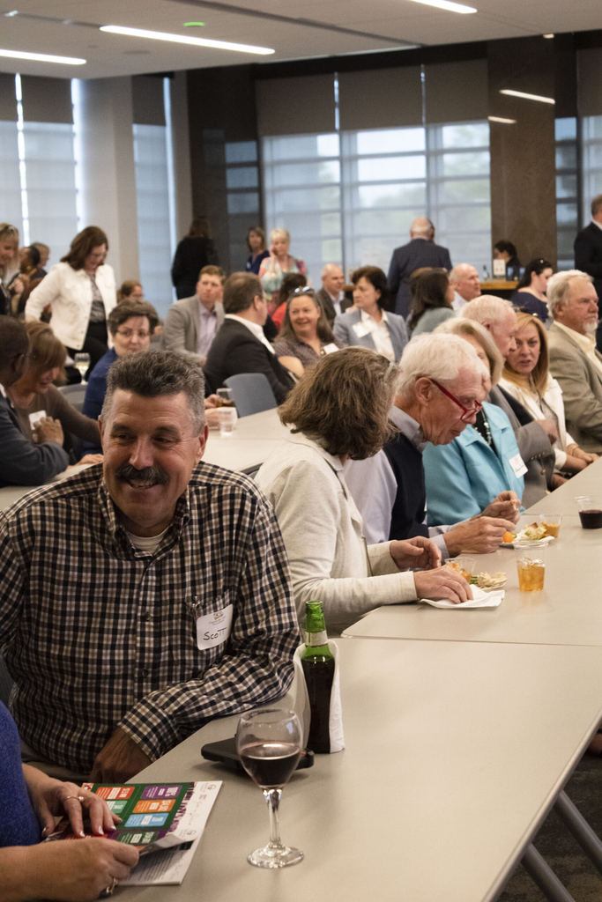
Events
DONOR APPRECIATION
RECEPTION
APRIL 18, 2024
CHAMPIONS FOR STUDENT SUCCESS
OCTOBER 22, 2024
Notes:
We typically host 3 major events each year:
We do an annual employee giving campaign, usually in February. That’s our annual reminder inviting employees to make a gift, and we share stories of what your gifts mean for our students. Last year, we exceeded our goal, raising more than $65,000 through the Faculty/Staff Campaign.
The Donor Appreciation Reception is held in the Spring – This is an opportunity for us to thank all of our donors for their support. We have several students speak about how donor support, like scholarships, has had an impact on their educational journey.
Our Signature Fundraising Event is held in the Fall – Last year, we had our 50th anniversary celebration with a formal dinner and program held at Hilton Greenville. Through this event, we recognized and honored several people or organizations who have had a long history of supporting the college and students.

Slide 24
Get In Touch
WEBSITE
GreenvilleTechFoundation.org
ADDRESS
556 Perry Ave, Suite B110
Greenville, SC 29611
EMAIL
foundation@gvltec.edu
Phone
(864) 250-8835
@greenvillerechfoundation
Notes:
Follow us on Facebook, Instagram, LinkedIn or visit our website for more info
Our offices are located at 556 Perry Avenue – co-located with the Truist Culinary and Hospitality Innovation Center. If you haven’t been there yet, we invite you to visit and take a tour or sign up for a cooking class!
You have my business card in your hand outs – so feel free to reach out anytime.

