Slide 1
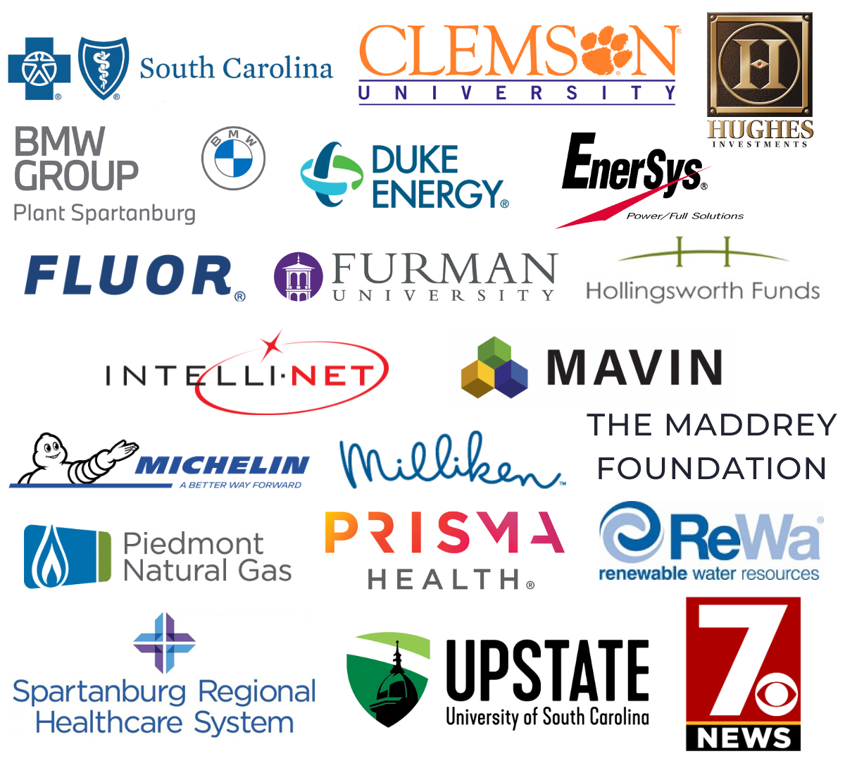
TATT
A BIG
-
Chat
August 8, 2024
thanks to…
Welcome
Joe Bryant, TATT Board Member
Guest Speaker
Tyson Jeffers, Hub City Spartanburgers
Resource Update
Phillip Clark, Just Say Something
Adjourn
Joe Bryant, TATT Board Chair
Our
Partners
Leadership-Level
Next TATT Chat - September 12, 2024

Slide 2
Phillip Clark
CEO
phillip@justsaysomethingsc.org
864-467-4099

Slide 3
ABOUT JUST SAY SOMETHING
2024 is our 40th Anniversary!
Previously known as Greenville Family Partnership
Our mission is to help youth, parents and communities have open, honest, and ongoing conversations about risky behavior, drugs, and alcohol.

Slide 4
PARENTING & SPORTS PROGRAMS
Parenting Programs
Triple P
Circle of Parents
Parenting Wisely
Back in Control
SFP
Greenville and Spartanburg
Programs in English and Spanish
Youth Impact Sports
This is a FREE program for children aged 6 to 12.
Fun and athletic outlet while promoting character-building skills such as discipline, accountability, bullying prevention, substance prevention, and anger management.
Flag Football
Basketball
Soccer

Slide 5
AIR PRESERVE
Air Preserve is a grassroots movement which does just that; it preserves the air we breathe.
We are working to educate communities and increase awareness of the importance of smoke and vape free ordinances in Greenville County. There are 70 ordinances in South Carolina. Our current focus is Greer with a “Why Not Greer” campaign. Click HERE to see if your community has an ordinance!
Partnering with ACS-CAN, American Heart Association, Gibbs Cancer Center, American Lung Association, Smokefree SC and community advocates.
Join us for our Air Preserve | Smoke Free Greer Coalition monthly call.
AirPreserve.org

Slide 6
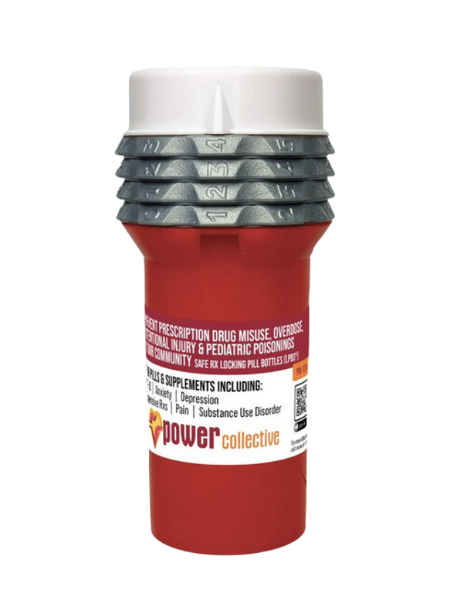
POWER COLLECTIVE
The POWER Collective: Community Action for Opioid Addiction and Overdose Prevention
In partnership with the Greenville County Sheriff's Office, RIZE Prevention, Inc., Just Say Something, and Safe Rx, are working together to combat the opioid crisis in Greenville County.
40,000 Locking Pills Bottles Year 1
Community events and education
PowerCollectiveSC.com

