Slide 1
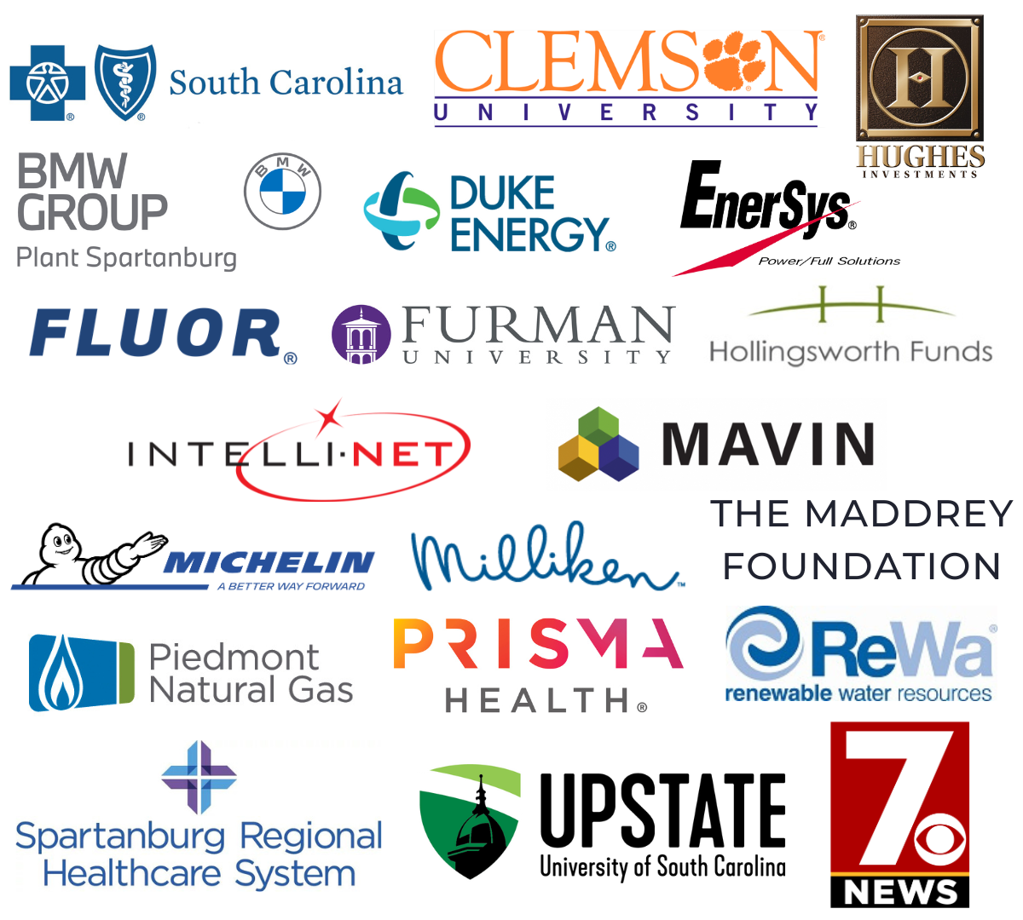
TATT
A BIG
-
Chat
December 12, 2024
thanks to…
Welcome
        Todd Horne, Ten at the Top Board Chair
Guest Speakers
Chunsta Miller, Goodwill Industries
Yolanda Campusano-Pilarte, Miracle Hill Ministries
Major Christine Harris, Salvation Army
Adjournment
        Todd Horne, Ten at the Top Board Chair
Our
Partners
Next TATT Chat - January 9, 2025
Leadership-Level

Slide 2


Slide 3
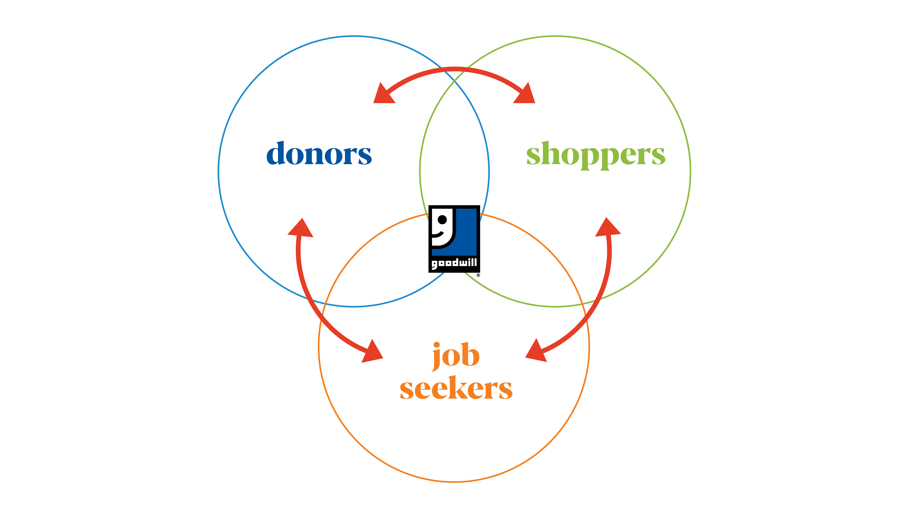

Slide 4
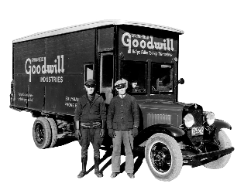




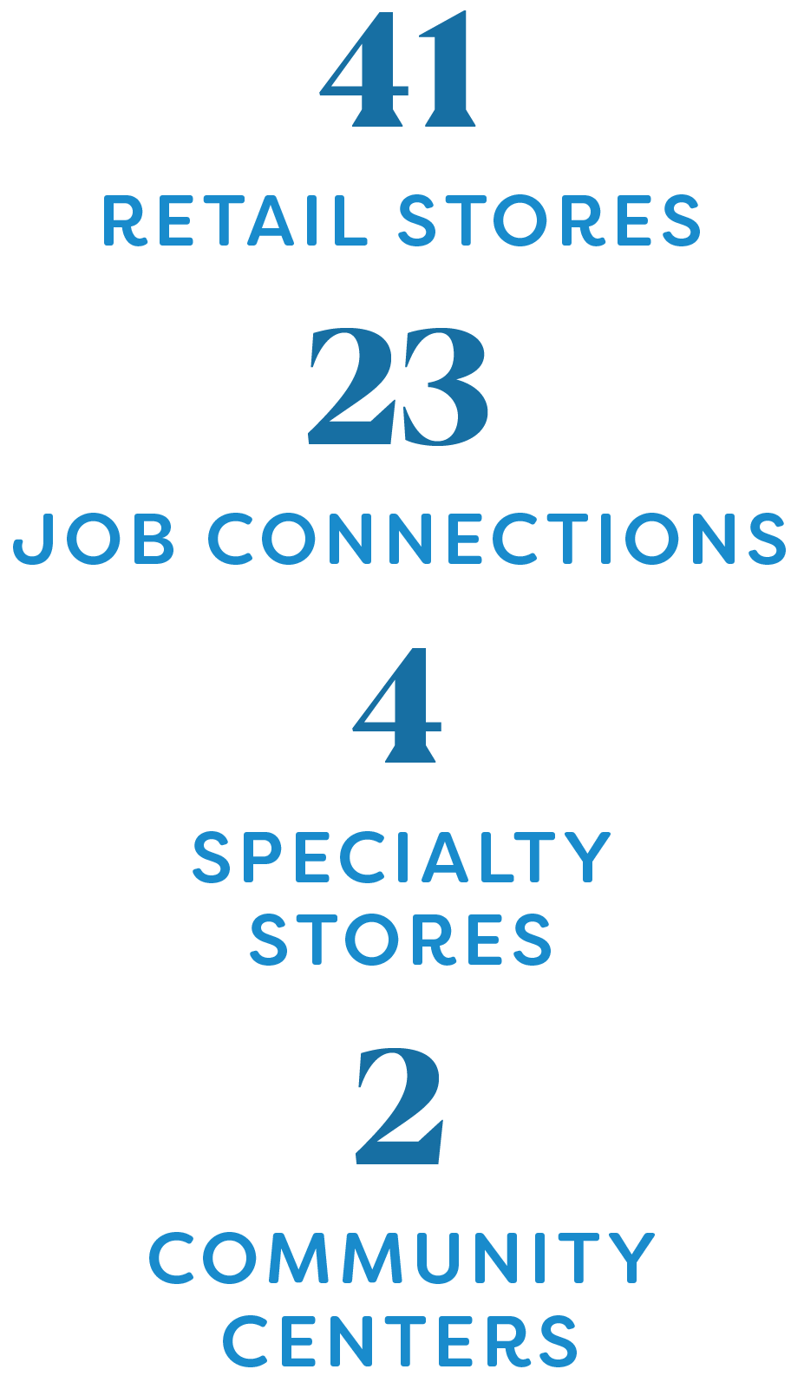


Slide 5
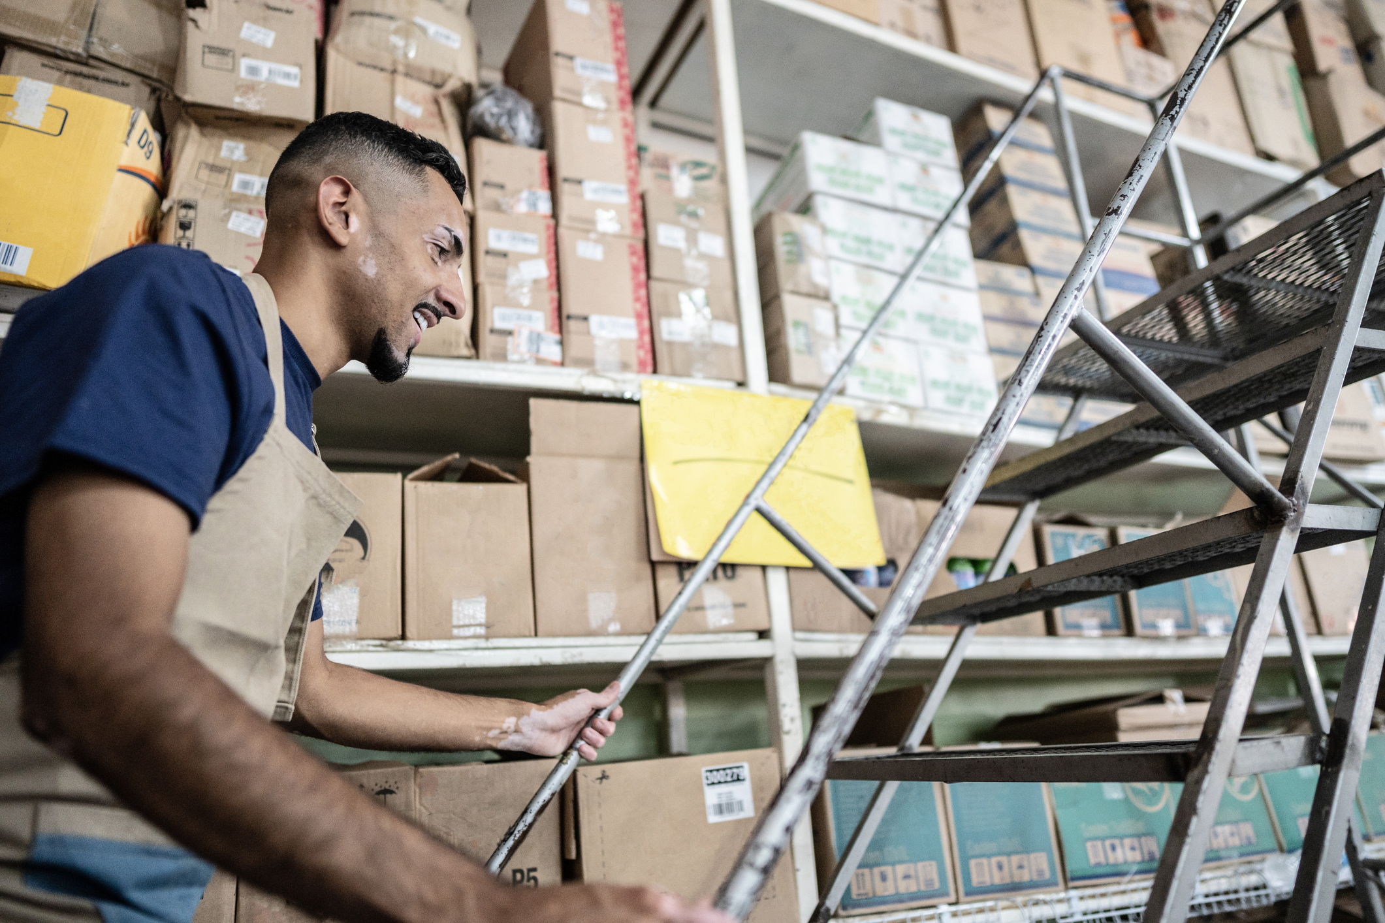

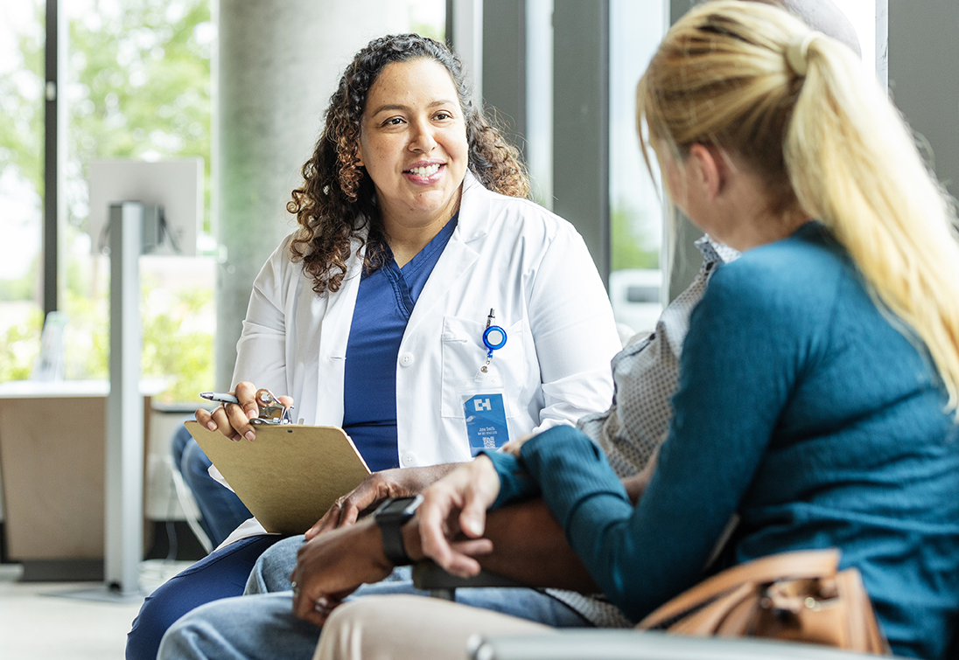

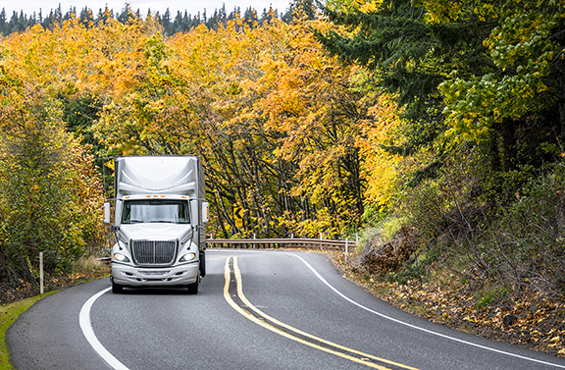


See how we do it.

Slide 6

20+ training programs within 5 in-demand areas of interest
Healthcare, Transportation and Logistics, Skilled Trade, Clean Tech and Technology

Slide 7

of enrollees earn an industry-specific certification
of training program graduates are
placed into competitive employment

Slide 8



Free career services, access to community resources
Advanced career and training programs within the science, technology, and business fields
INoVate Smart Labs: Virtual and in-person classes and training programs, collaboration spaces
Visits local business and partner agencies to offer free, onsite employment outreach, career services and training
Notes:
Our first Resource Opportunity Center opens next month at our Hardscrabble location in the Midlands. A client can access virtual or in-person training classes, career coaching from career specialists, and specialized labs and classrooms. Or explore other community resources to help improve their lives and career development journey.
Innovation Institute: Job seekers can access in-demand career training in STEM-based professions at our new Innovation Institutes. A variety of programs are offered year-round and may be available virtually or in-person. Pursue careers such as a drone specialist, electric vehicle technician, cybersecurity specialist or information technology professional.
INoVate Smart Labs: Goodwill is pleased to offer this brand-new space that fosters collaboration while building advanced skills. The labs are modern, bright and feature state of the art equipment.
And when you can’t get to a Job Connection, you might find it closer to you in the form of Mission Mobile. Mission Mobile is a 30’ air-conditioned, wheelchair-accessible vehicle that regularly takes career and training services out and about in Midlands and Upstate communities. Community organizations like yours can request a visit from Mission Mobile right on our website.

Slide 9


100% on-demand online platform
Class and training calendar, career exploration, local job search, resume builder, connect or live chat with career specialists*
*during business hours
Notes:
Launching next month is our new Career Services website that includes an on-demand platform called MyCareer Advisor geared towards making our services efficient and accessible anywhere you are.

Slide 10

of economic impact to local communities
We contributed more than

Slide 11
of goods per year diverted from landfills
Notes:
The Impact of our current efforts:. Each year, we prevent about 42 million pounds of things like clothes, books, shoes, silverware and computers from going into a landfill.

Slide 12



Access programs and services
Drop-off gently used items
Refer to programs
Donate to support Goodwill’s mission
Partner with us to enhance community services
Shop or volunteer at Goodwill

Slide 13


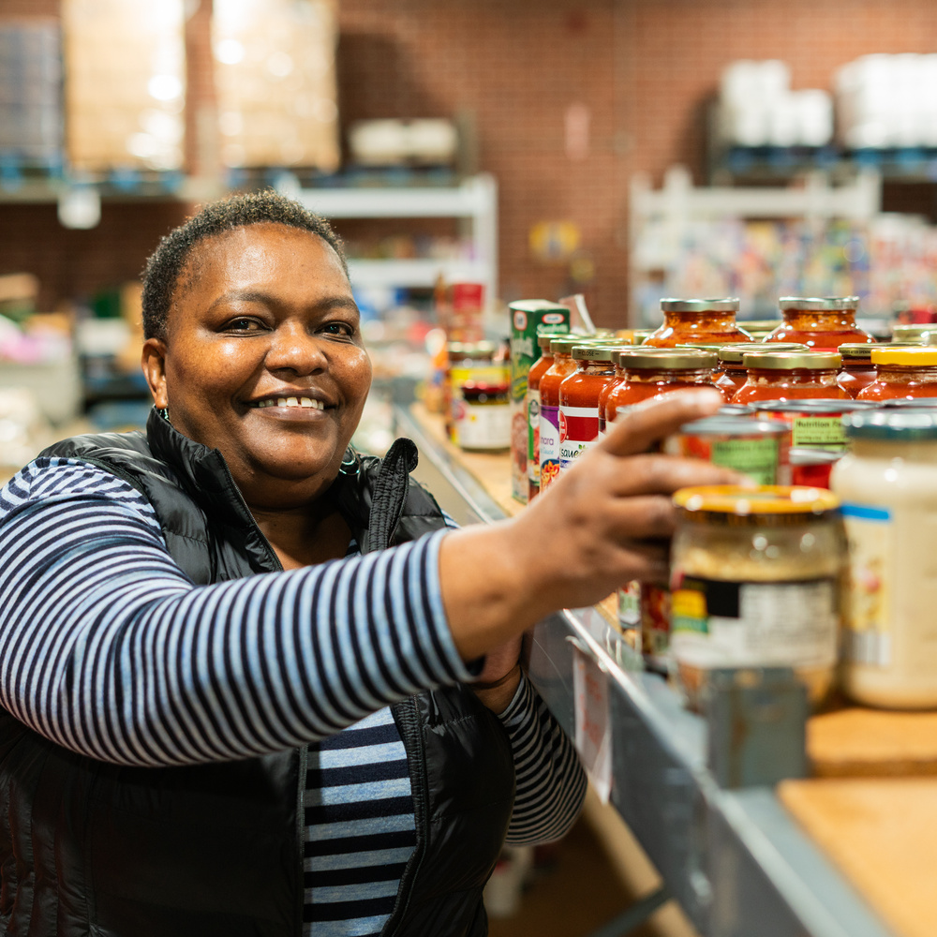

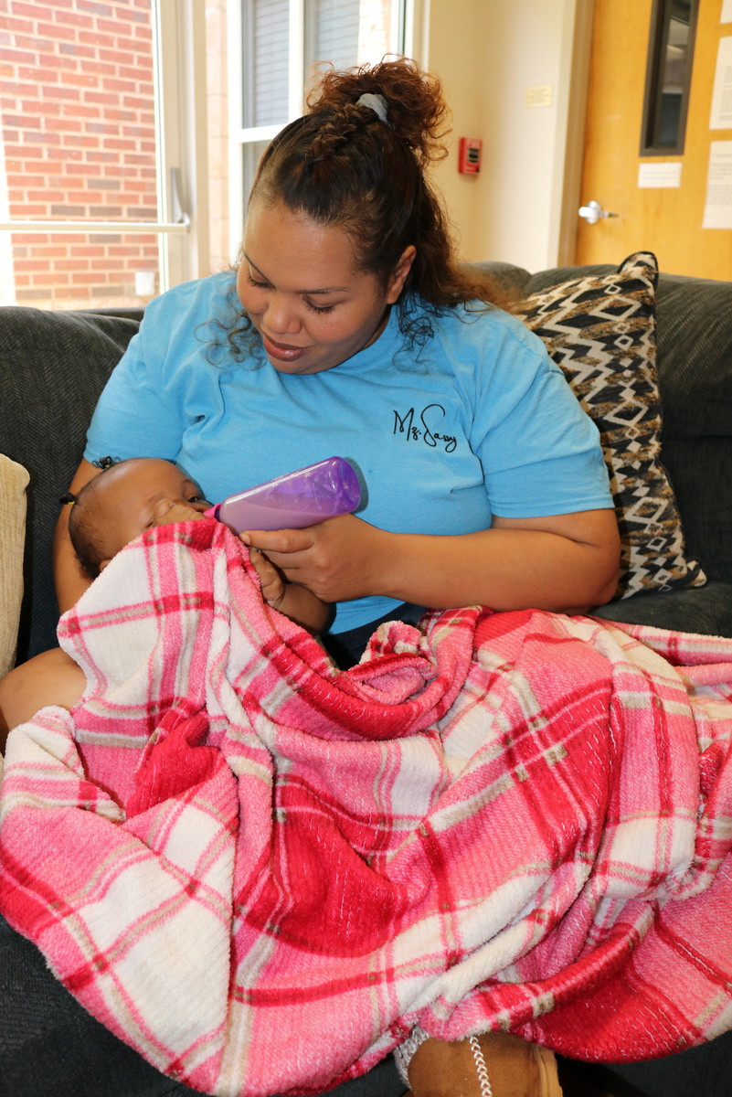
MIRACLE HILL MINISTRIES
OVERVIEW 2024
Presented by
Yolanda Campusano-Pilarte
PR Manager

Slide 14




Our Mission
“Miracle Hill exists that homeless children and adults receive food and shelter with compassion, hear the Good News of Jesus Christ, and move toward healthy relationships and stability.”
Rescue Missions
Greenville Rescue Mission (R)
Shepherd’s Gate (R)
Cherokee Rescue Mission
Spartanburg Rescue Mission
Addiction Recovery
Overcomers Center
Renewal Center
Renewal Wade Hampton
Foster Care
Foster Care Program
Miracle Hill Children’s Home/Community

Slide 15
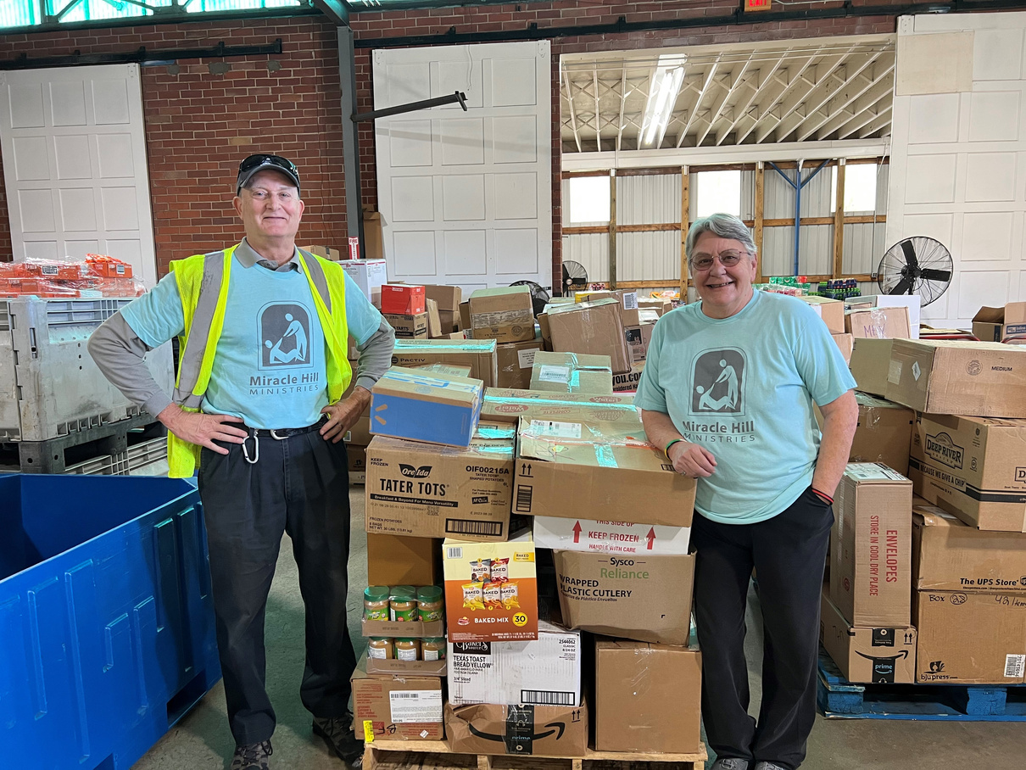
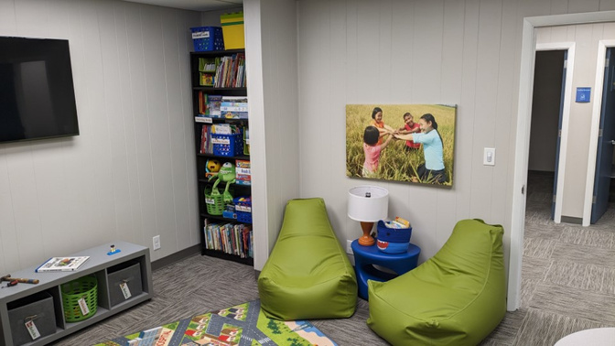
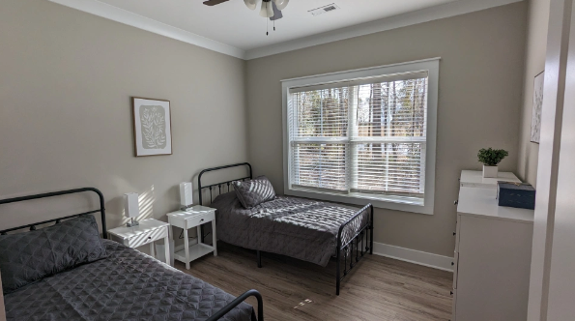
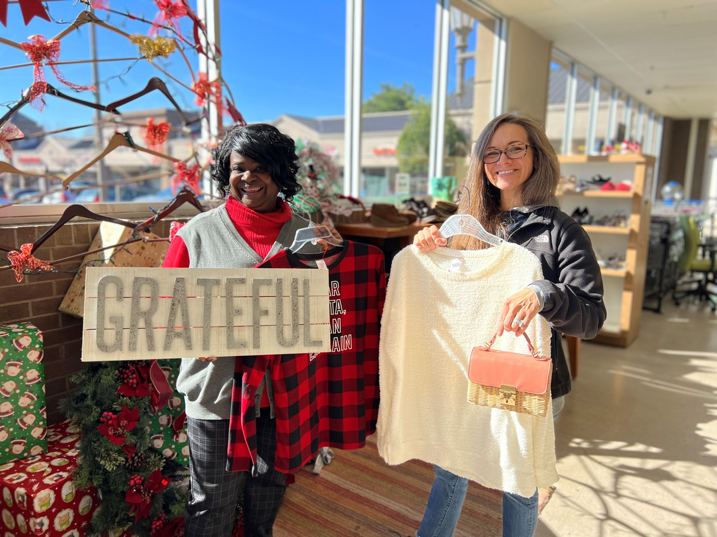
Services
Food
FMC
Miracle Hill From God To You is a community food pantry for people in need and a food warehouse for Miracle Hill’s shelters.
We also provide prayer support, and counseling when needed.
Transition
Family Ministry Center
Provides a warm, safe, non-threatening space where children, birth families, foster families, counselors, therapists, and other service providers can meet and have safe visitations.
Thrift
18 Transitional Houses
Counseling
Case Management
Access to Public Transportation
Proximity to Job Sites
9 Thrifts stores and an Auto Sales Operation
All of the income generated from donations and shopping at our thrift stores directly supports Miracle Hill’s mission.

Slide 16



Limitations turned into opportunities for Guests and Staff.
Transportation -Bridge to Wheels
The purpose of the program is to enable guests who meet specific criteria to obtain transportation while also receiving mentoring and support.
Career Progression Plan
To help our people get from guest to counselor with all the education, experience, and training needed.
Ex: Ministry trainee program
BridgeWorks/Creation Works
Social enterprise, provides employment and helps with other barriers that stop our guests from full time employment.

Slide 17
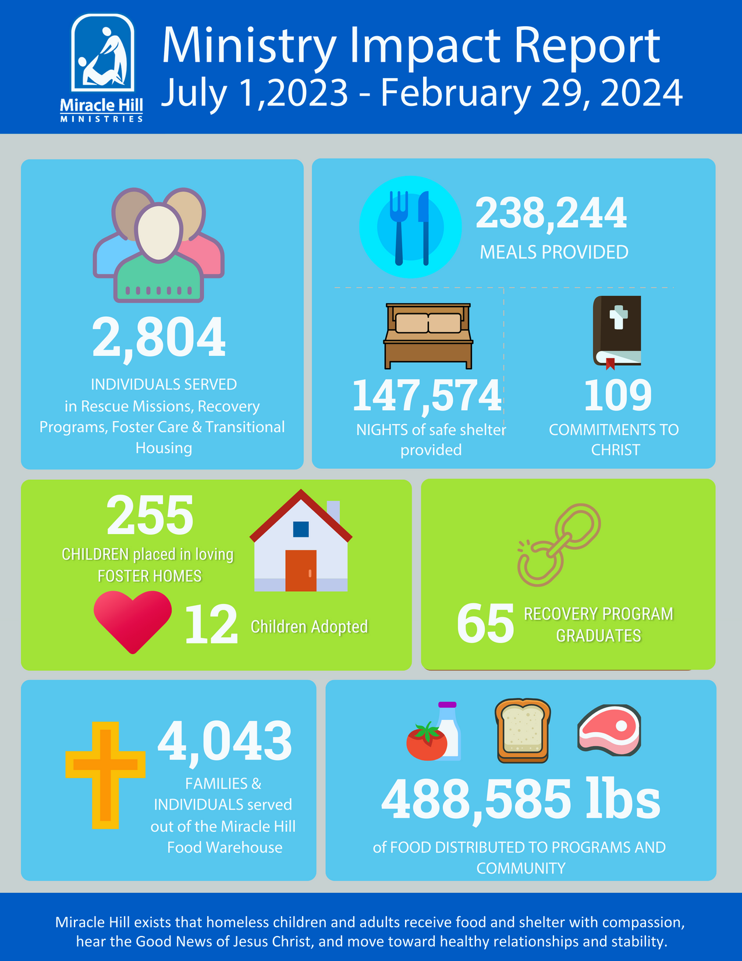



Slide 18
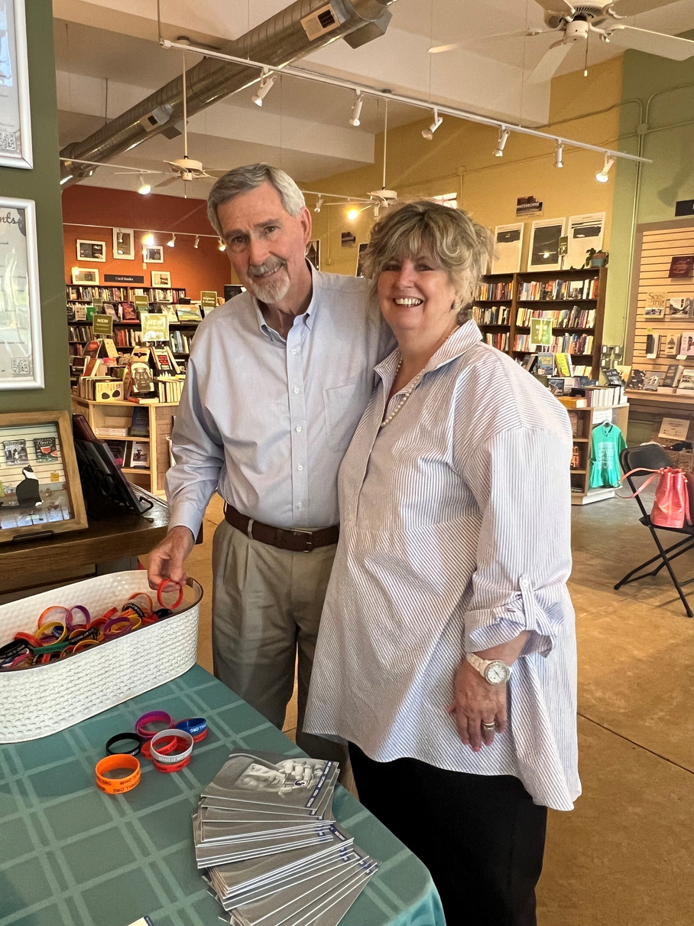
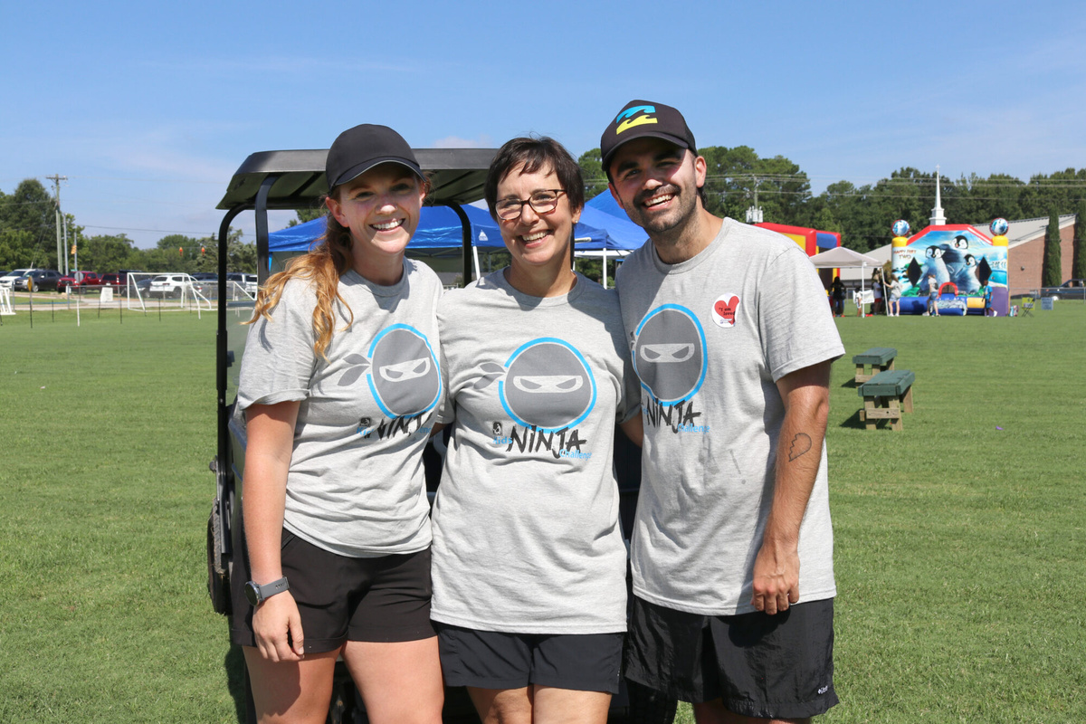
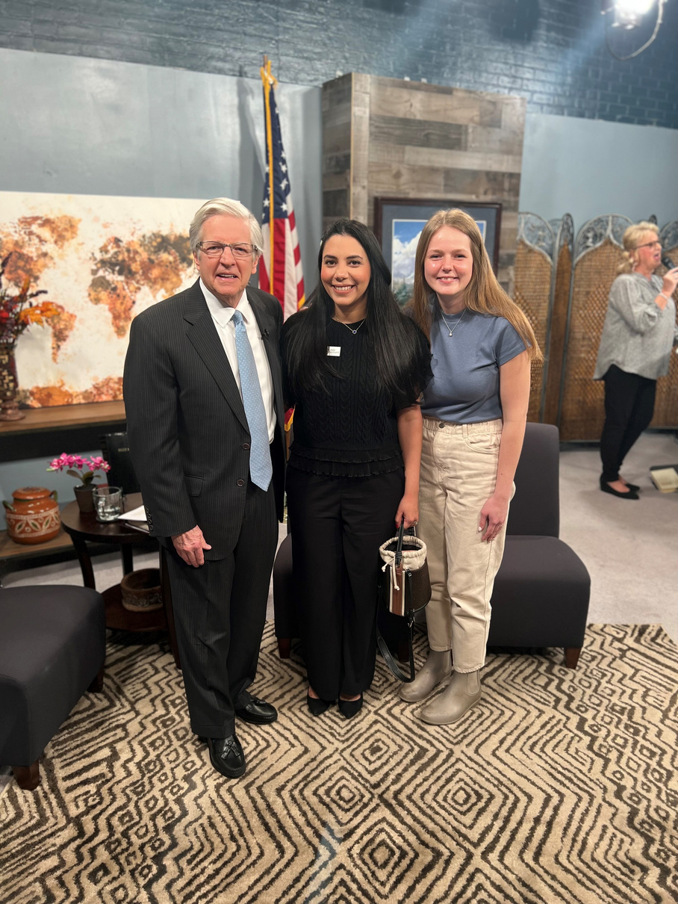
How to get Involved?
Donate supplies
Volunteer your time/mentor
Donate financially
You can help our guests meet their basic needs by donating items like soap, toothpaste, shampoo, and other similar items directly to a shelter.
We welcome both individuals and groups, and we offer all different types of opportunities. Whether you want to lend professional expertise or participate in a recreational activity.
Support our mission in the Upstate.: Event sponsorships
Monthly donations
Special Projects

Slide 19




THANK YOU
FOR YOUR ATTENTION
miraclehill.org

Slide 20


Slide 21

Together, we can help those in need in Greenville, Pickens & Oconee Counties
The Salvation Army has been Greenville’s largest provider of social ministries since 1904. Locally, 87 cents of every dollar received is invested back into the community.
The Area Command includes shelter and food pantry for men, women and children in Greenville, Service Centers in Pickens and Oconee Counties, the Kroc Center, Boys & Girls Club, four Thrift Stores and Disaster Relief efforts

Slide 22
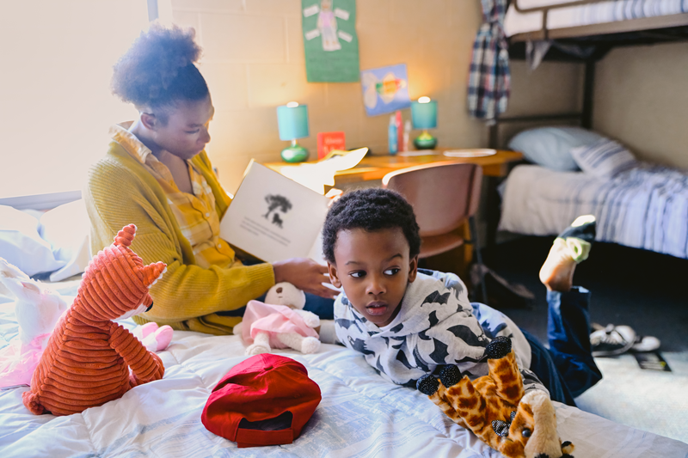
The Salvation Army serves individuals and families
experiencing the realities of poverty

Slide 23
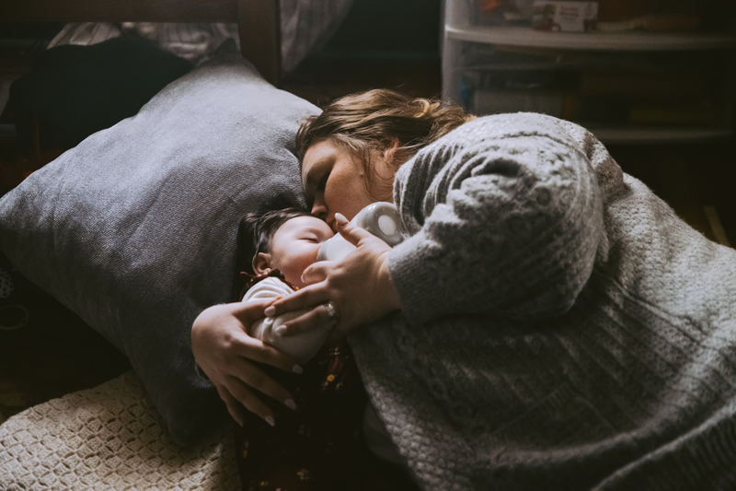
We provide shelter in Greenville to men, women and children without a safe place to rest

Slide 24
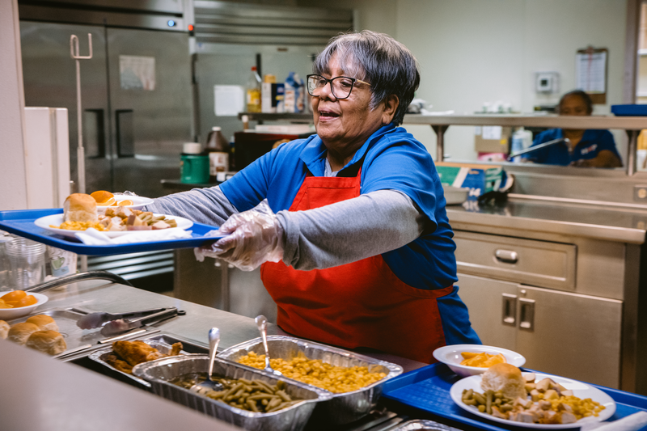
We provide three meals and shelter for 90 men, women and children daily in Greenville

Slide 25
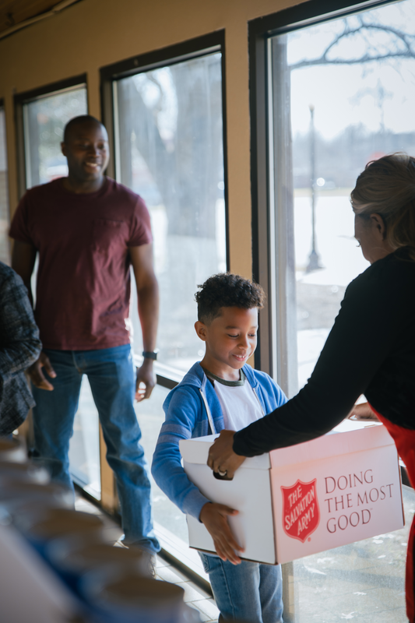
We offer food boxes, bread and baked goods to those facing hunger in and across Greenville, Pickens & Oconee Counties.

Slide 26
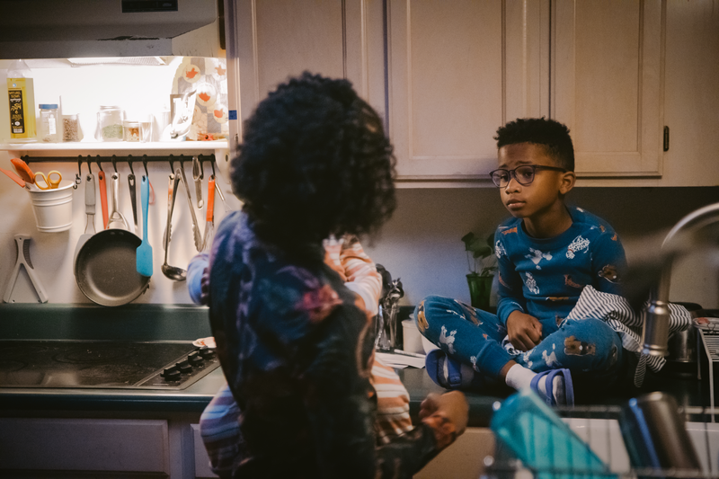
Our Diversion Program supports over 400 families annually with rent and utilities assistance to help them avoid eviction.

Slide 27
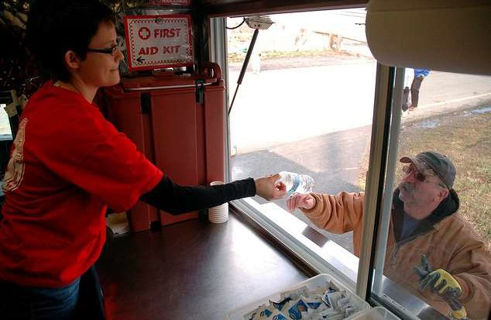
The Salvation Army of Greenville provides Disaster Services throughout Florida, North Carolina, and the Coast of South Carolina

Slide 28
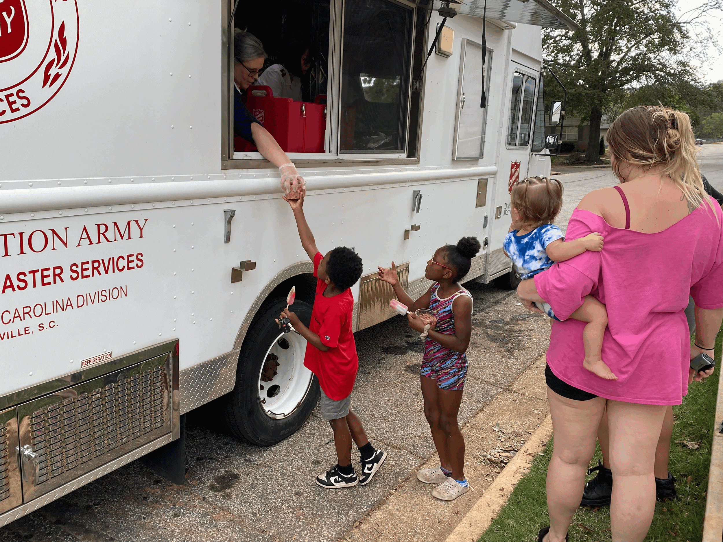
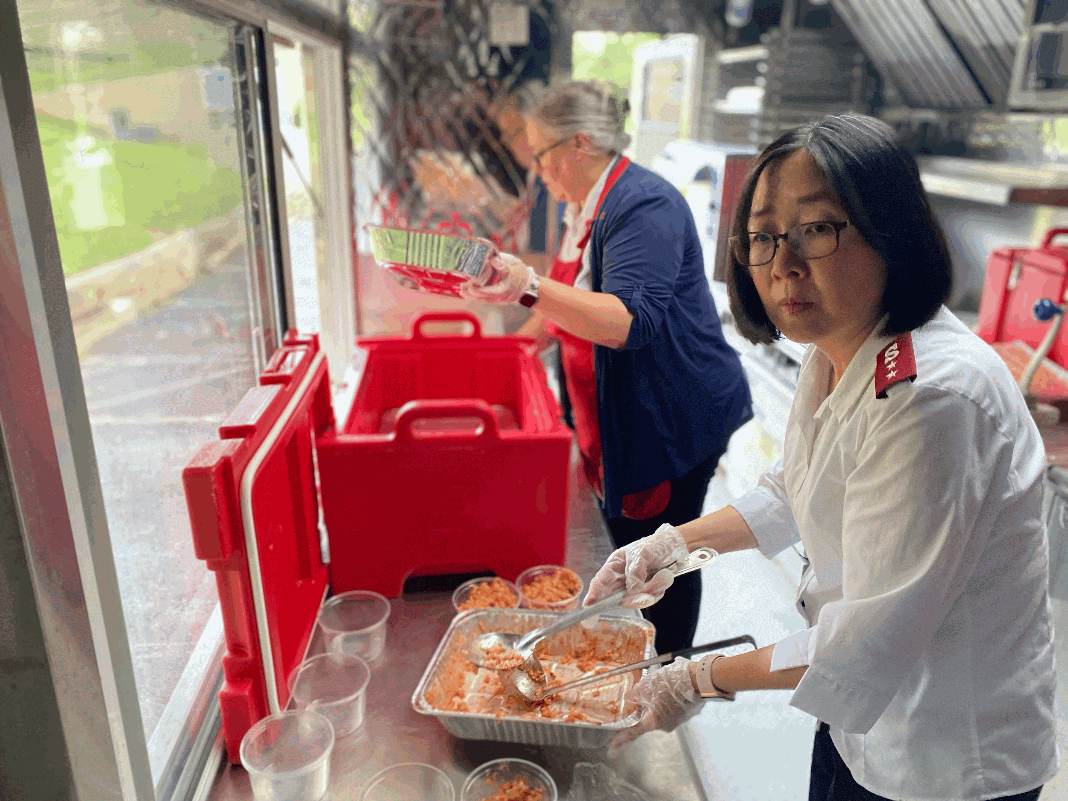
Helping in the community in the wake of Hurricane Helene in Greenville

Slide 29
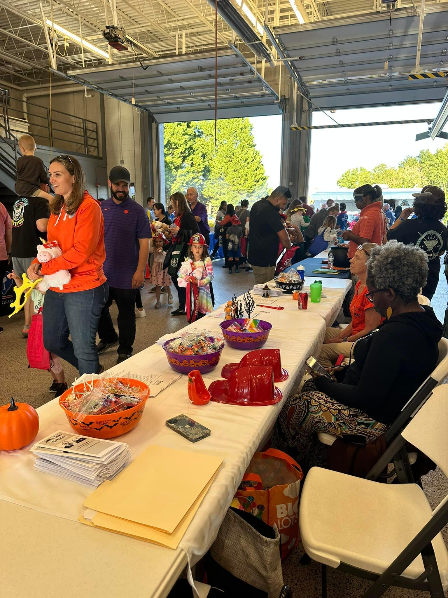
The Salvation Army of Pickens County
Assisted over 270 families with
food boxes
rent and utility assistance
clothing vouchers
Assisted over 335 children with
Christmas gifts

Slide 30
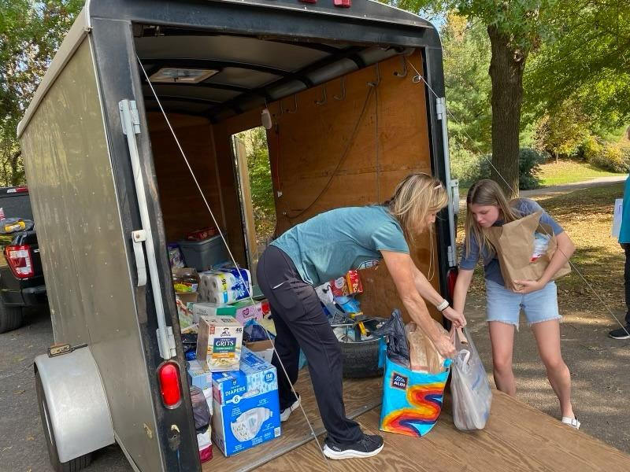
The Salvation Army of Oconee County
Assisted over 1,036 families with
food boxes
rent and utility assistance
clothing vouchers
Assisted over 208 children with
Christmas gifts

Slide 31
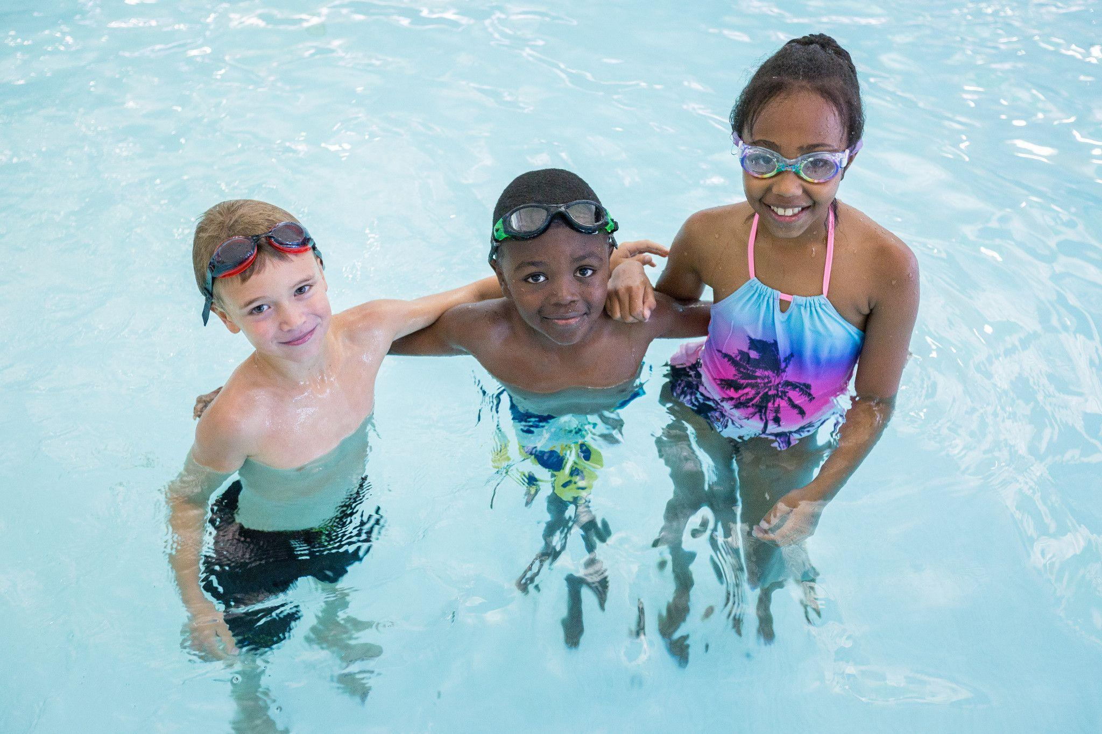
The Salvation Army Ray & Joan Kroc Community Center in Greenville provides a safe place for fitness, faith, & fun for over 4,500 people.

Slide 32
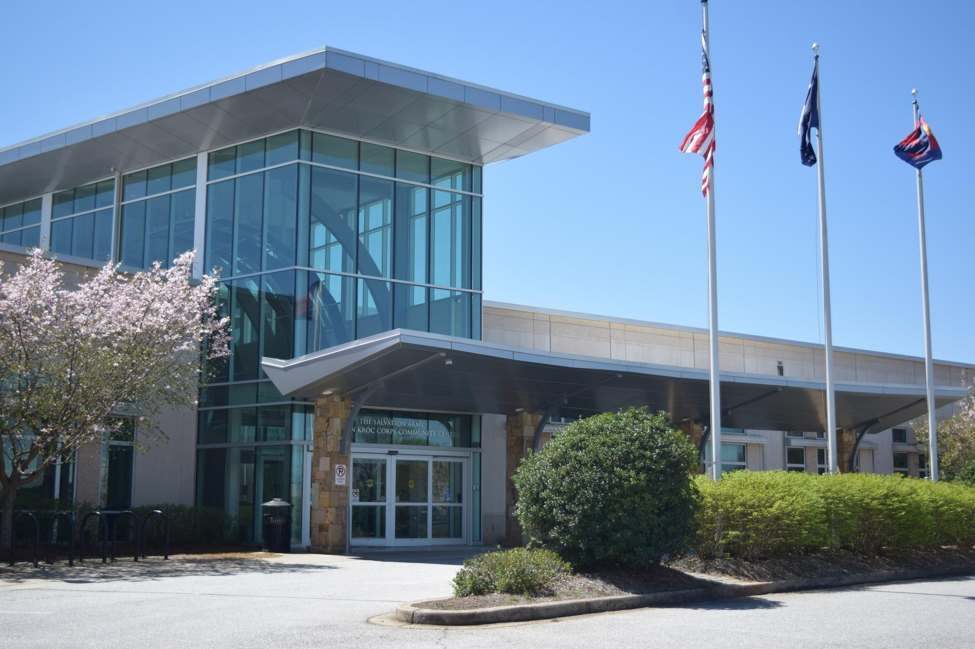
Kroc Center Amenities
25 meter x 25 yard short course Competition Pool
Recreation Pool
Indoor, warm water Therapy Pool
Multipurpose gym designed for basketball, indoor soccer, volleyball, and more
Fitness Center, including over 50 pieces of cardio equipment, a weight room, and track
Group Fitness and Cycling Studios
400-seat Performing Arts Theatre
Four Community Rooms for classes, meetings, and more

Slide 33
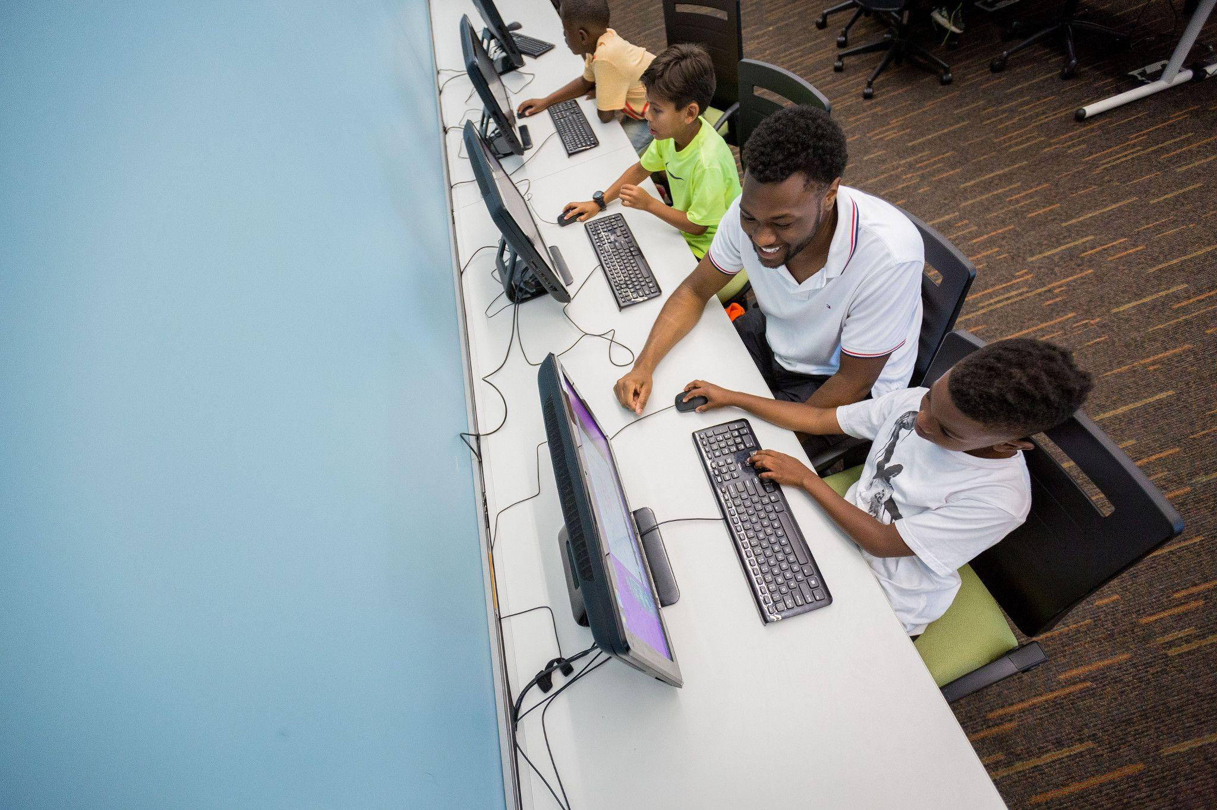
The Salvation Army Boys & Girls Club provides high quality afterschool and summer programs for
more than 125 children

Slide 34
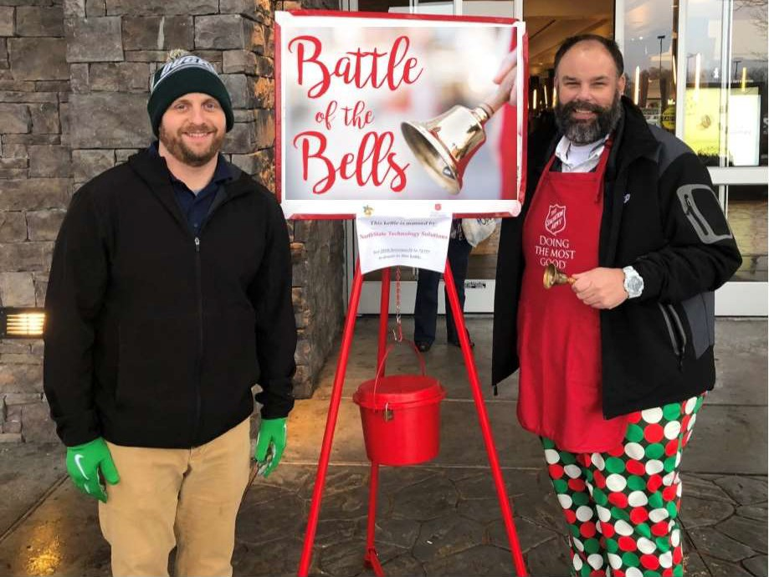
The Red Kettle Impact Campaign supports our programs all year

Slide 35
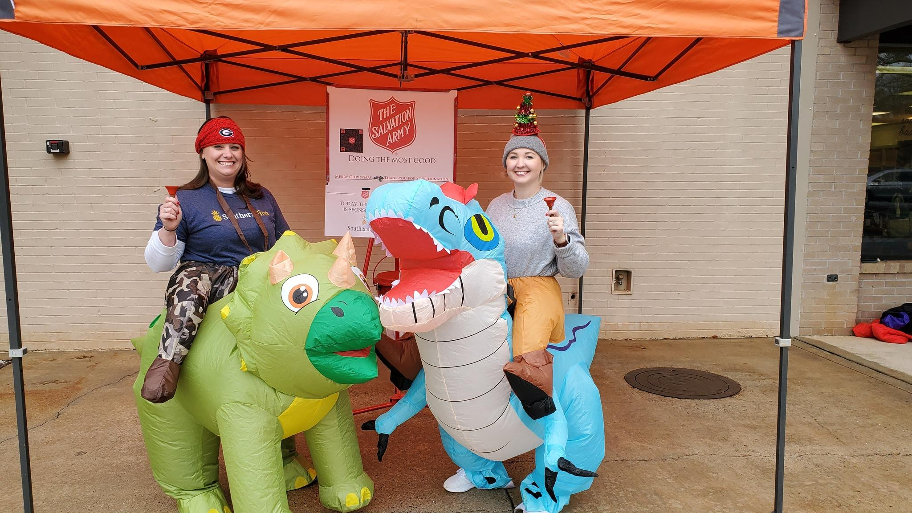
This year our Red Kettle Impact Campaign hopes to raise $350,000 in Greenville alone!

Slide 36
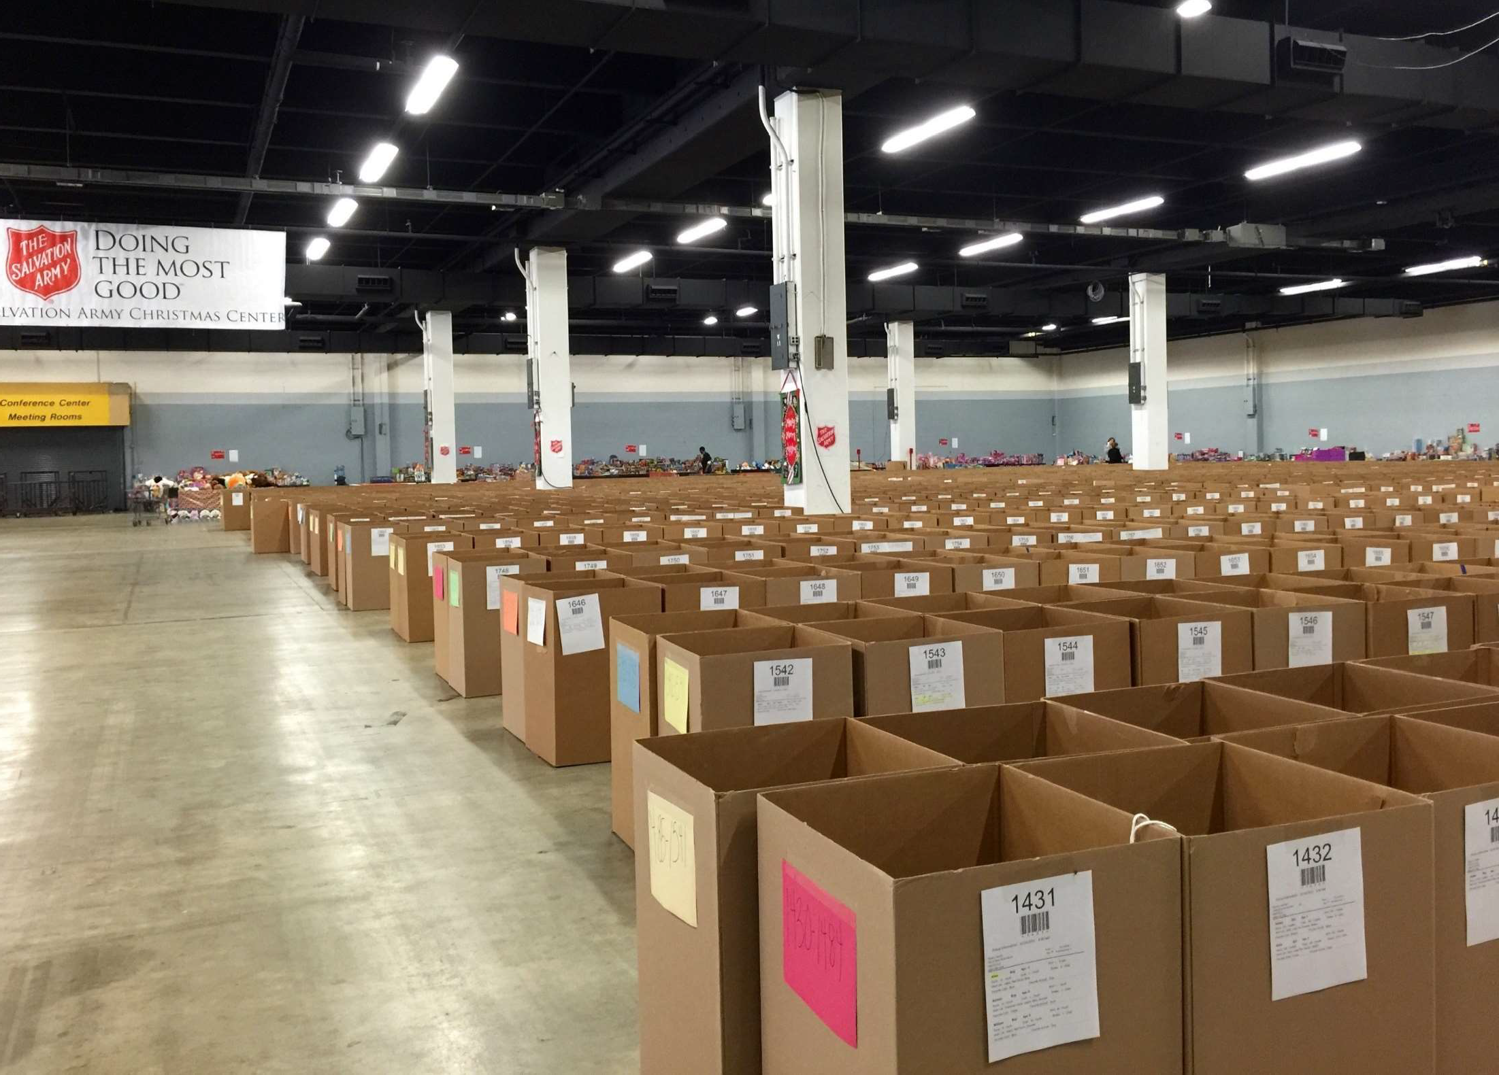
The Angel Tree program will provide Christmas for over 1,900 children this year

Slide 37
BY THE NUMBERS LAST YEAR
39,918 PERSONS SERVED
81,646 MEALS PROVIDED
280 YOUTH SERVED IN BOYS & GIRLS CLUB
25,633 NIGHTS OF SHELTER
464 FAMILIES ASSISTED WITH UTILITIES AND HOUSING
1,900 CHILDREN WERE PROVIDED GIFTS THROUGH THE ANGEL TREE PROGRAM
www.salvationarmygreenville.org

Slide 38
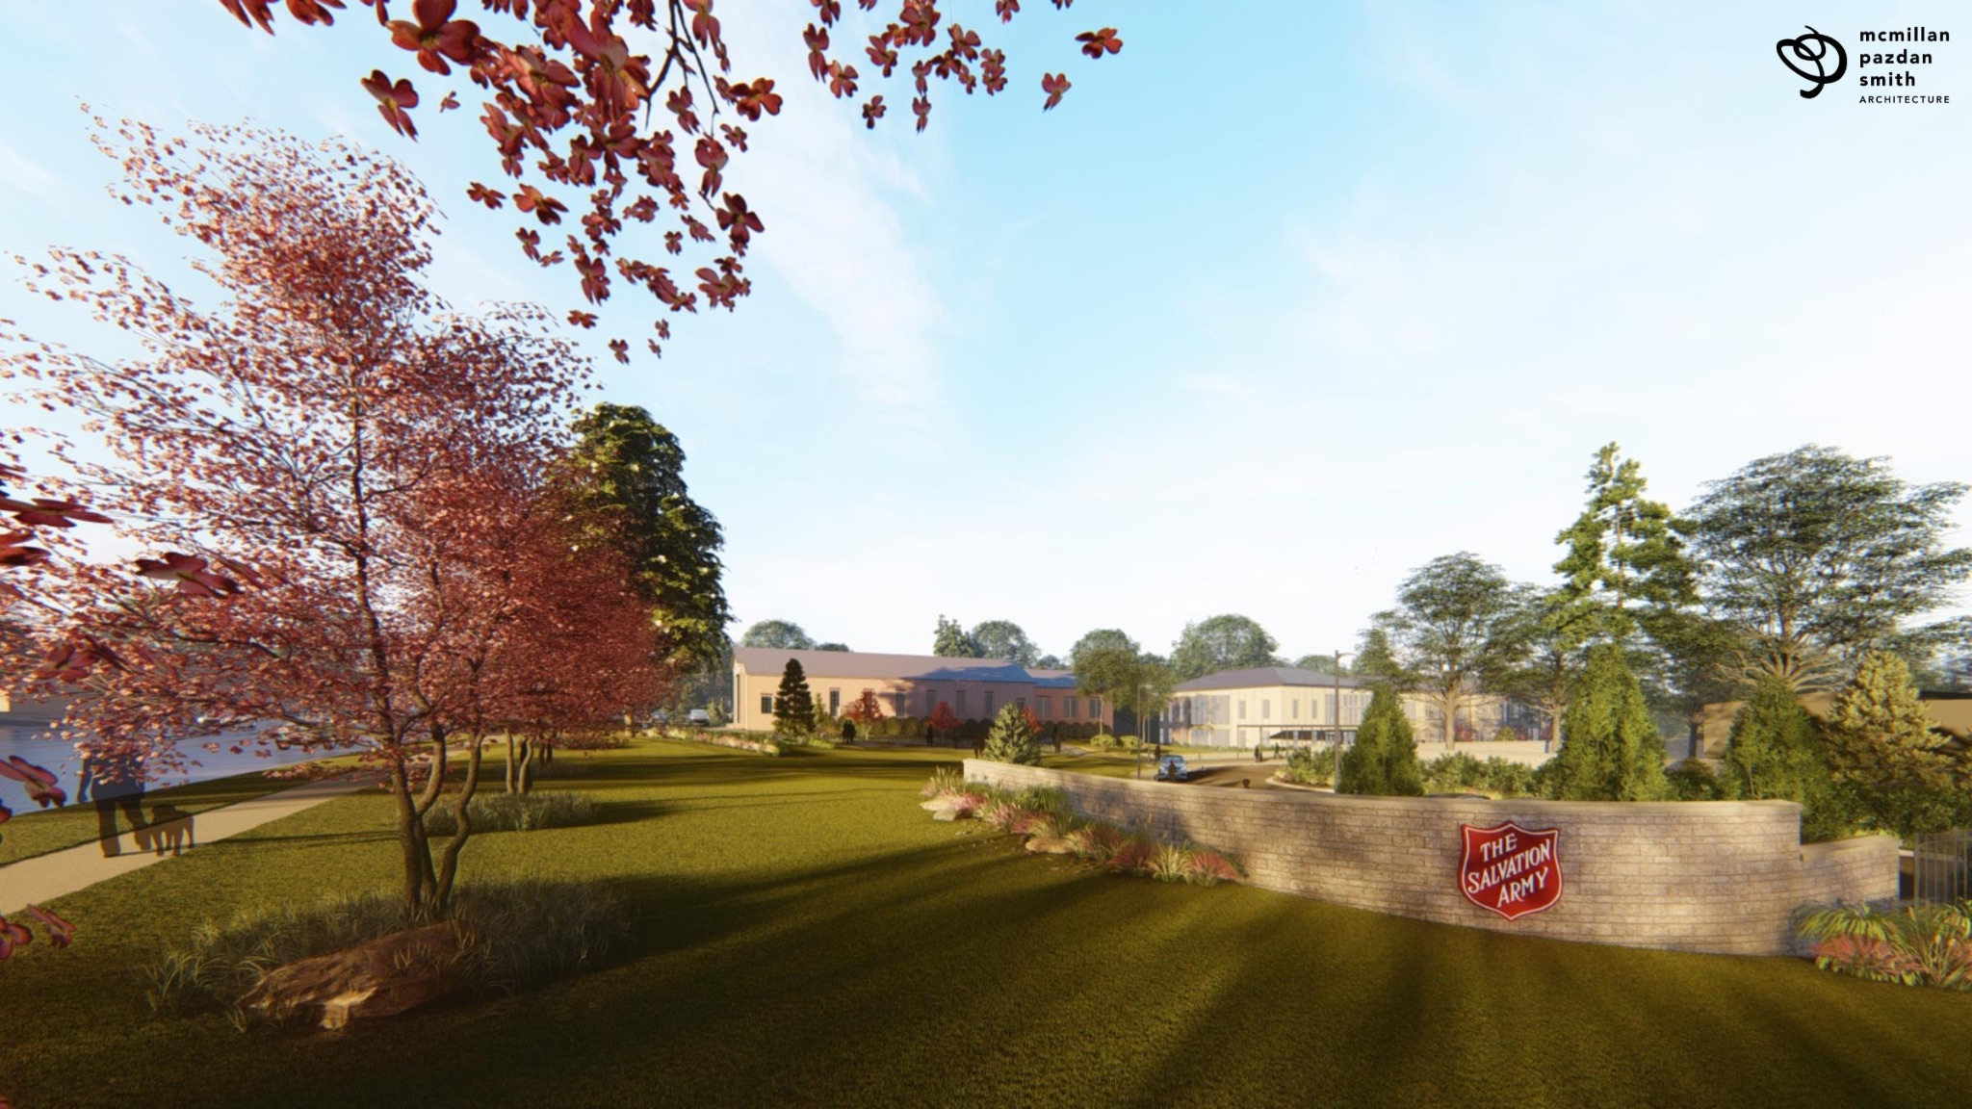
Rebuilding Hope Restoring Lives Shelter Campaign

Slide 39
Rebuilding Hope Restoring Lives Shelter Campaign
The revitalized 45,000 sq. ft. Social Services Campus will provide greater security and cohesiveness. The new space will increase efficiency in daily operations, create greater security and accessibility, and allow for better engagement with our clients.
The renovated Social Services Campus will increase the emergency shelter bed capacity from 93 to 143. It will also feature:
● New Transitional Housing space where clients can begin to rebuild their lives.
● Family Units to provide temporary housing options to keep the family together (men with children, couples with children, families with older children).
● Larger dining hall facilities that are less institutional (more natural light) to serve meals.
The current Chapel will remain in place with a new façade to compliment the rest of the revitalized campus.
$6.8M needed to reach our goal!

Slide 40
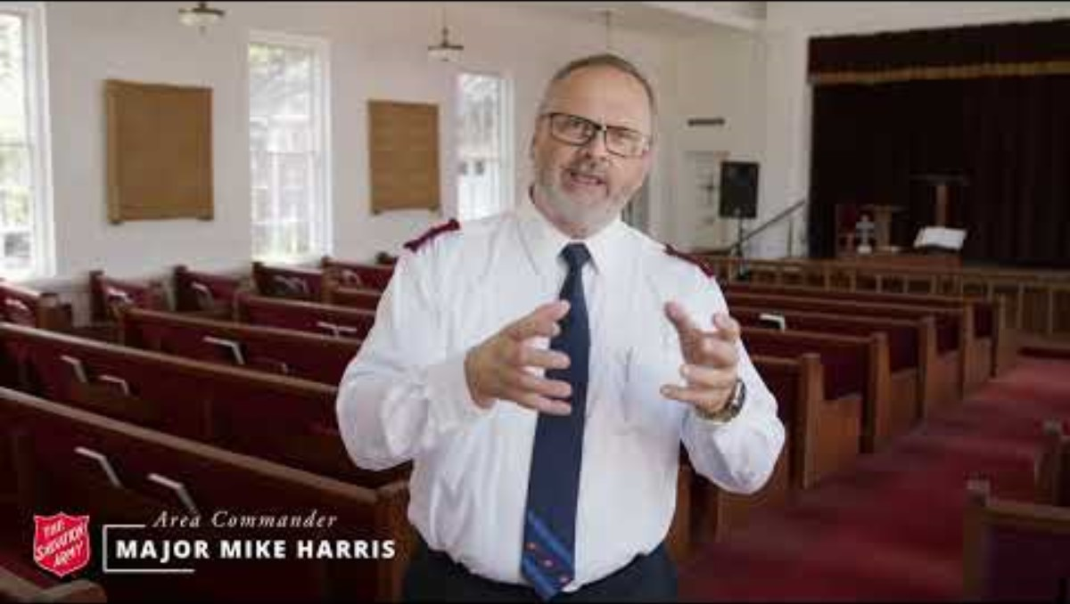
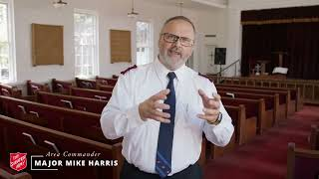

Slide 41

Ways You Can Help
Sponsor a Red Kettle
Support our Shelter Renovation Campaign
Adopt an Angel in our Angel Tree program
Ring a bell at a Red Kettle location
Help a child with homework at the Boys & Girls Club
Serve a meal in our shelter dining hall
Sort donations for our Thrift Stores
Teach music, art or crafts at the Kroc Center

Slide 42
You can help our neighbors in need in Greenville, Pickens & Oconee!
Support The Salvation Army today
www.salvationarmygreenville.org

