Slide 1
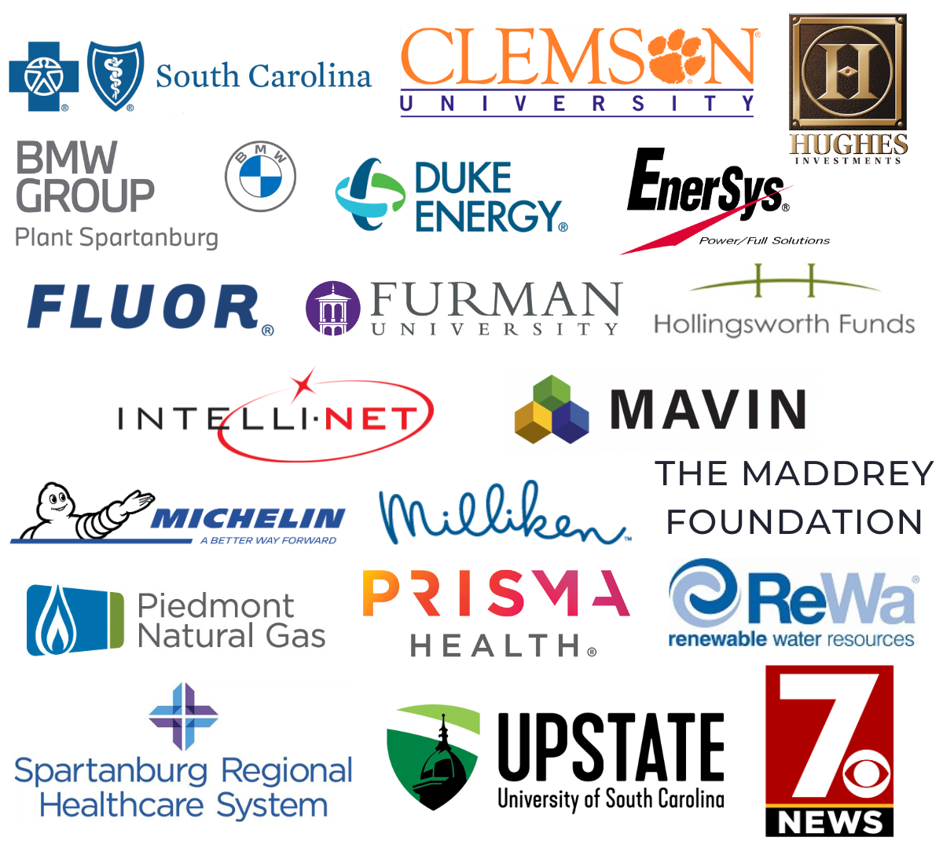
TATT
A BIG
-
Chat
January 9, 2025
thanks to…
Welcome
Dean Hybl, Ten at the Top Executive Director
Guest Speakers
Matt Willis, Greenville Chamber of Commerce
Resource Update
Victoria Novak, Greenville Literacy Association
Adjournment
Dean Hybl, Ten at the Top Executive Director
Our
Partners
Next TATT Chat - February 13, 2025
Leadership-Level

Slide 2
2025 Policy Agenda

Slide 3
Upstate Chamber Coalition
Representing 14 chambers, 8,000 member-businesses, and more than 300,000 employees
Our state’s economic heart lies in the Upstate. In 2009, seven Upstate Chambers of Commerce joined forces to form the Upstate Chamber Coalition.
Today, we are 13 Chambers strong united as the voice of Upstate business concerns and devoted to improving our region’s business climate.

Slide 4
Upstate Chamber Coalition Members
Anderson Area Chamber Greater Easley
Cherokee County Greenwood
Clemson Area Laurens County
Fountain Inn OneSpartanburg, Inc.
Greenville Simpsonville
Greater Greer Greater Travelers Rest
Upstate LGBT+

Slide 5
Improve Our Business Climate
Evergreen Priorities
Accessibility & Affordability of Childcare
Policy Agenda
Infrastructure
Workforce Sustainability

Slide 6
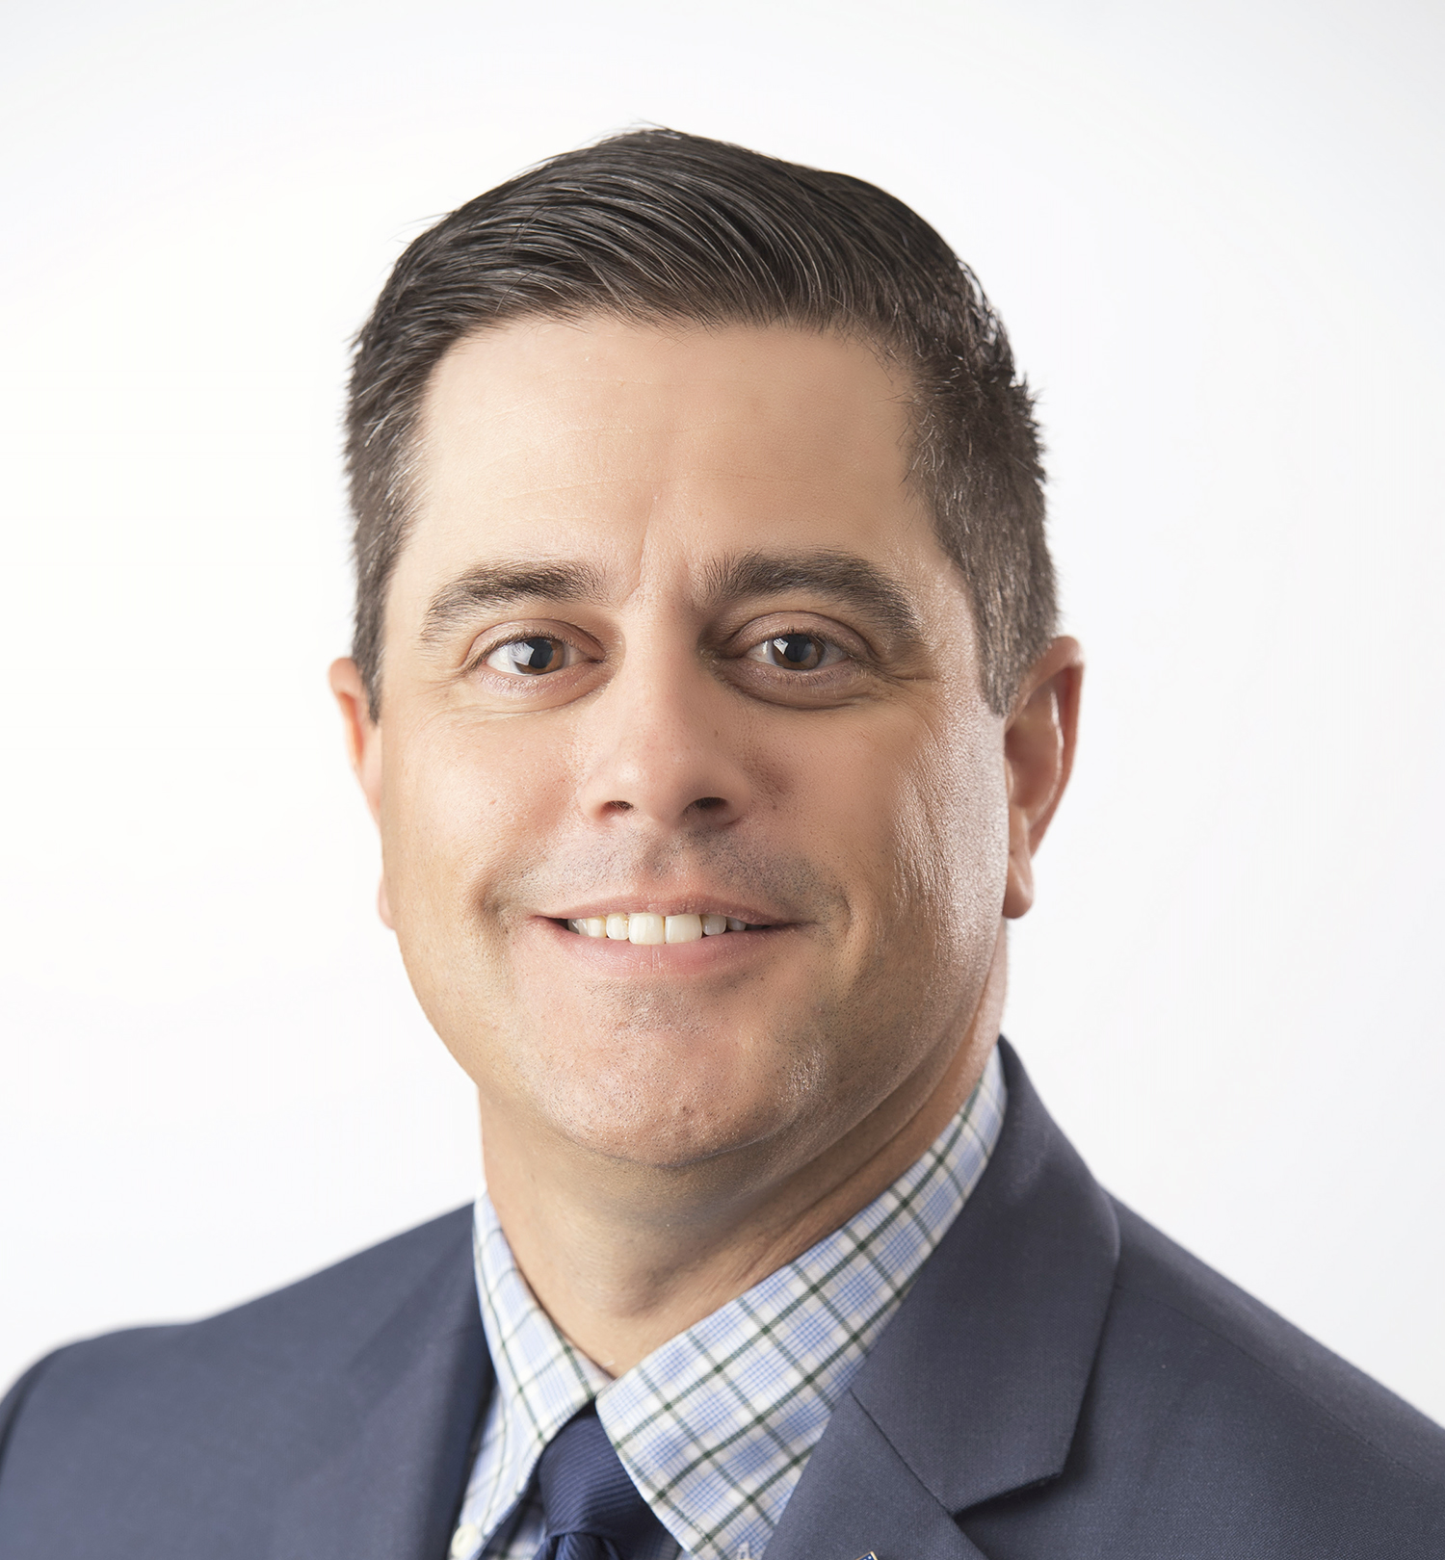
MATT WILLS
Vice President, Government Affairs
mwills@greenvillechamber.org
UpstateChamber.org

Slide 7
GREENVILLE LITERACY ASSOCIATION
PARTNERING FOR WORKFORCE EXCELLENCE
AND COMMUNITY IMPACT
VICTORIA NOVAK
EXECUTIVE DIRECTOR

Slide 8
THE NEED
1 in 5 SC adults read at or below 3rd grade level
45,000+
Without a High School Diploma
20,000+
are not fluent in English

Slide 9
ABOUT GLA
CELEBRATING 60 YEARS
501C3 ESTABLISHED IN 1965
MISSION: TO INCREASE THE LITERACY AND EMPLOYABILITY OF ADULT LEARNERS
WORKPLACE TRAINING: ESL IN THE WORKPLACE
ACCELERATED GED BOOTCAMP IN PARTNERSHIP WITH GOODWILL INDUSTRIES
GED PREPARATION
ENGLISH AS A SECOND LANGUAGE
BASIC ADULT EDUCATION: READING, WRITING, MATH
DIGITAL AND FINANCIAL LITERACY
COLLEGE AND CAREER NAVIGATION

Slide 10
THE GOAL:
SELF-SUFFICIENCY
Post-Secondary Education
New Job or Career
Job Skills Training
Promotion/Pay Increase

Slide 11
POWER OF ESL IN THE WORKPLACE
Why Choose GLA?
Convenient, on-site English classes for your employees.
Customized vocabulary tailored to your company’s needs
Experienced TESOL-certified instructors.
Curriculum and Materials Provided.
PL Developments: Supervisor Training Apprenticeship program (16 graduates)
Benefits
Decrease communications barriers
Reduce safety risks
Improve customer service
Improve team collaboration
Increase retention
LEARN MORE

Slide 12
MANY WAYS TO GET INVOLVED
GROUP VOLUNTEERS AT THE ANNUAL BOOK SALE
SPONSOR A TABLE AT GLA’S 60TH ANNIVERSARY LUNCHEON
DONATE BOOKS FOR THE REALLY GOOD, REALLY BIG, REALLY CHEAP BOOK SALE
DONATE ONLINE OR SHOP OUR AMAZON WISH LIST
VOLUNTEER AS AN INSTRUCTOR, TUTOR, OR ADMINISTRATIVE
JOIN OUR BOARD OF DIRECTORS
HIRE US FOR YOUR WORKPLACE TRAINING

Slide 13
THANK YOU
Victoria Novak
Executive Director
victoria.novak@greenvilleliteracy.org
greenvilleliteracy.org
864-467-3456

