Slide 1
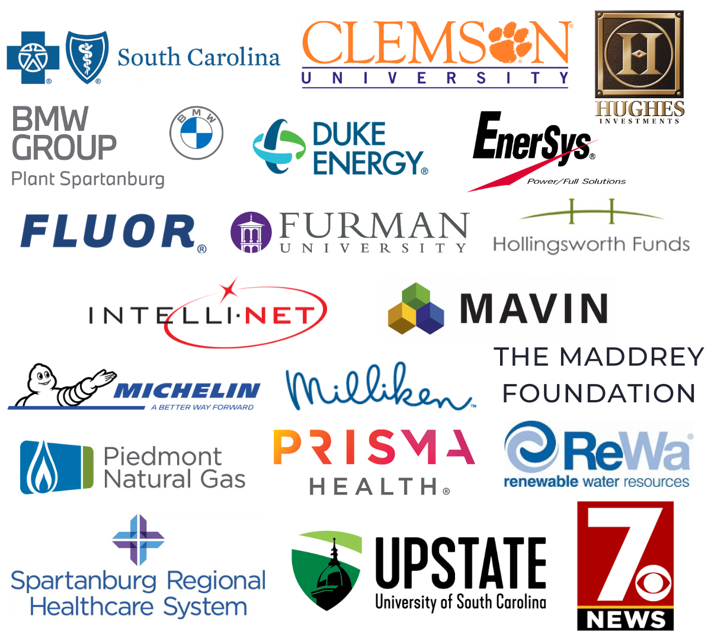
TATT
A BIG
-
Chat
February 13, 2025
thanks to…
Welcome
Dean Hybl, Ten at the Top Executive Director
Guest Speakers
Dr. Rachel Brown, Thriving Workforce Solutions
Resource Update
Dee DiCarlo, Thrive Upstate
Adjournment
Dean Hybl, Ten at the Top Executive Director
Our
Partners
Next TATT Chat - March 13, 2025
Leadership-Level

Slide 2
Achieving corporate goals
through a healthy, engaged workforce.
TATT Chat
Rachel S. Brown, MD
2/13/25

Slide 3
Why address workforce well-being?
Moral imperative
Success factor for organization’s mission
Proven return and value on investment
Regulatory or organizational requirements
Notes:
Moral imperative—people matter, their well-being matters most
Achieves mission of providing compassionate and high-quality patient care

Slide 4
Chronic stress
Burnout
Ineffective
Languishing
Coping
Resilience
Growing
Thriving
Flourishing

Slide 5
Stress
Stress is a physiological response to any stressor, threat, extreme emotion, or condition.
Stress can be caused by “good” and “bad” situations.

Slide 6
Burnout
Burnout is a syndrome defined by the three principal components of emotional exhaustion, depersonalization, and diminished feelings of personal accomplishment.
Chopra & Sotile. JAMA, Vol 291, 2004.
Burnout, at its core, is the inability to experience positive emotions.
Dr. Bryan Sexton, Duke Patient Safety Center, 2017.
Burnout includes feelings of energy depletion or exhaustion; increased mental distance from one’s job or feelings of negativism or cynicism related to one’s job; and reduced professional efficacy.
WHO ICD-10 work environment diagnosis of burnout, 2019.
Notes:
If you CARE, you are at risk of burnout!

Slide 8
Impact
More frequent disruptive behavior, less professionalism, imposter syndrome→decreased system-wide morale
Decreased job satisfaction and higher turnover rates→higher cost (50-200% of salary) to replace or retrain staff
Lower productivity and quality (37% increase in absenteeism and 30% in productivity)→lost revenue (average of 31 days missed)
Increase in errors (50% increase in safety incidents)
Stress related physical health concerns→higher healthcare costs ($125-$190 billion average loss)
Higher rates of divorce and family discord (71% reported a relationship ended due to burnout, 37% couldn’t tend to their family)
Increased rates of depression, anxiety, and other mental health disorders (30-50% chance if burned out)
Notes:
Lower cognitive capacity, concentration, effort, empathy, and professionalism (Dike Drummond, MD. Stop Physician Burnout, 2014.)
According to the Harvard Business Review, U.S. businesses lose between $125 billion to $190 billion annually in healthcare costs due to workplace burnout. Additionally, burnout can lead to a 50% increase in safety incidents and a 37% increase in absenteeism, which further elevates operational costs.
SHRM
Headspace survey
NIH

Slide 9
Resilience is the capacity to recover quickly from difficulties using awareness, healthy limit setting, and constructive engagement. Resilience is a function of the ability to cope and grow via healthy patterns and access to health and well-being approaches.
What is the solution?
Notes:
Kindness and compassion are a part of our biology.
Happiness set point is 50% our genetics. We will always drift back to our happiness set point.
Stress is not the same as burnout. Stress is caused by specific events that results in a physiologic response—can even be good at times. Burnout is result of not being resilient of coping with stress well.

Slide 10
Multi-layered Culture of Wellness
Resilience tools
Healthy lifestyle
Understanding purpose
Work-life balance
Leadership investment
Wellness planning
Workflow efficiencies
Operational excellence
Generous staffing
Autonomy
Rejuvenation time

Slide 11
External Resilience Drivers
Meaning in work
Job control
Balanced workload
Optimized teams and roles
Adequate resources
Leadership engagement
Psychological safety, decreased stigma

Slide 12
Wellness Dimensions
Notes:
1. Eight wellness dimensions: physical, emotional, intellectual, spiritual, social, environmental, career, and financial. Resilience comes from all eight dimensions being healthy and optimized.
Resilience comes from stockpiling the rejuvenating effects of fleeting positive emotions. Dr. Barbara Fredrickson (psych at UNC-CH, author of Positivity) discovered the 10 positive emotions: serenity, love, joy, gratitude, hope, interest, pride, amusement, inspiration, and awe. Folks with 1:1 ration of p:n emotions were more likely to be divorced, burnout, unsuccessful by individual’s standards. High achievers who were also “happy” and content were at least 3:1. Folks with ratio higher than 11:1 were maladaptive.
Increasing positive emotions—frequency is more important than magnitude

Slide 13
Emotional Wellbeing
Recognize and resource the entire spectrum of emotional wellbeing
Managing stress—autonomous education
Building resilience—workshops
Short term counselling—EAP
Long term cognitive therapy—access to psychologists
Medication management—coverage of psychiatrists
Try a mindfulness moment at the beginning of every meeting
Establish policies that promote work-life harmony

Slide 14
Financial Wellbeing
Transparency of financial goals, budget, and approaches
Share quarterly trends and status
Share financial summaries
Post internal “want-ads”

Slide 15
Social Wellbeing
Create connections and networks among the workforce
Establish Employee Resource Groups
Create mentoring programs
Include families in system-wide events

Slide 16
Spiritual Wellbeing
Provide clarity to all team members about the mission and vision of the organization or the department
Create an intentionality or value algorithm and rubric
Write a departmental mission and vision statement
Describe and design your team’s perfect 20% day

Slide 17
Occupational Wellbeing
Understand the career goals of the whole team
Use the Signature Strengths exercise to increase awareness and probability of success
Conduct a skills inventory
Create employee recognition initiatives

Slide 18
Physical Wellbeing
Support optimized health and prevention among the workforce
Allow time to go to prevention appointments—mammograms, dental, colonoscopies, etc.
Small exercise equipment scattered throughout work areas
Provide healthy food and snack options on work campus

Slide 19
Intellectual Wellbeing
Incorporate employees' hobbies into the work culture
Create hobby groups and blogs
Start real or virtual intramural teams
Have a quarterly talent/hobby showcase

Slide 20
Environmental Wellbeing
Workspaces and workflow are optimized and efficient
Nuisances to Newsenses
Set up Rejuvenation Rooms
Evaluate ergonomics and equipment

Slide 21
Your people are the key to your success. Wellbeing is the key to theirs.
Notes:
What we can be, what we can look like…HOPE
Leadership are people, too, struggling with their own issues. Let’s have some fun with a recipe exchange—connection without sharing food/risk; builds resilience and increases positive emotions
Prework—NAM summary doc NEJM article Shanafelt recipe video? https://www.youtube.com/watch?v=obxIT6ehvrQ&feature=youtu.be

Slide 22
rachelbrown@thrivingworkforcesolutions.com

Slide 23
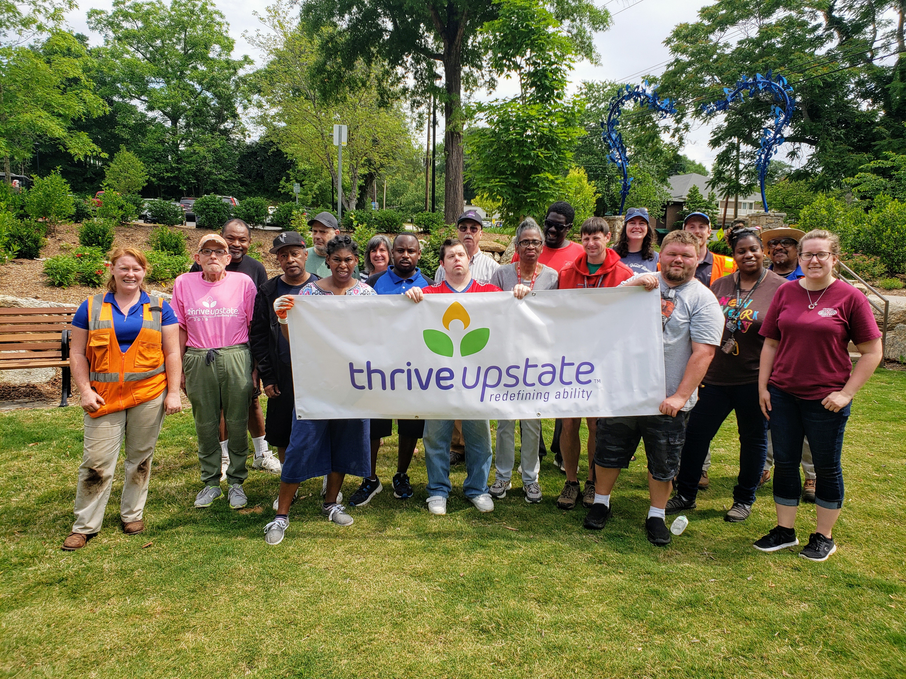
MISSION:
To provide all people with disabilities and special needs with meaningful services, opportunities, and support, so they may thrive in life, work and play.

Slide 24
Individuals Supported
Residential
Day Programs
Head & Spinal Cord Injury
250 Residents-39 Group Homes
387 Participants – 5 Locations
28 Survivors
Early Intervention
167 Families

Slide 25
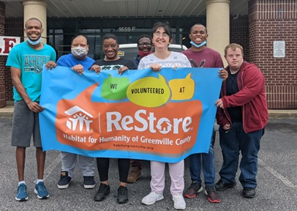
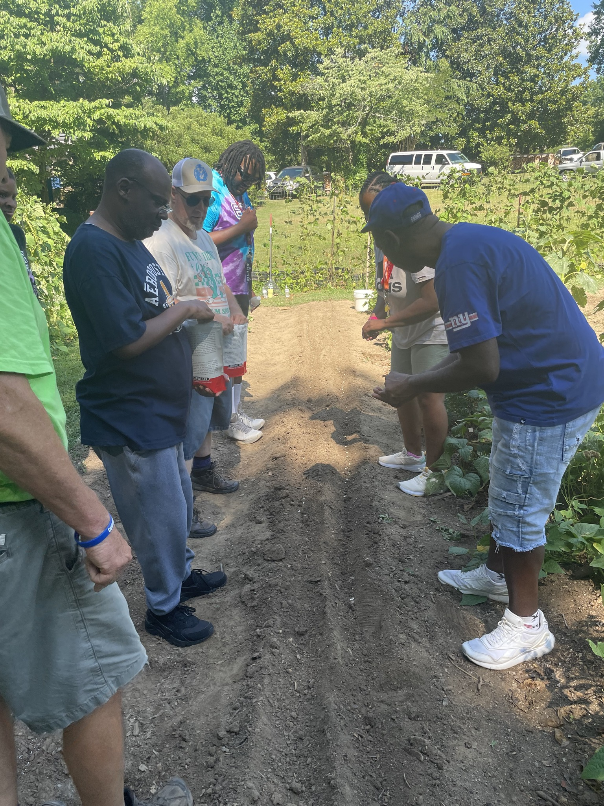
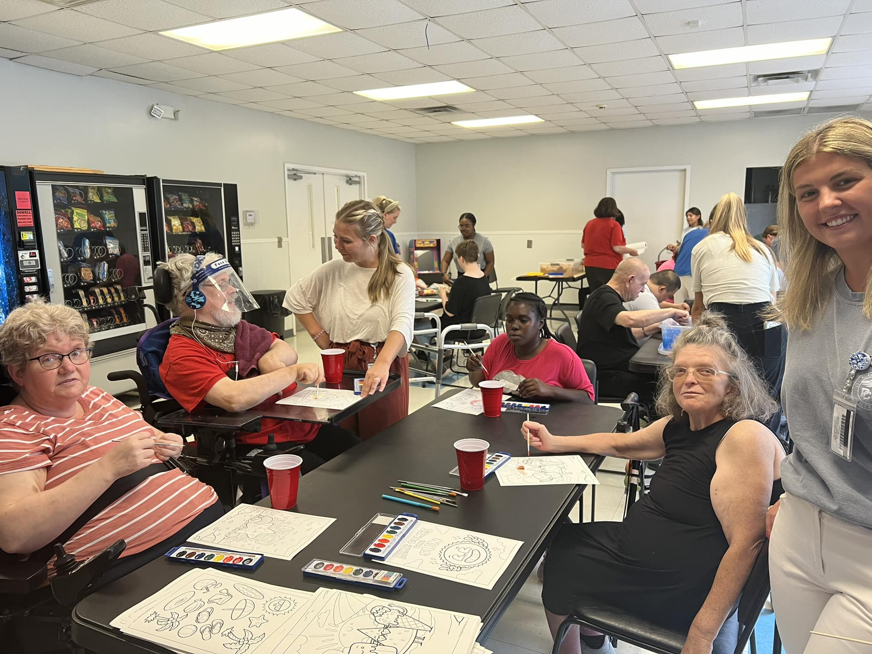
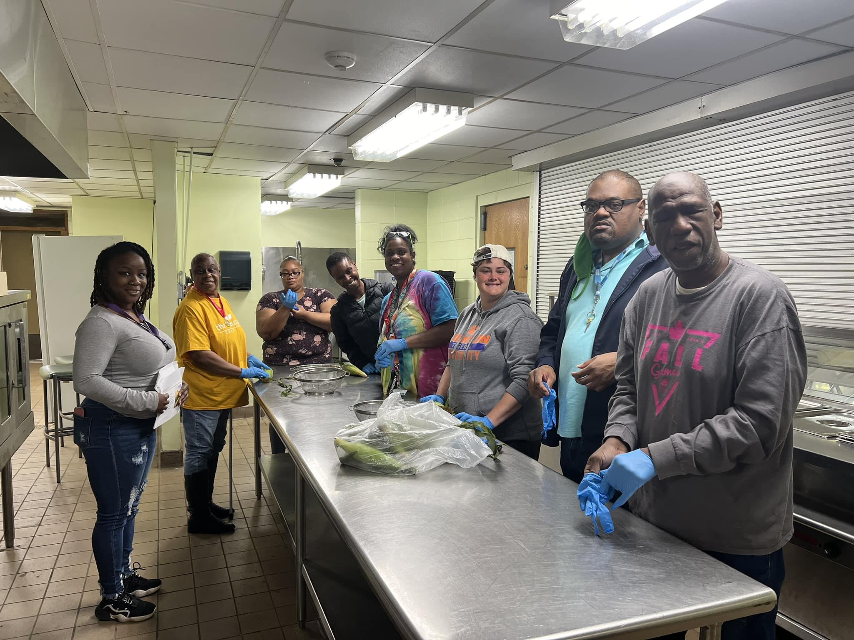
DAY PROGRAMS

Slide 26
Thrive Upstate: Developing Strong Partnerships
Employment First

Slide 27
BIGGEST CHALLENGE
DEE DICARLO | DIRECTOR OF BUSINESS DEVELOPMENT & EMPLOYMENT
DOREEN.DICARLO@THRIVEUPSTATE.ORG | 864-540-6565

