Slide 1
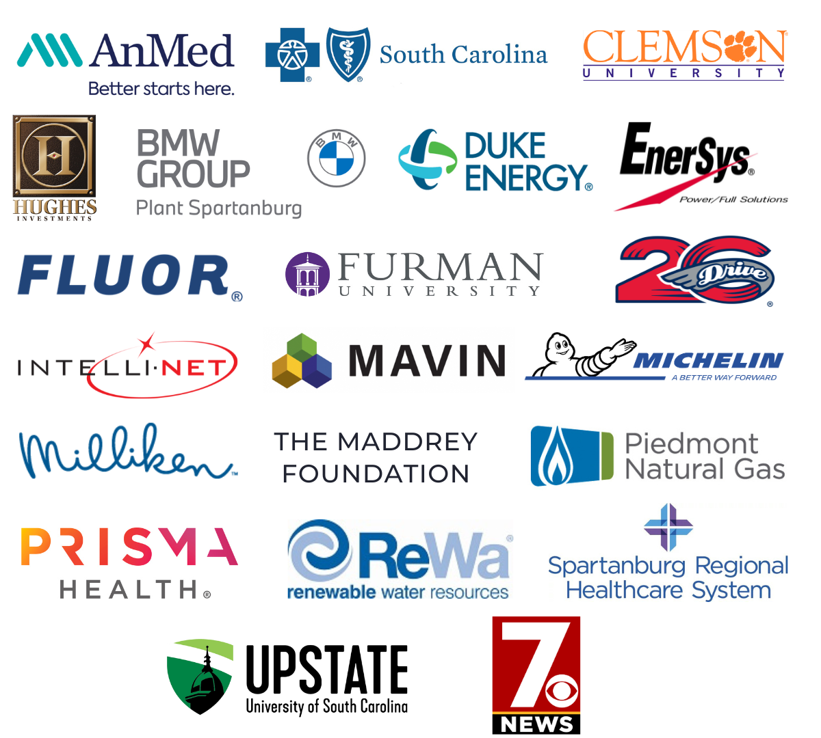
TATT Chat -
A BIG
April 10, 2025
thanks to…
Welcome
Terence Roberts, Ten at the Top Board Member
Guest Speaker
Leah Quattlebaum, Deputy Secretary of SC Department of Transportation
Resource Update
Keri Driggers, Able South Carolina
Adjournment
Terence Roberts, Ten at the Top Board Member
Our
Partners
Next TATT Chat - May 15, 2025
Leadership-Level

Slide 2
POSITIONING SOUTH CAROLINA FOR A BRIGHT FUTURE

Slide 3
4500
EMPLOYEES
41,000
MILES OF STATE MAINTAINED ROADWAYS
7
DISTRICTS
8,400
BRIDGES MAINTAINED
4th Largest State Maintained Highway System ● Fastest Growing Population in the Nation

Slide 4
Realizing the Promise of Infrastructure in SC
$6.5B in construction projects across the state
Up from $1B just 10 years ago.
$4.7B in 2017 Roads Bill Funds
Since the General Assembly’s bold action.
$900M in One-Time General Assembly Funds
For infrastructure in the past three years.

Slide 5
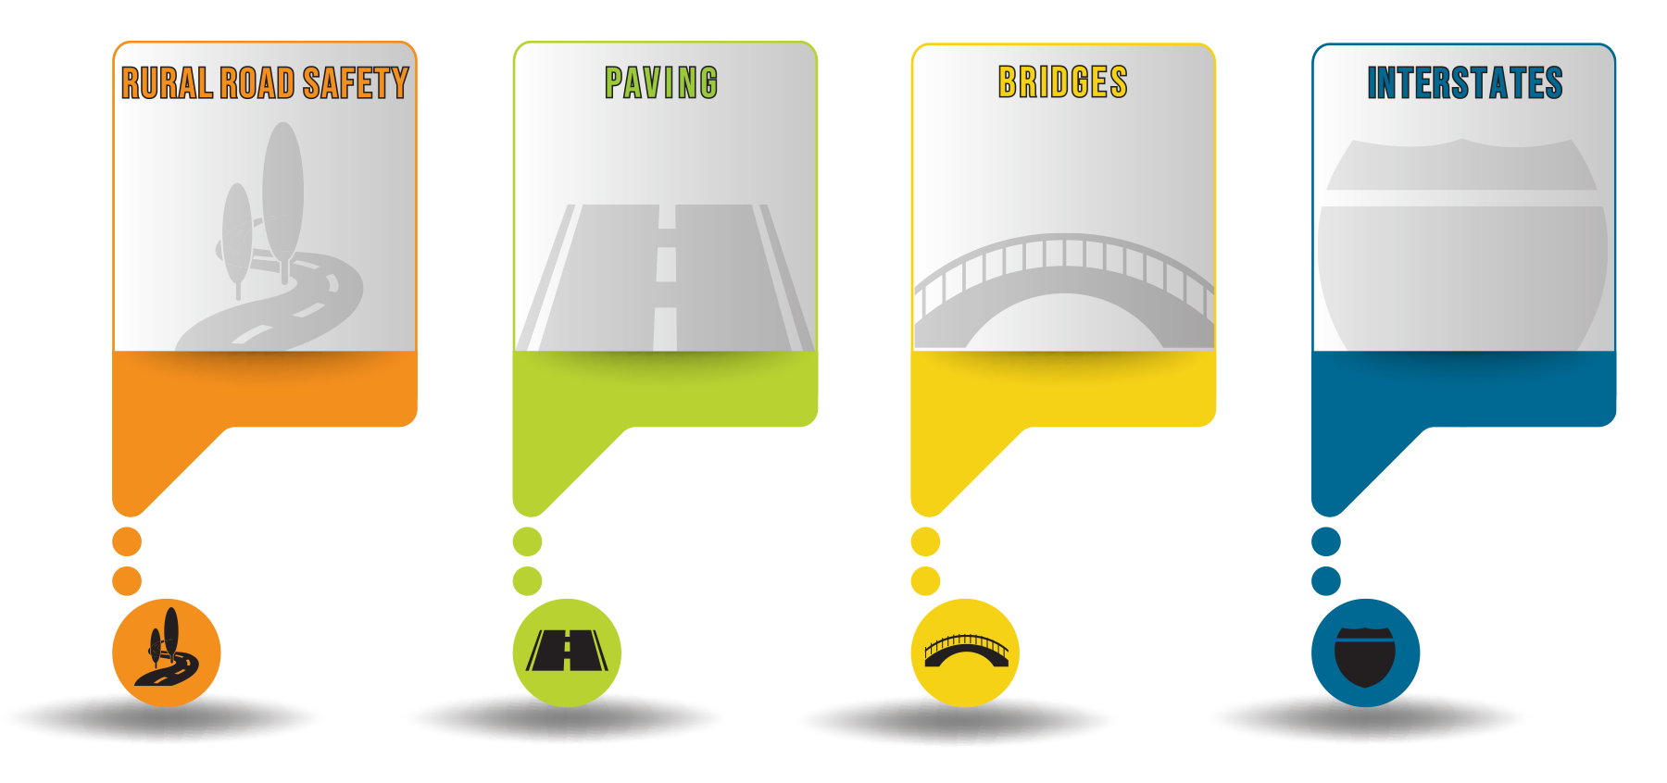
10-Year Plan Accomplishments
The completed projects have seen a 20% reduction in Fatal and Serious Injury crashes
Approaching one-fourth of the 4th largest state highway system being repaved in the past 7 years.
Bridges must continue to be a major focus and an area for additional investment
Work is underway on nearly every interstate in the State
1126 miles
>9385 miles
370 bridges
111 miles

Slide 6
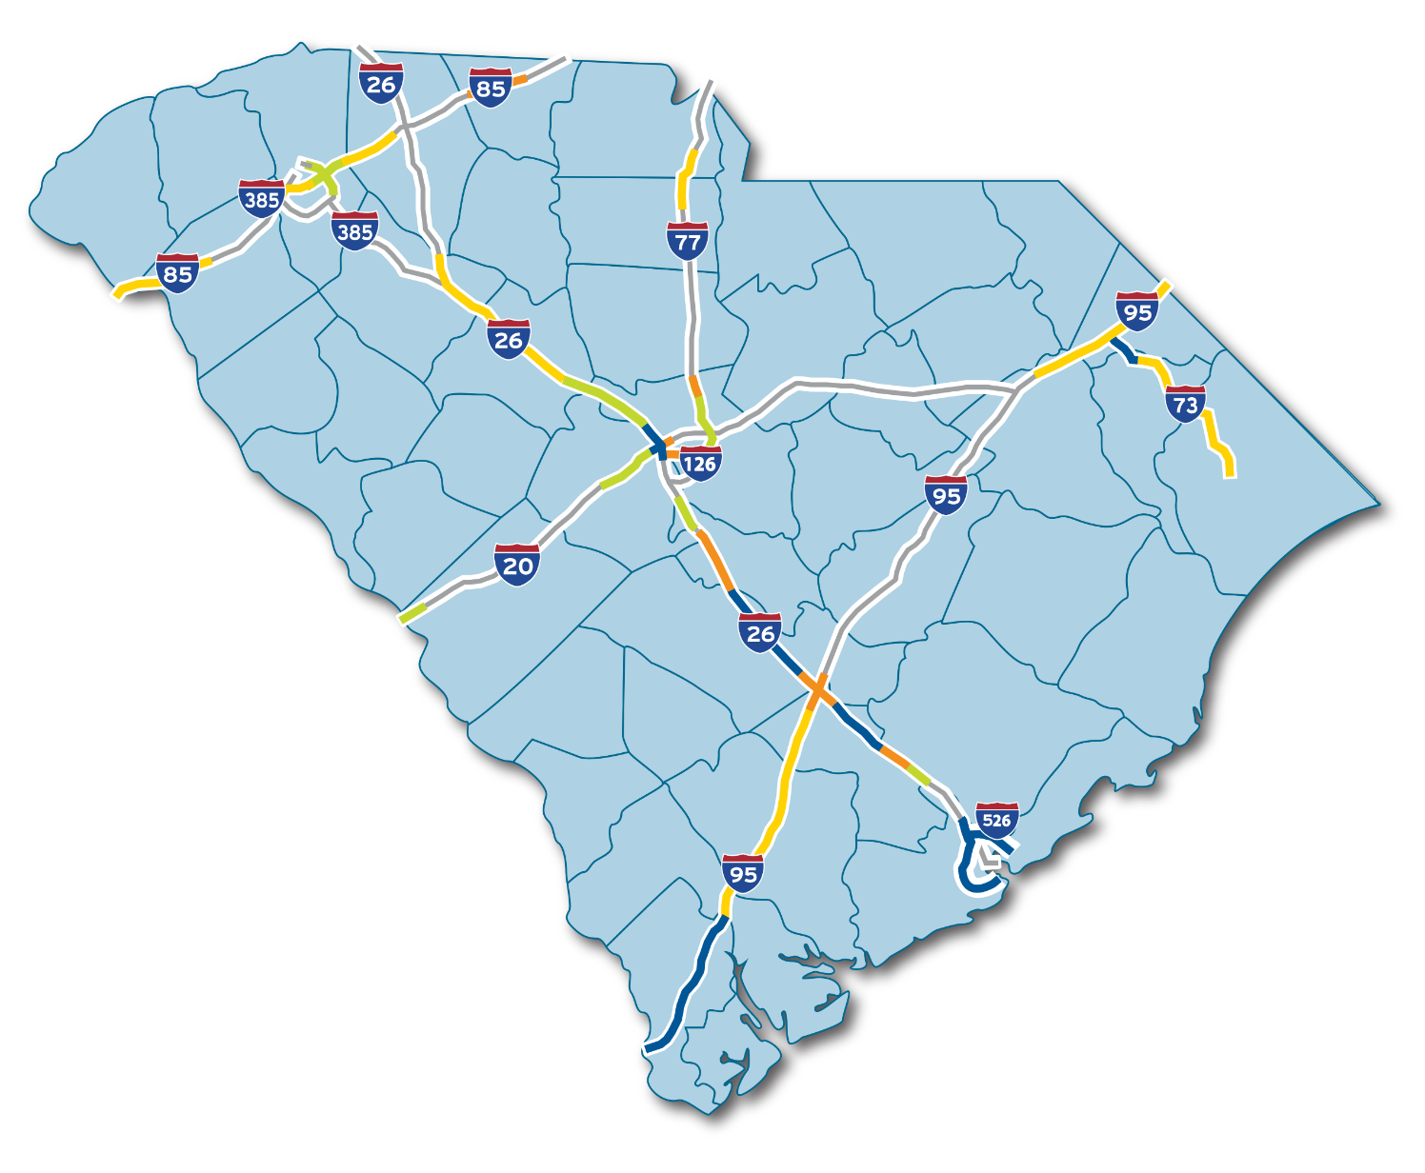
Interstate
Progress
INTERSTATE MODERNIZATION

Slide 7
US 221 Corridor Improvements

Slide 8
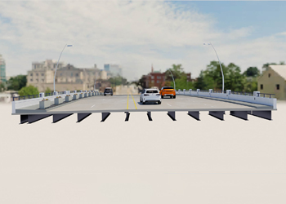
US 29 Church Street Bridge Rehab

Slide 9
Woodruff Road Congestion Relief

Slide 10
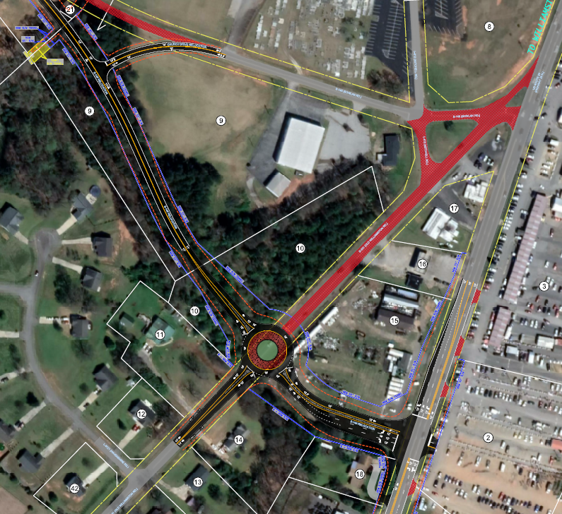
US-29 @ Bowland Road and Old Willamston Road

Slide 12
Public Survey
Which is most likely to impact your daily travel?

Slide 13
Emerging Trends
GROWING PORT
CHANGING DEMOGRAPHICS
CHANGING TECHNOLOGY

Slide 14
Anticipated Cargo Volumes

Slide 15
South Carolina’s Accelerating Growth

Slide 16
EVs Are a Small Part
of the Fleet, but Rapidly Growing
3.6%
122,000 Hybrids and EV’s out of 3.4M Registered Vehicles
22%
Average increase in total number of EVs and Hybrids added to our roads since 2020

Slide 17
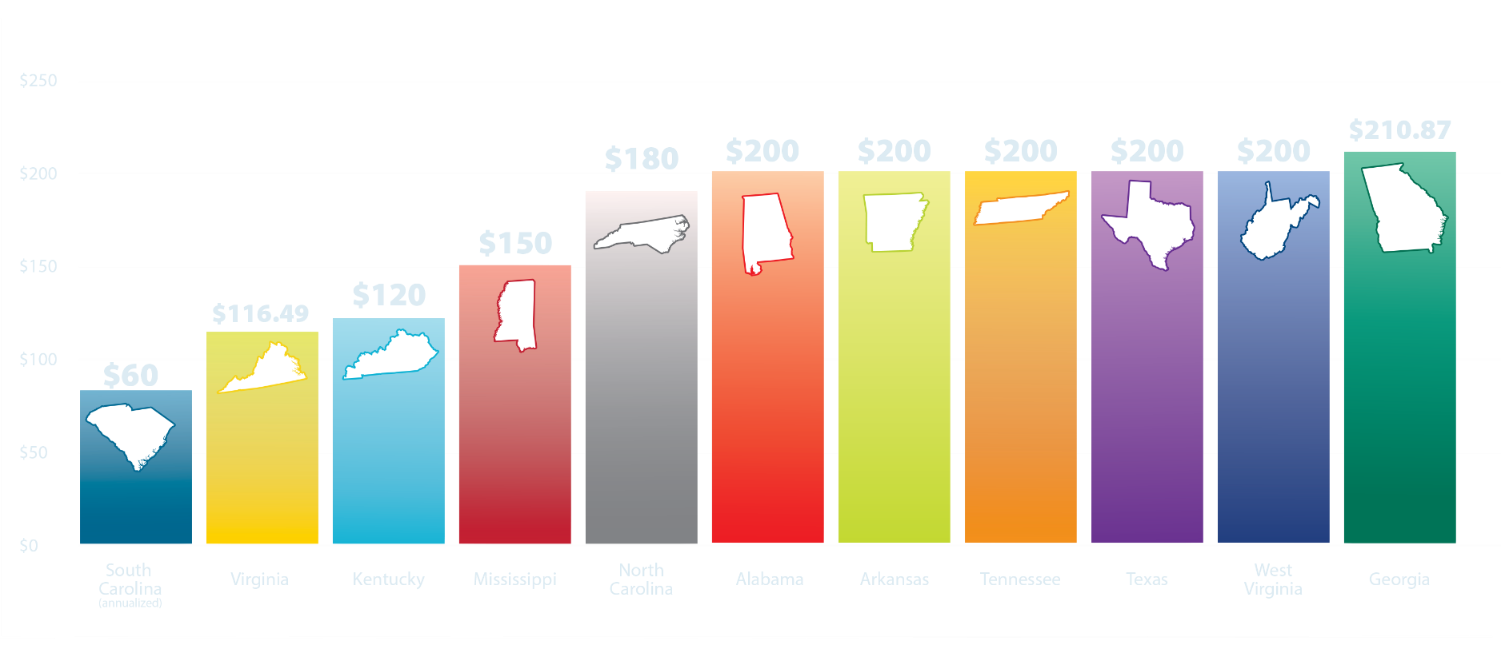
Southeastern State Electric Vehicle Fees as of September 2024
*Beginning January 1, 2027, Tennessee’s fee increases $274 annually then adjusts for inflation annually starting at $274 in January 2028

Slide 18
Trending Revenue Forecast

Slide 19
Vision and Goals
The vision of Momentum 2050 aims to move South Carolina forward economically as it grows.
Continue System Recovery
Support Freight Movement
Address Urban and Rural Mobility
Deepen Multimodal Partnerships

Slide 20
Current Spending and Future Needs

Slide 21
Future Annual Needs = $3,251
30% Gap

Slide 22
Sign up for the e-Connector and stay in touch with SCDOT

Slide 23
Able South Carolina
Disability-Led
Notes:
My name – title - description

Slide 24
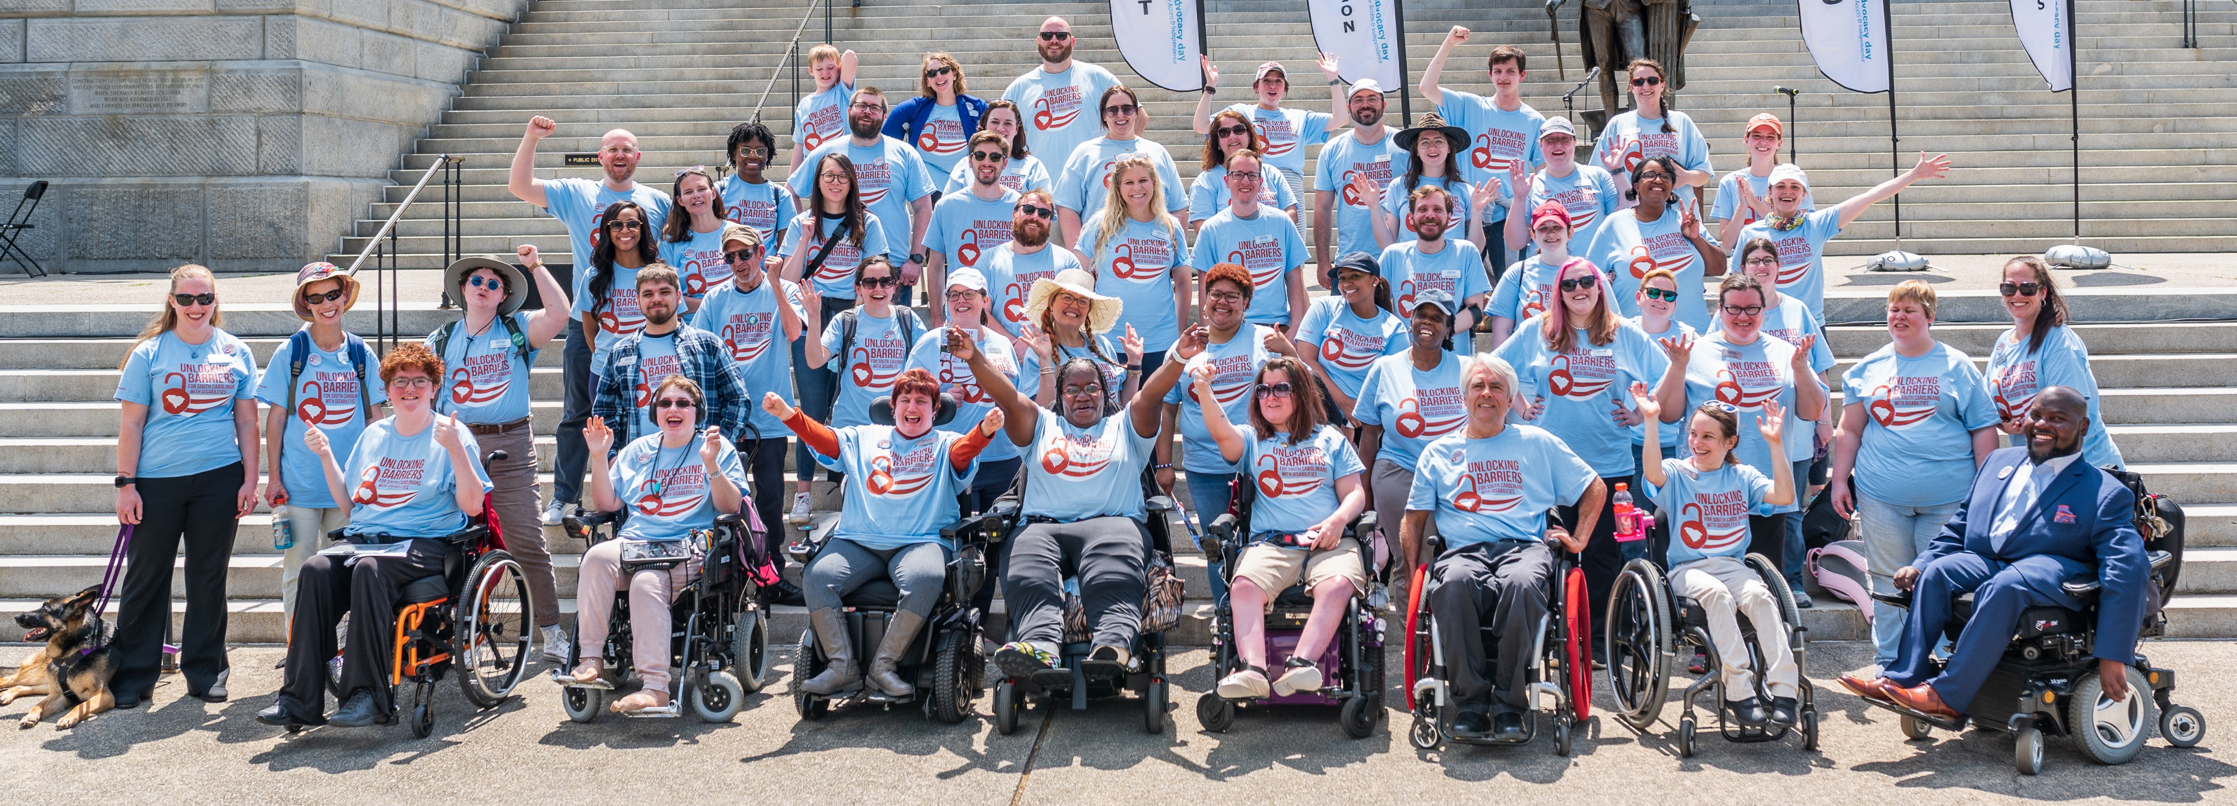
Able SC’s Mission & Vision
Mission
We are an organization of people with disabilities leading the charge to:
Equip people with disabilities with tools to foster pride and to direct their own lives;
Educate the community to challenge stereotypes and eliminate barriers; and
Advocate for access, equity, and inclusion at the individual, local, state, and national level.
Vision
A South Carolina that is a national model of equity and inclusion for all people with disabilities.
Notes:
Able South Carolina is a Center for Independent Living which is misleading because we do not offer housing, but are focused on IL skills for our consumers. Every state is federally mandated to have at least one CIL and SC has 3.

Slide 25
Services we offer:
Core Services:
Information & Referral
Independent Living Skills
Peer Support & Mentoring
Advocacy
Transitional Services (from living in institutions to living in the community)
Youth Transition Services (from school to work or higher education)
Additional Services:
Assistive Technology
Healthcare Navigation
Benefits Counseling
Supported Decision Making Counseling
Outreach
Emergency Preparedness
Accessibility Consultations:
Professional Trainings
ADA Assessments
Digital
Physical
Policy & Procedural
Notes:
We have core services that we are required to offer and then we have additional programs as well. All of our services are free to our consumers and we do not require a proof of disability.
The only service that we offer for a fee is our Accessibility Consultations, but we also have grants that may cover this fee.

Slide 26
Able Access
Architectural Assessments
Digital Accessibility testing and training (web, documents, social media)
Policy and Procedure Review
Job-site assessments and recommendations
Professional Training/Presentations/Keynotes
Disability Culture & Understanding Disability
ADA Architectural Standards/Barrier Removal
Creating Accessible Digital Resources
& More!
Notes:
the only ADA assessing provider
all types of accessibility
SE ADA Center state affiliate – no other affiliate in SC, work directly with the ADA Center to promote accessibility throughout the state. We understand that businesses may not have knowledge of all the aspects of the ADA. We are here to help guide you to make your organization accessible to not only the disability community, but the general public as well! We're here to give you the knowledge and confidence to not only interact with disabled people, but to understand reasonable accommodations, and supervising PWD.

Slide 27
Events & Programs
Notes:
One in three South Carolinians has a disability however, 60% of people with disabilities are unemployed. This is a workforce employers can’t afford to miss out on. The Employer Summit is a one-day conference for business managers, executives, and HR professionals ready to hire and retain a workforce inclusive of people with disabilities. The Employer Summit will show businesses how including individuals with disabilities will strengthen their workforce.
The Advocacy Day for Access and Independence was held on Tuesday, April 8th at the State House. We had a great turnout this year! Please visit our website for more information about the issues that we are advocating for, how these issues affect the disability community, and how you can get involved next year!
This summer is Equip's Summer Series where youth with disabilities ages 13 to 28 will be able to attend a multi-day self advocacy, disability pride, and skill-building event. Summer Series meets in person in Greenville and Columbia to build skills that assist young adult leaders with increasing their independence! Please reach out if you are interested and I can provide the address for those events.
The vision of AgrAbility is to enhance quality of life for farmers, ranchers, and other agricultural workers with disabilities, so that they, their families, and their communities continue to succeed in rural America. AgrAbility South Carolina will support cross-training between Able SC and Extension agents from Clemson and South Carolina State for individuals with disabilities who engage in farming or farm-related occupations.

Slide 28
Stay in touch
Website: able-sc.org
Email: info@able-sc.org
Phone: 803-779-5121
TTY: 803-779-0949
Columbia, SC Office: 720 Gracern Rd. Suite 106
Greenville, SC Office: 135 Edinburgh Ct. Suite 101
Join Email List: Text ABLESC to 72572
Follow us: Able South Carolina, @able_SC

